Slide 1
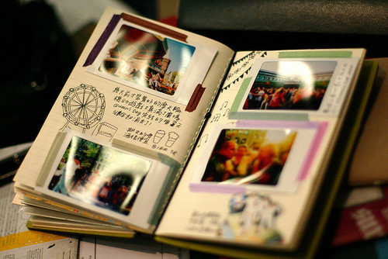
My Lockdown photo diary
By Gracie Lowe
Year 10

Slide 2
Monday 30th March 2020 Today is the first day of our Easter holidays, however I will be spending Easter a bit differently this year as we are on lockdown for at least 3 weeks! I had a very lazy day as it consisted of me watching lots of episodes from my favourite series the ‘Originals’. As the day went by, I decided I would go on run to get some fresh air. The streets were empty, the roads were clear, it was like a ghost town!
I used my Canon SLR Camera to take these shots.
I then edited them by using Adobe Photoshop Express.
Day 1

Slide 3
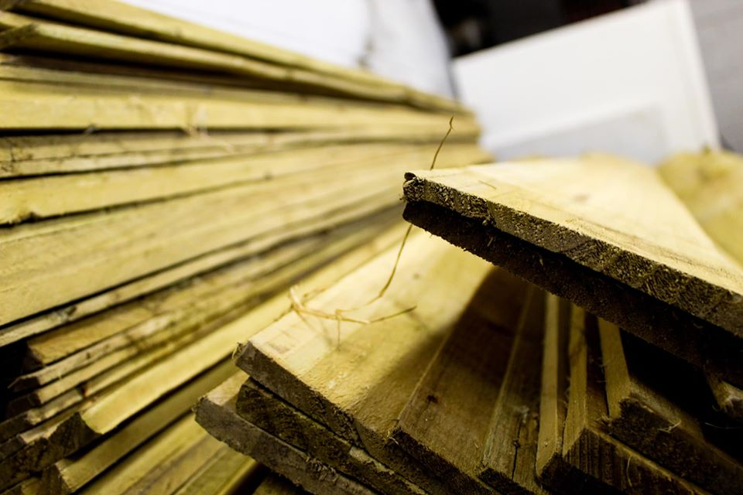
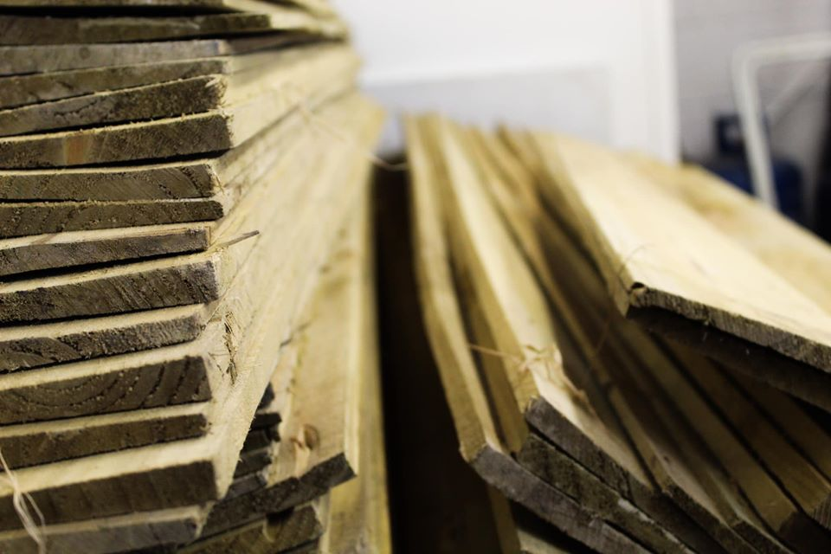
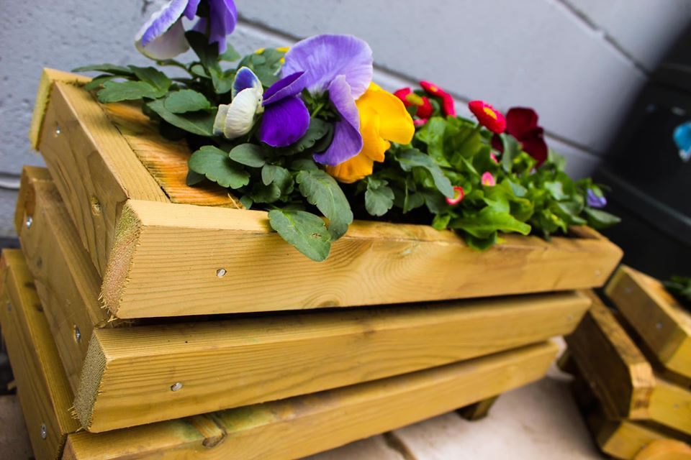
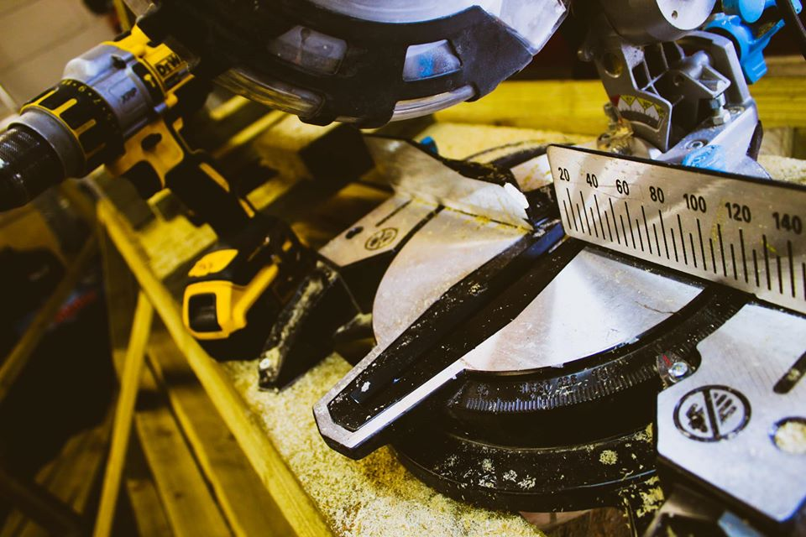
Tuesday 31st March 2020 As I had a rather lazy day yesterday, I thought I would be a bit more productive today. Using spare old wood, me, my brother and sister made our own plant boxes. We all created different styles, for example; I made the long rectangular plant box, my sister made a small square plant box and my brother created a plant box in the style of a go-kart! After hours spent outside creating the boxes I did my daily workout and finished the day by watching the tv.
Day 2
I used my Canon SLR Camera to take these shots.
I then edited them by using Adobe Photoshop Express.

Slide 4
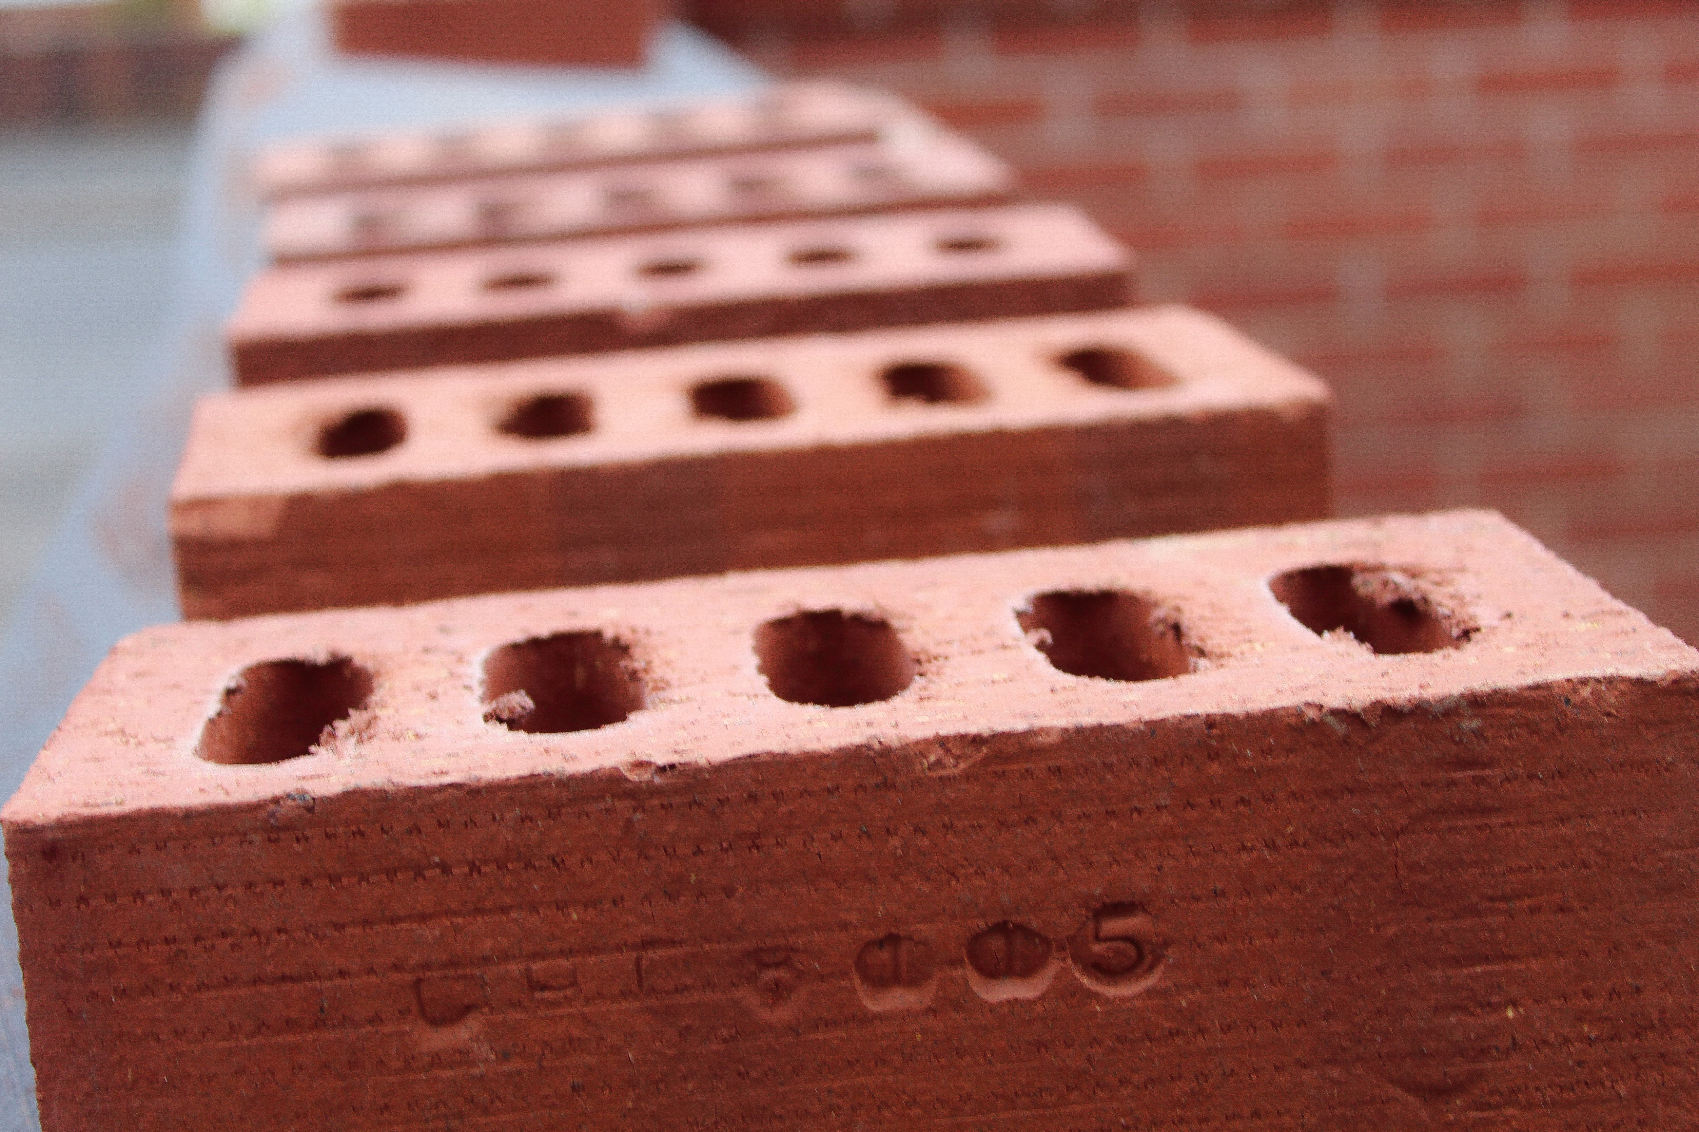
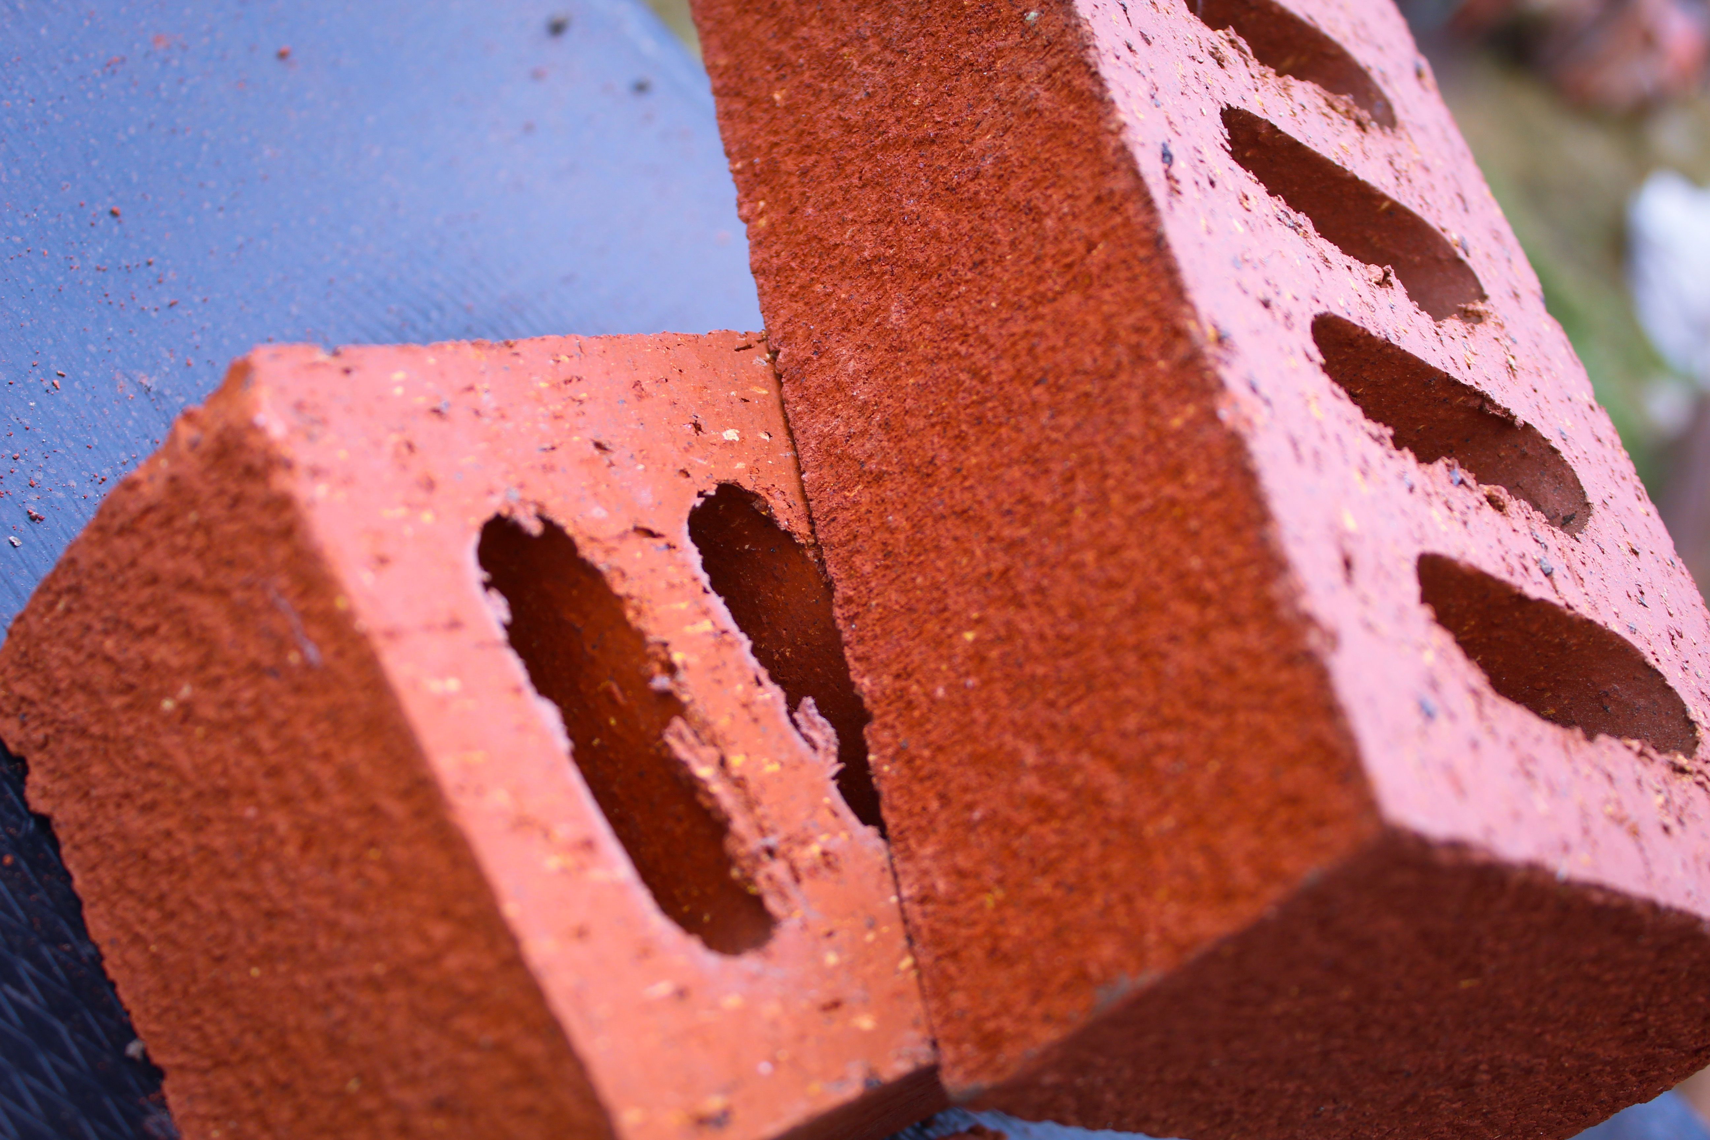
Wednesday 1st April 2020 Today, my dad was busy outside helping build our brick wall so I thought I would go and give him a hand. Me and my sister carried and stacked the bricks ready for them to be used. However it got quite boring after a while so I got my gym clothes on and went on a 3.6 mile run! To finish the day, I did my daily workout and watched the BBC live update on coronavirus. 29,474 have now tested positive for coronavirus and 2,352 have sadly died.
Day 3
I used my Canon SLR Camera to take these shots.
I then edited them by using Adobe Photoshop Express.

Slide 5
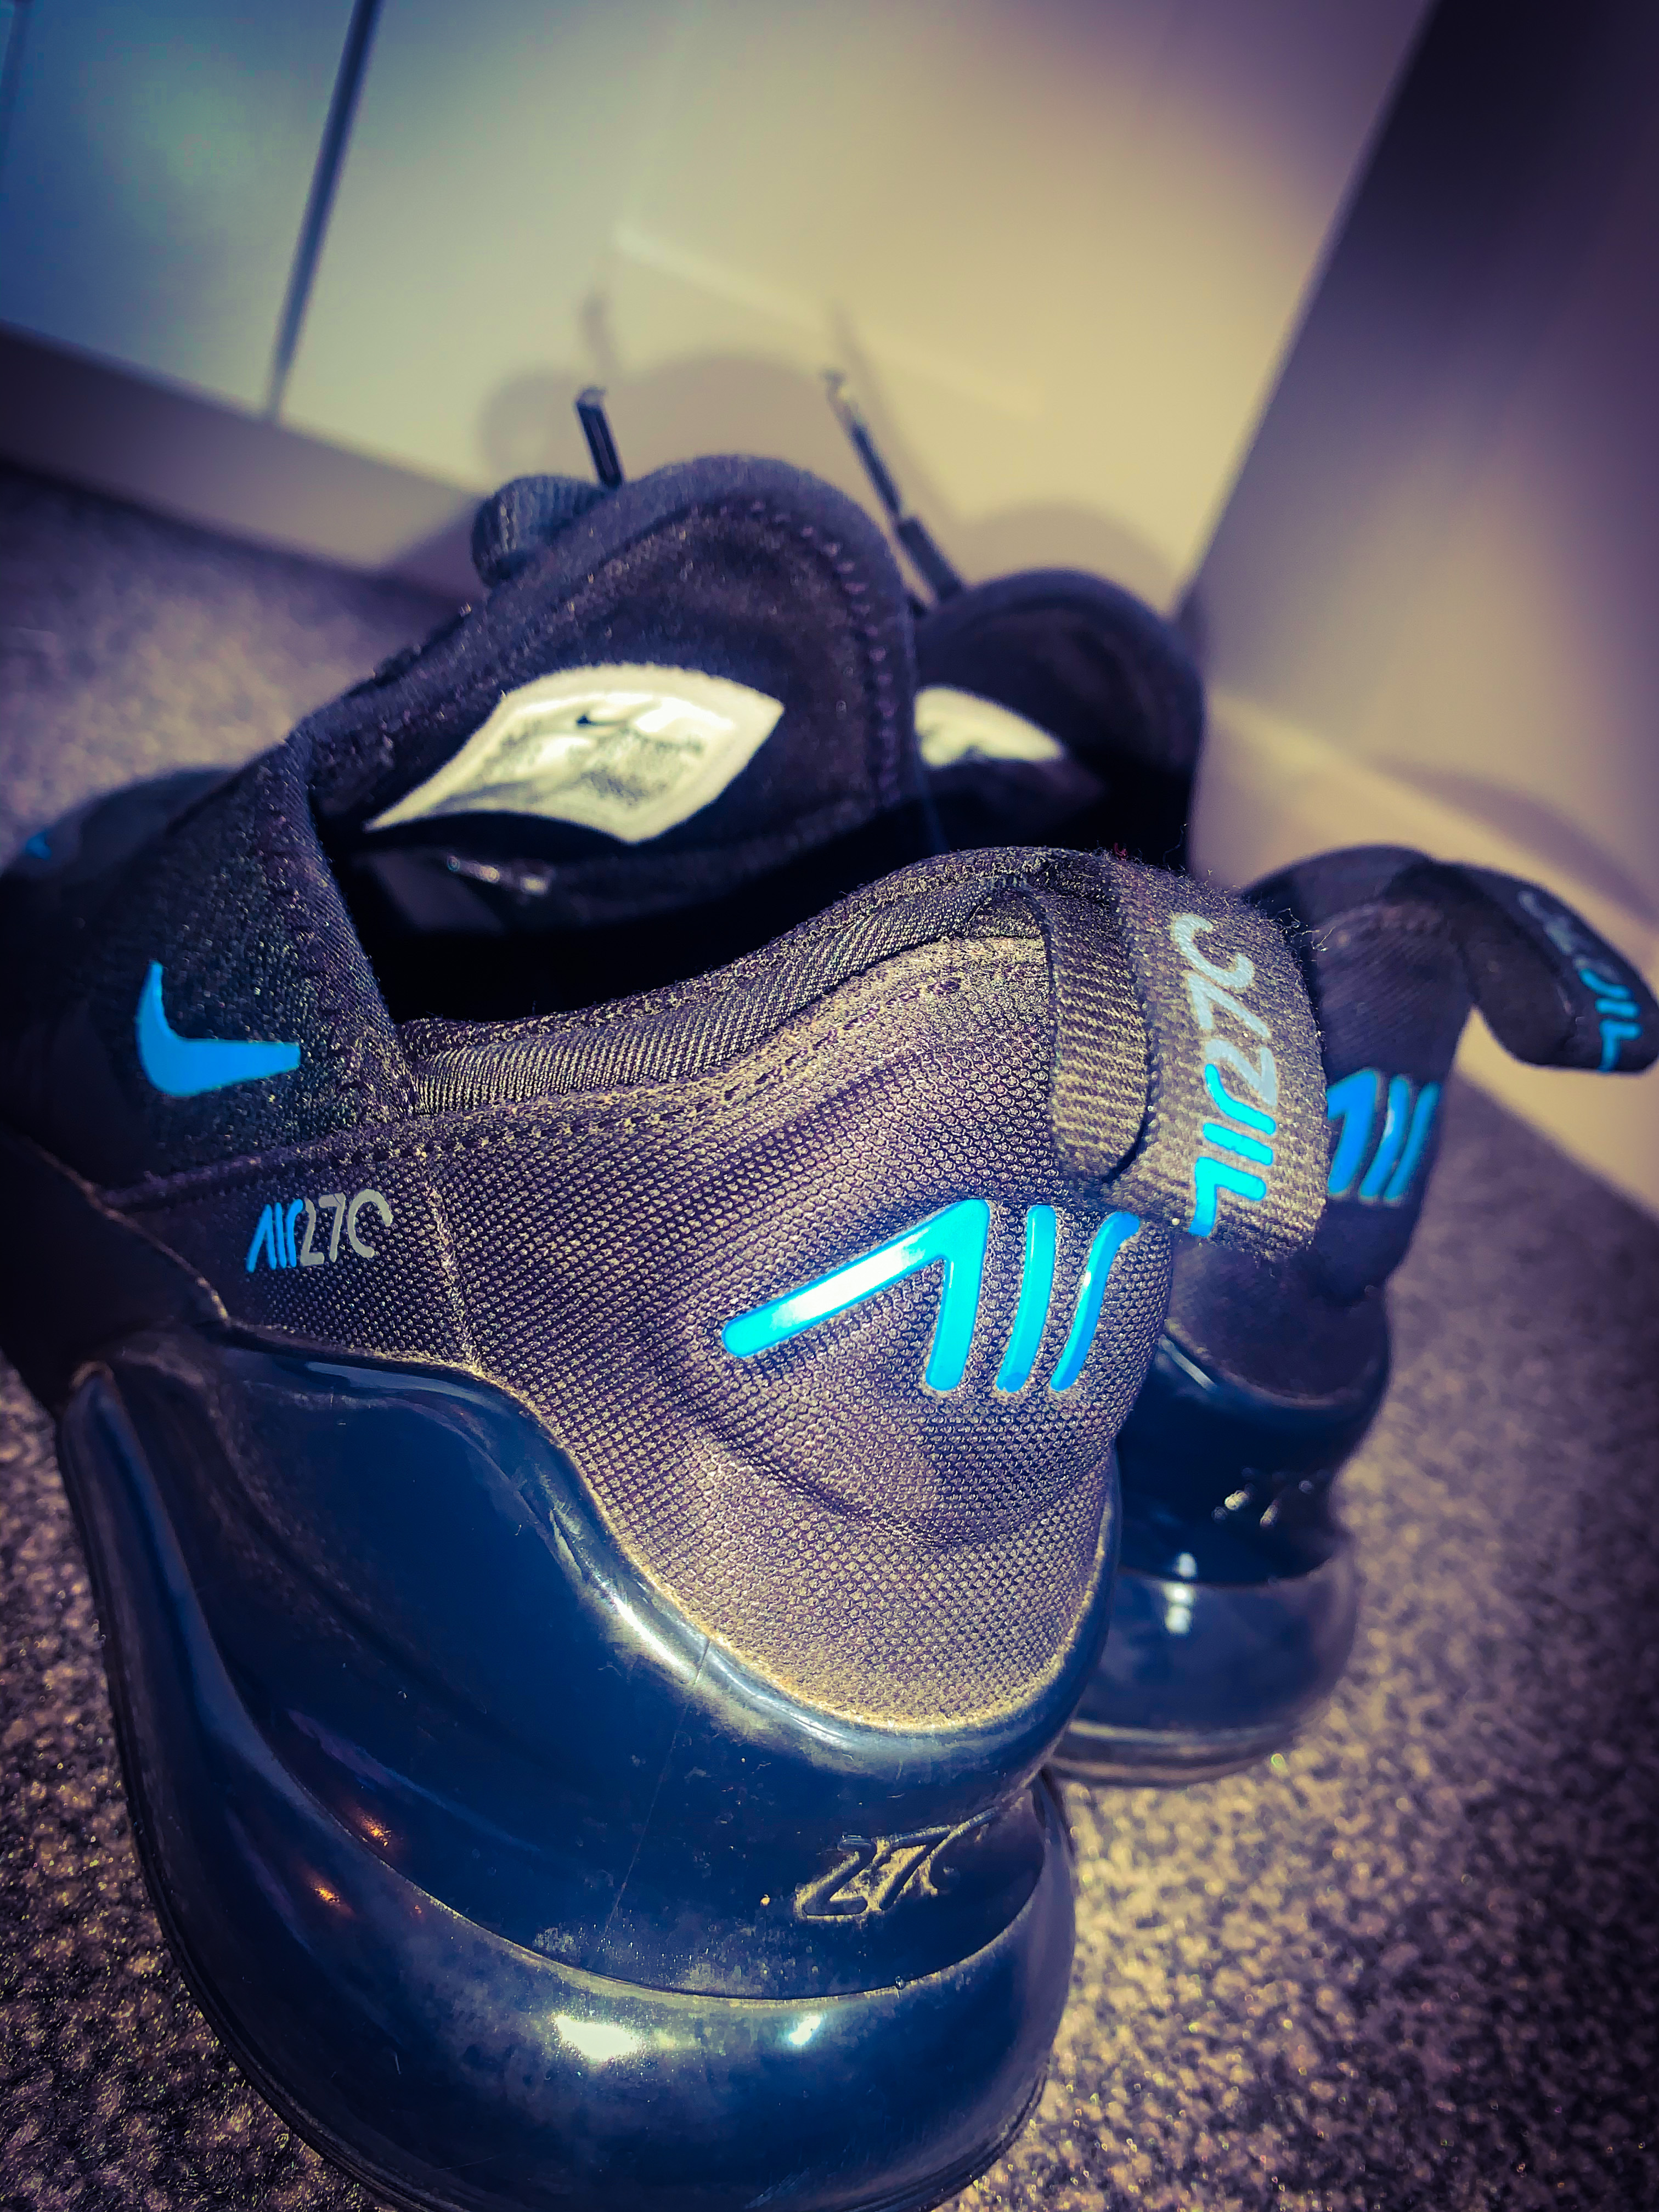
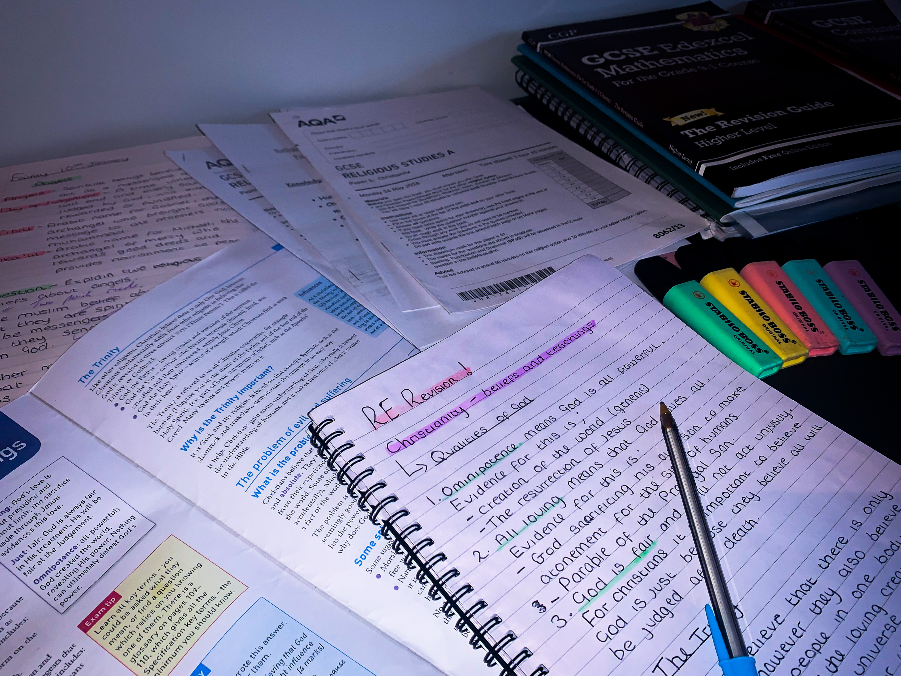
Thursday 2nd April 2020 This morning, I watched a few more episodes of the ‘Originals’ and then decided to revise some RE topics and complete some revision tasks on Seneca learning. Then around 3pm I wanted to get some fresh air so I went out on a run! At 8pm it was time to clap and appreciate all the hard work and effort the NHS are doing for us. It was amazing to see everyone in our community taking part.
Day 4
I used my I Phone XR to take these shots.
I then edited them by using Adobe Photoshop Express.

Slide 6
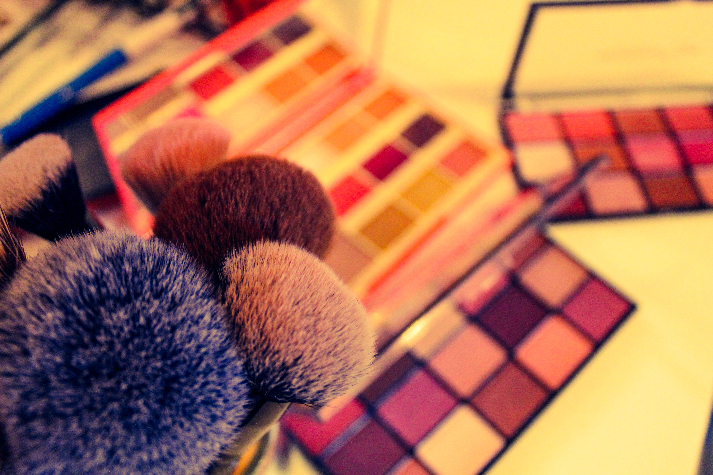
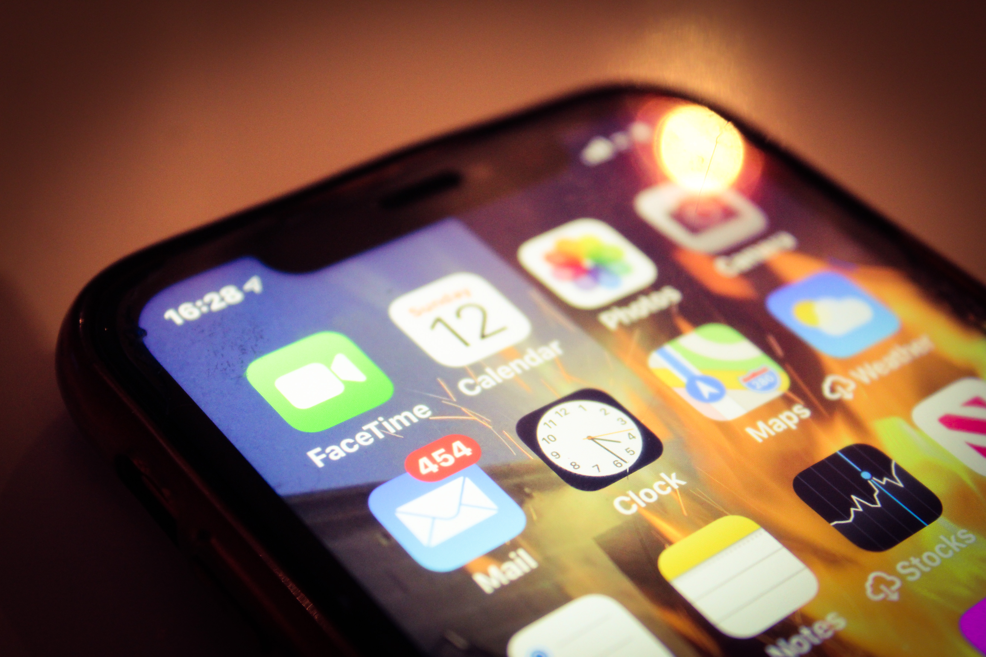
Friday 3rd April 2020 My mum and dad thought it would be a good idea for us all to have a “party” tonight and for us to have a group facetime with all my family. She wanted us all to get dressed and for me and my sister to do her makeup & hair! I went for my afternoon run and completed my workout but then it was time for me to start getting ready! There was lots of laughs and singing whilst we facetimed our family. It was so fun!
Day 5
I used my Canon SLR Camera to take these shots.
I then edited them by using Adobe Photoshop Express.

Slide 7
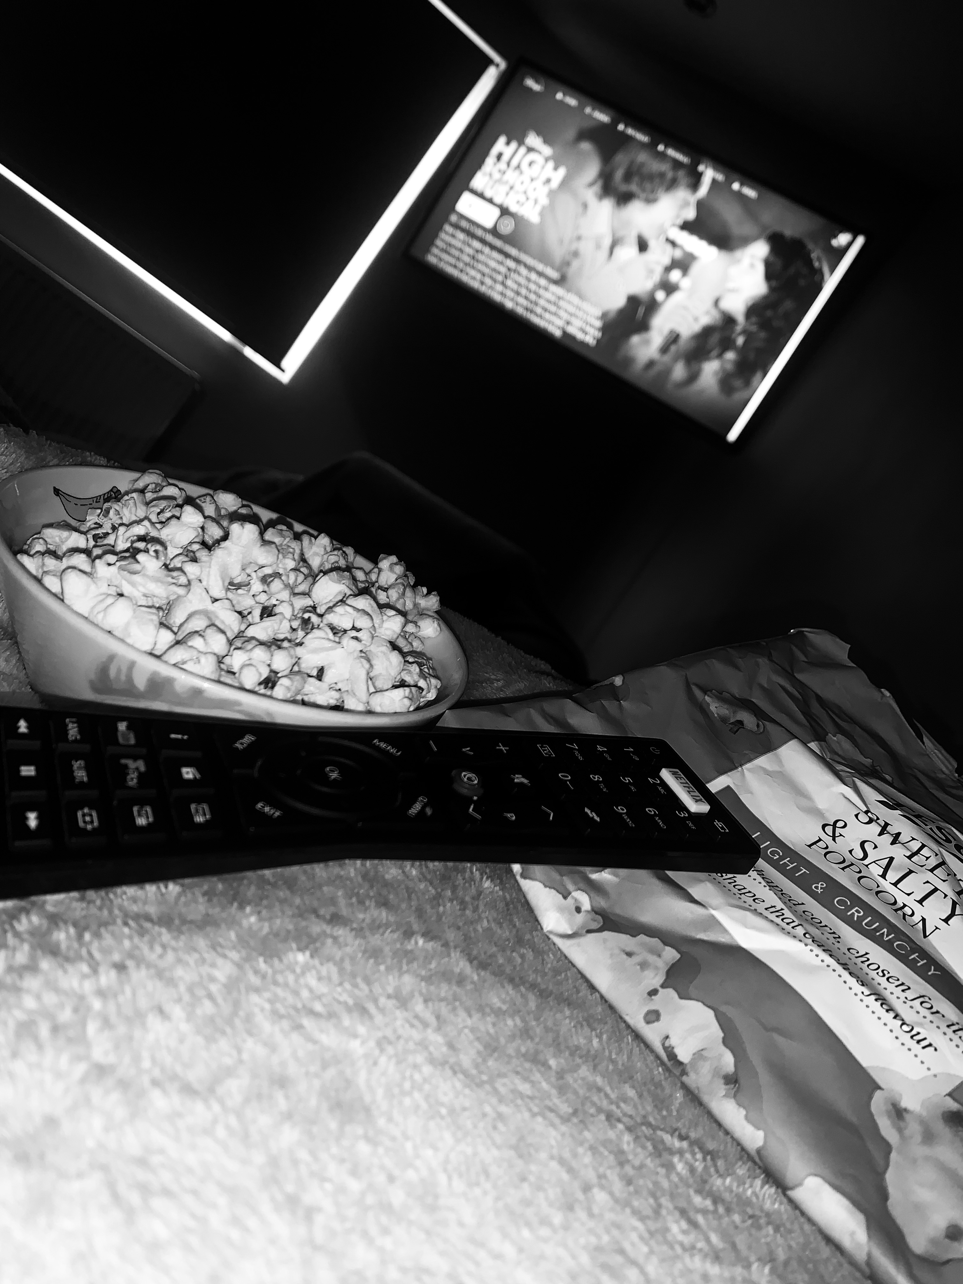
Saturday 4th April 2020 After a rather late night last night, I only awoke at 11am! My mum had signed up for Disney plus therefore that meant that it was movie day!! I spent the whole day in bed watching all 3 of the High School musicals! It made me realise how much I missed school and how I wish I could just go back and get things back to normal.
Day 6
I used my I Phone XR to create this shot.
I then edited them by using Adobe Photoshop Express.

Slide 8
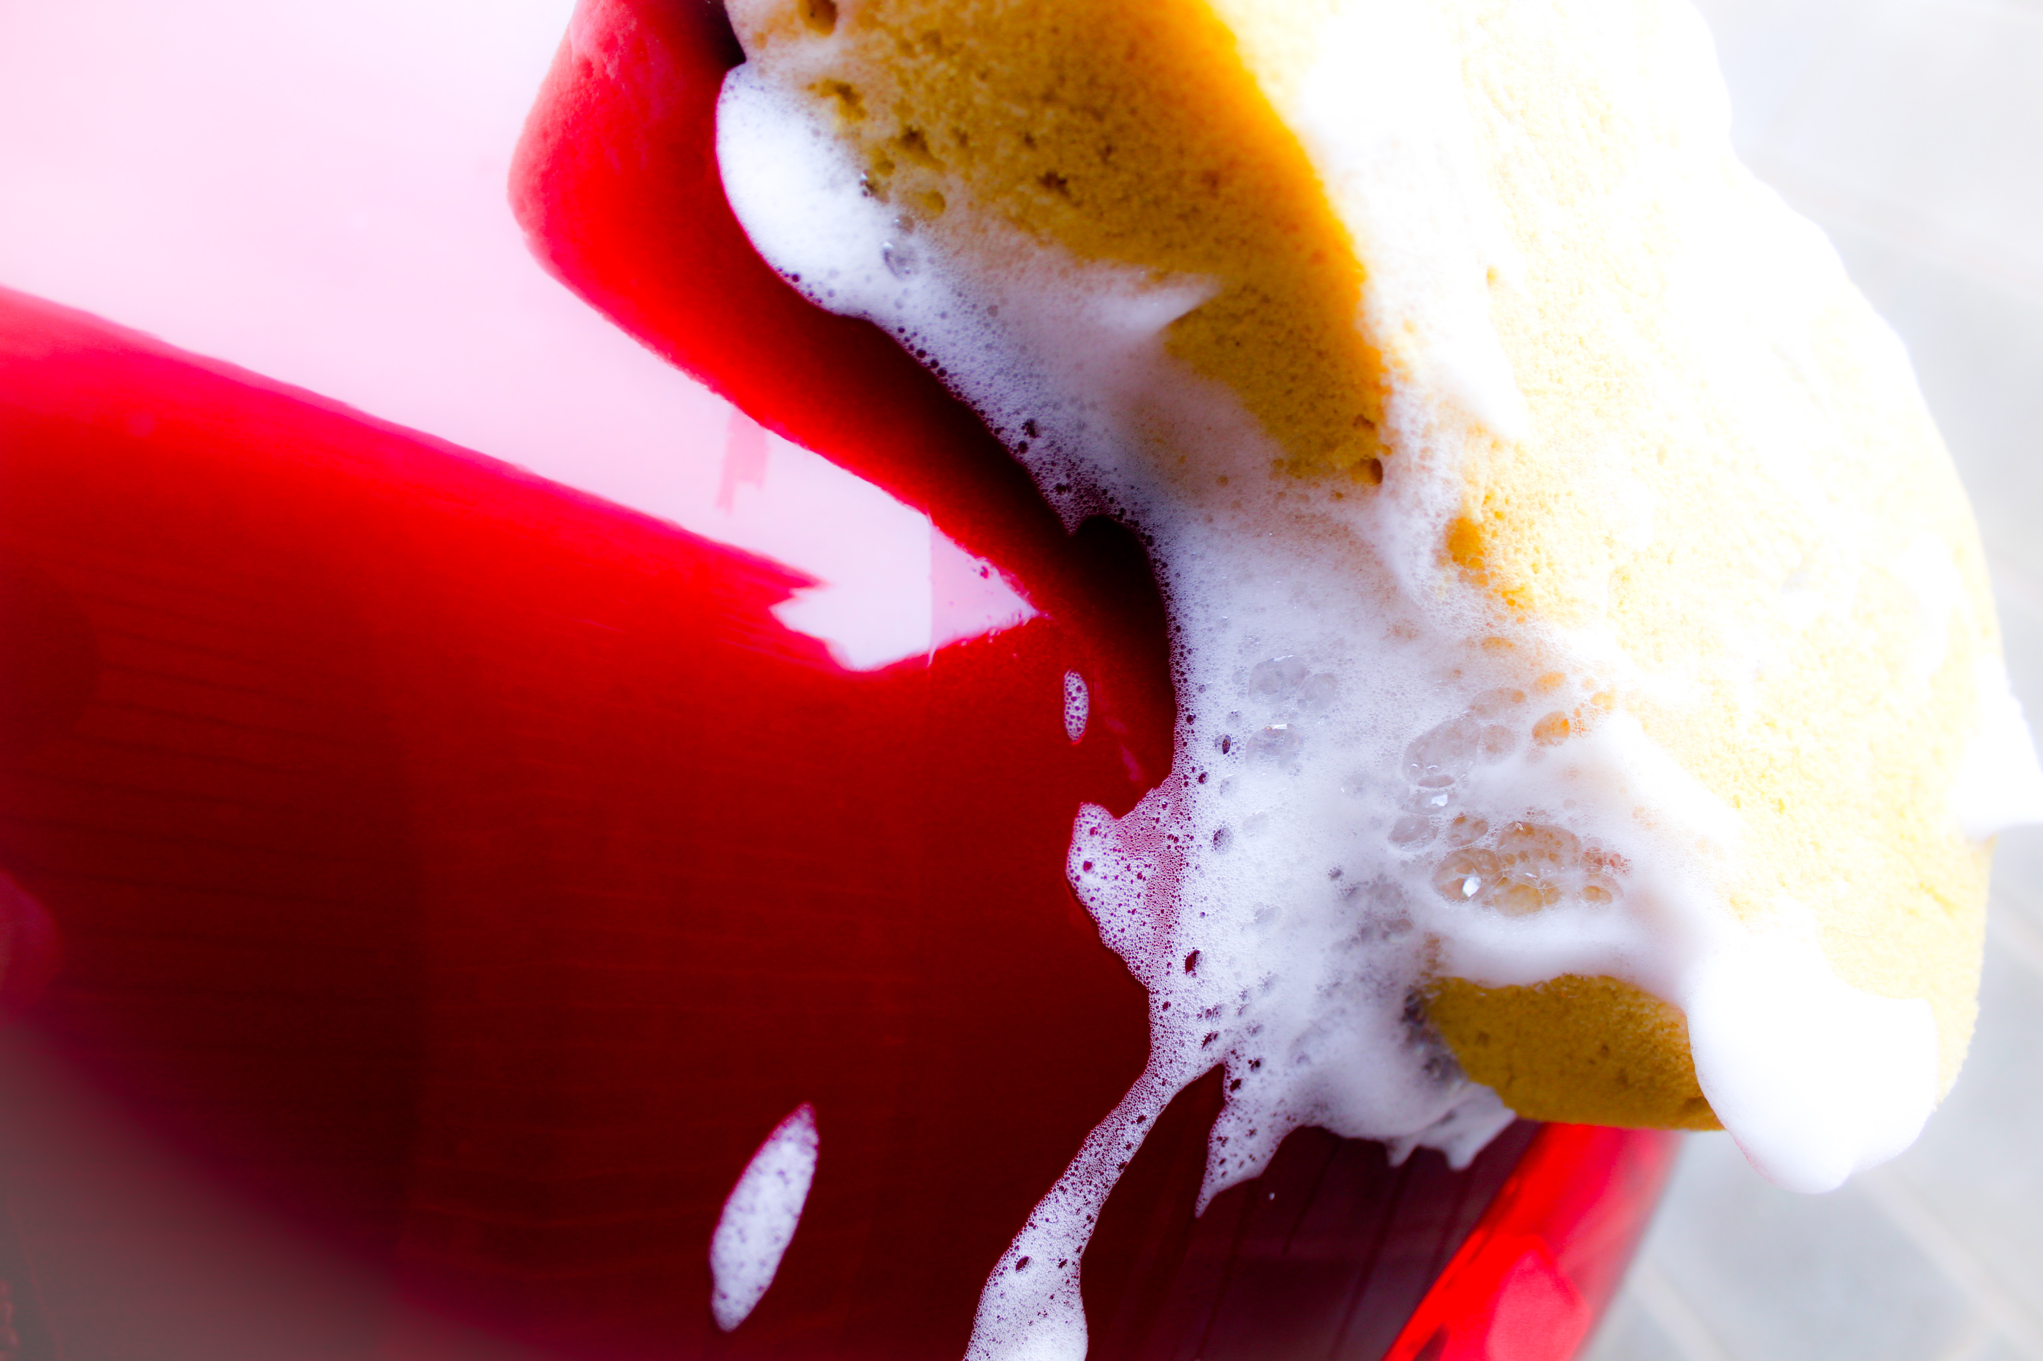
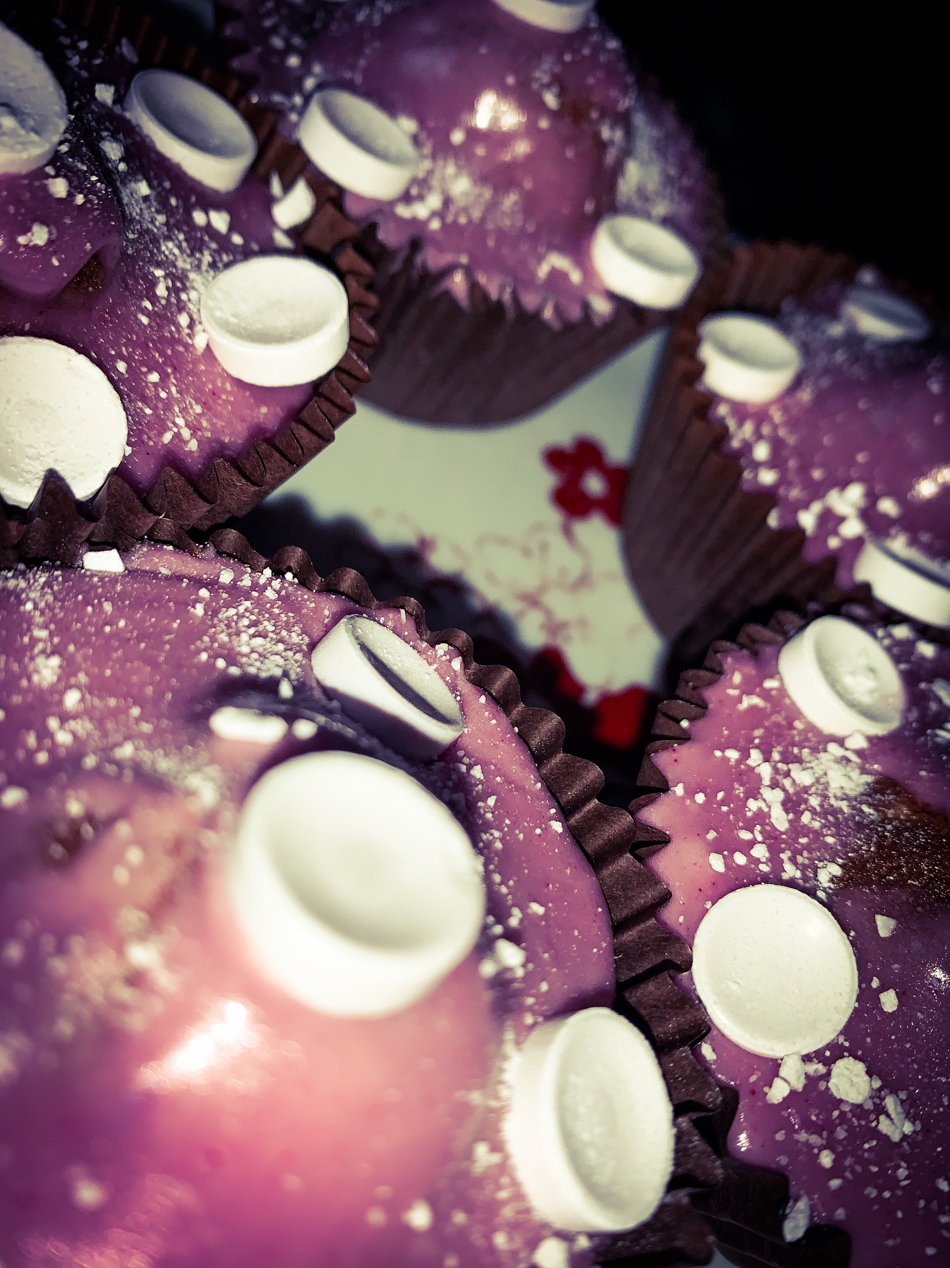
Sunday 5th April 2020 As it was a nice, spring morning I thought it would be a nice idea to wash my mums car! It took us ages and I was soaked at the end but it was lots of fun. Then later on I wanted to do some baking. So I made some Parma violet cupcakes – they were delicious. Even though I cooked them for a bit longer than I should have, they still turned out alright.
Day 7
I used my Canon SLR Camera to take these shots.
I then edited them by using Adobe Photoshop Express.

