Slide 1
My Lockdown Diary
Abby Downing

Slide 2
Brief
Over the next few slides I am going to show ten images I have taken whilst in lockdown. I am going to include the photo itself, the date the image was taken, a paragraph explaining why I took the image, what I took the image with and what I used to edit it.

Slide 3
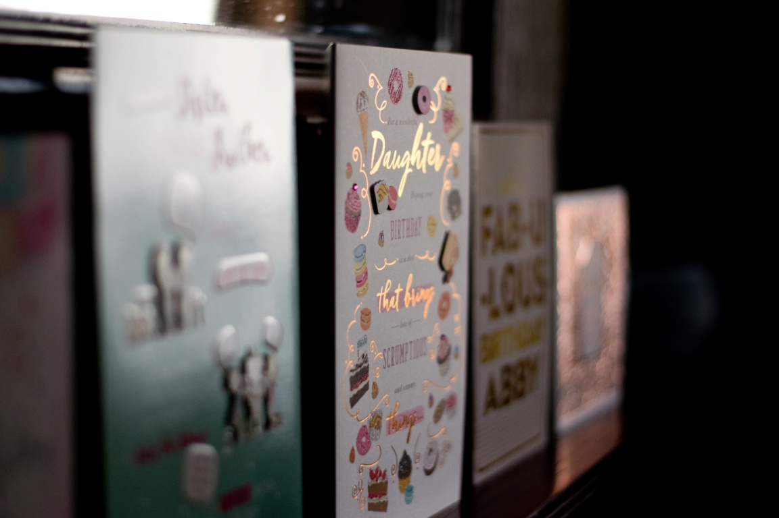
I took this image because yesterday I celebrated my birthday but wasn’t able to leave my house because of being in lockdown. The image was taken using a Nikon D3300 and edited in Lightroom.
1st
April
2020

Slide 4
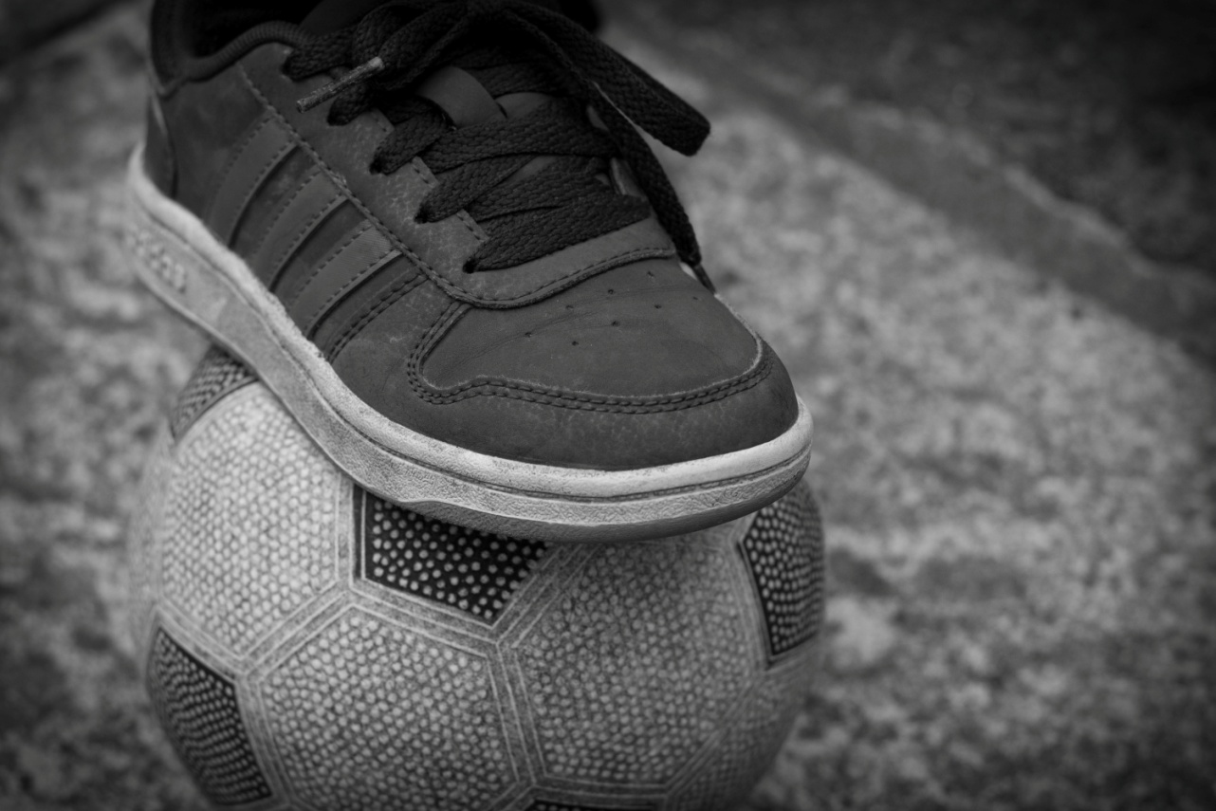
I took this picture because during lockdown I have spent a lot of time playing football with my brother. I used a Nikon D3300 to take the image. I used Lightroom to edit this image.
2nd
April
2020

Slide 5
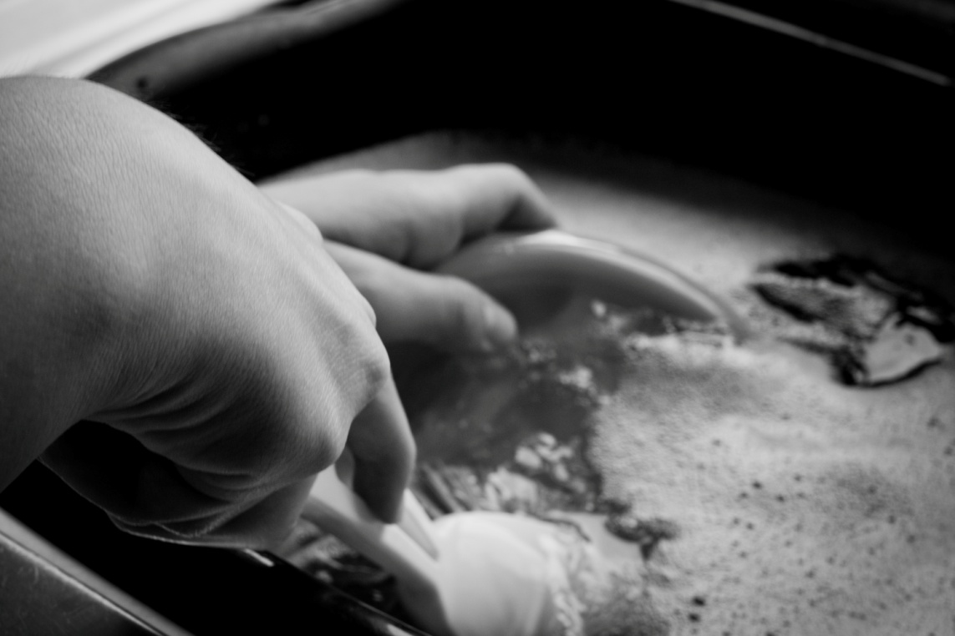
I took this image because this is a daily task that we still have to do even in lockdown. This image was taken using a Nikon D3300 and was edited using Lightroom.
3rd
April
2020

Slide 6
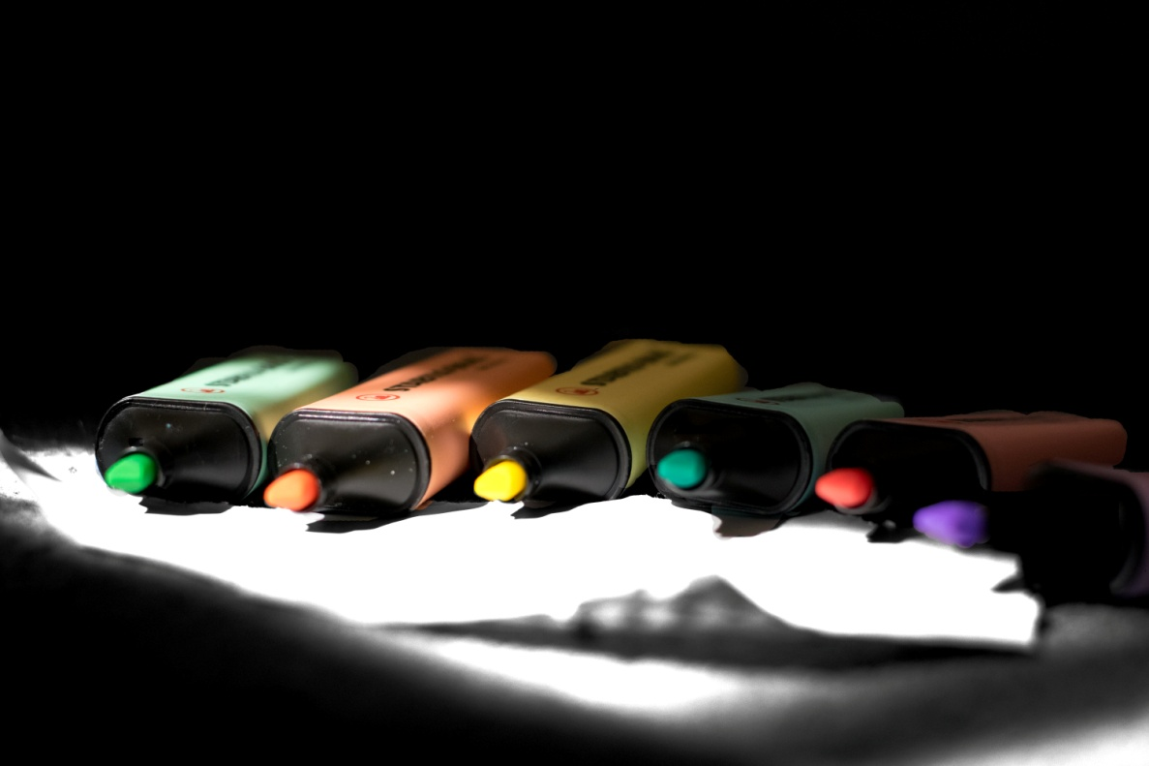
This was an image I decided to take to show that during lockdown we still have to work. This was taken using a Nikon D3300 camera and edited using Photoshop.
4th
April
2020

Slide 7
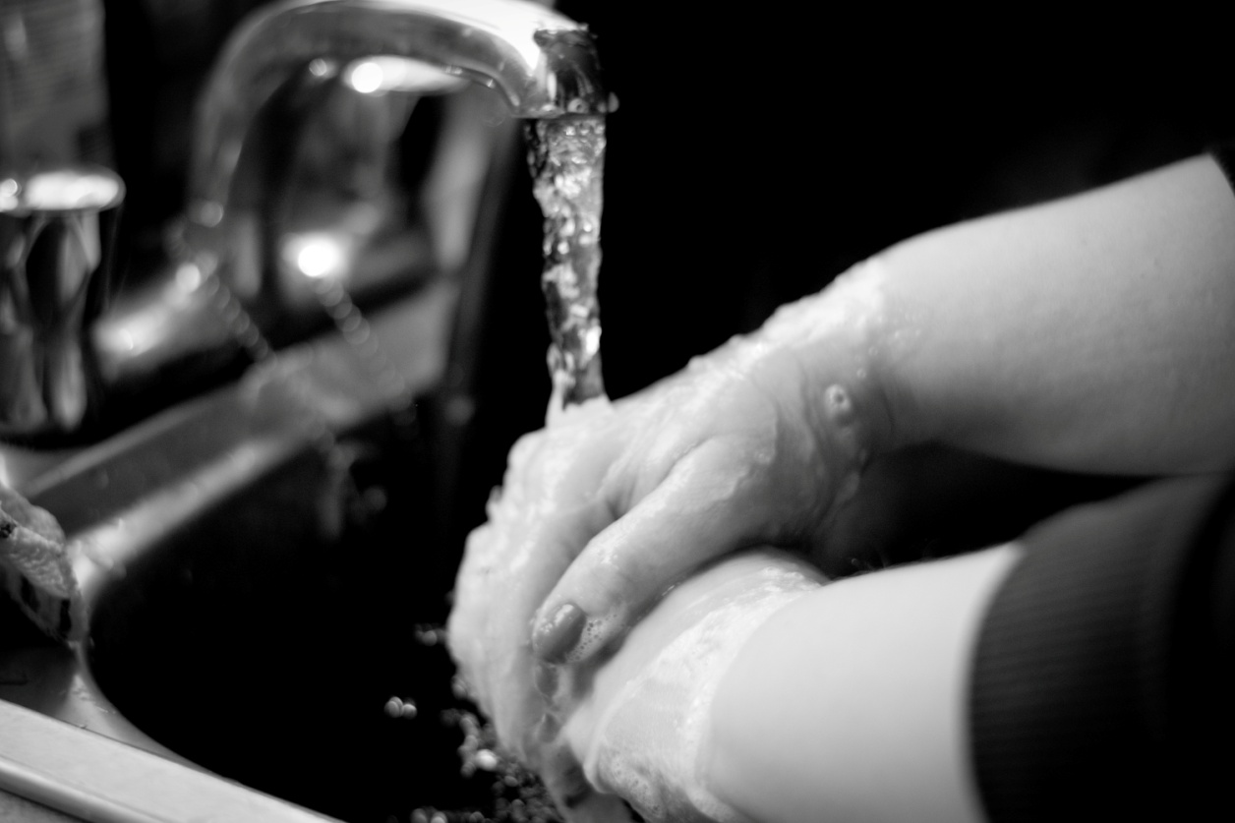
The purpose of this image is to show how careful we have to be and how we need to be keeping clean because of the virus. This image was taken with a Nikon D3300 camera and was edited in Lightroom.
5th
April
2020

Slide 8
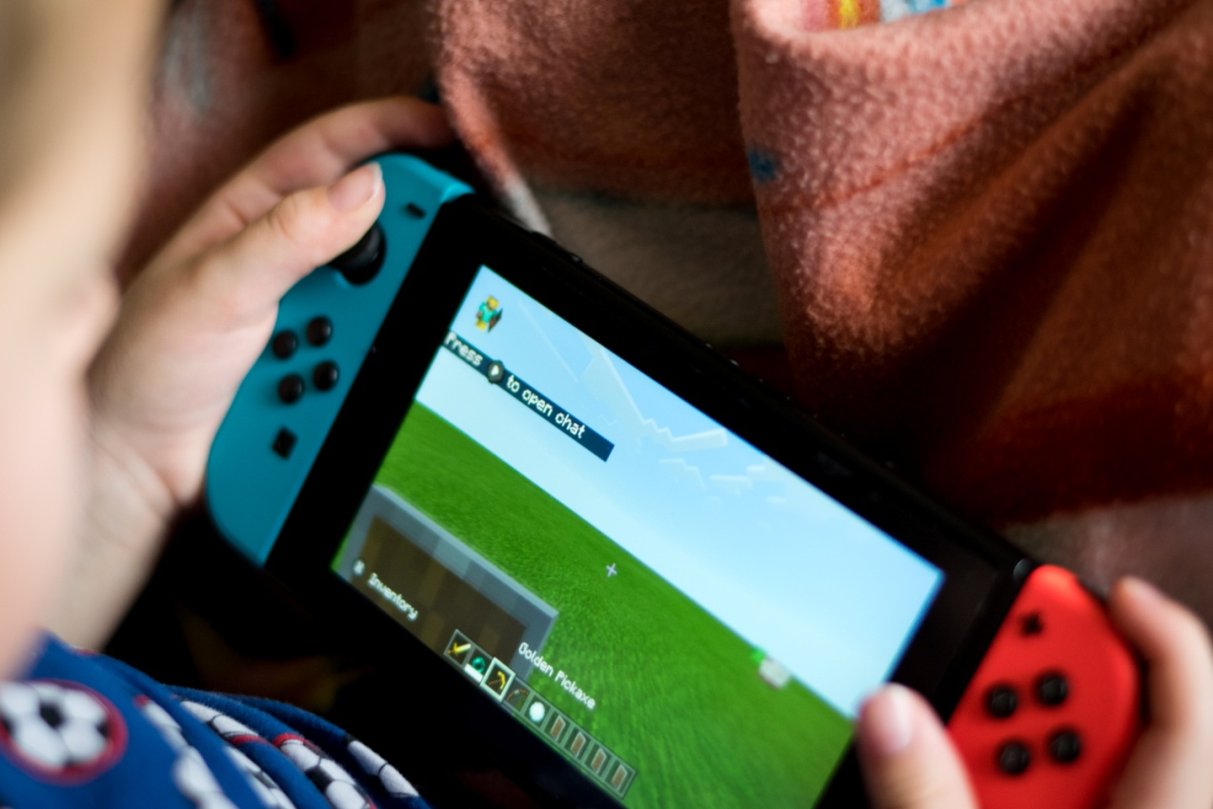
This image shows one of the things that we have been doing during lockdown. The image was taken with a Nikon D3300 camera and edited in Lightroom.
6th
April
2020

Slide 9
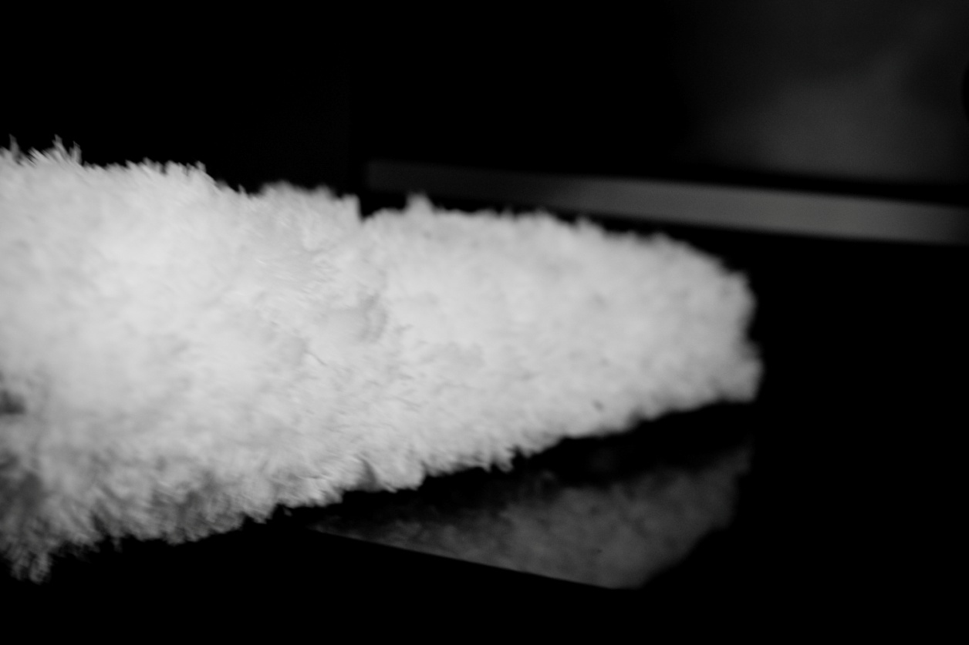
This image shows another daily task that has to be completed even when in lockdown. The image was edited in Lightroom and taken with a Nikon D3300 camera.
7th
April
2020

Slide 10
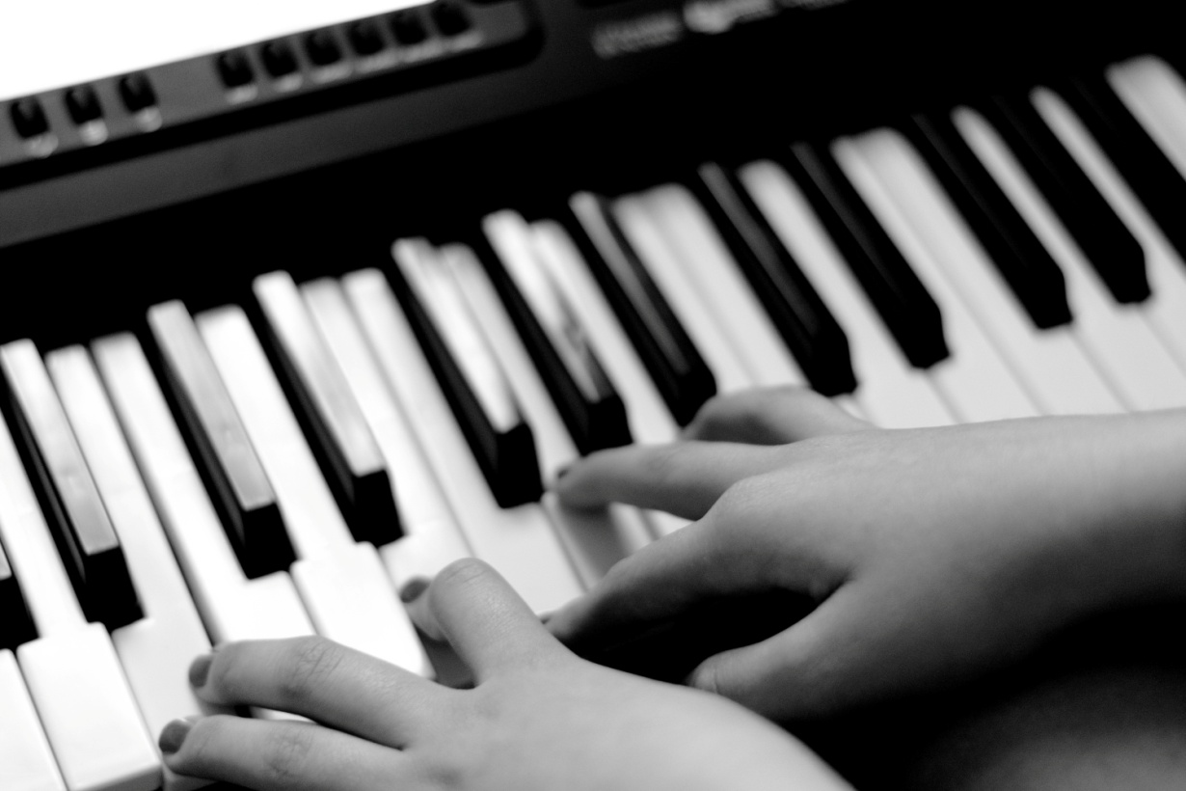
This shows another thing that my family have been doing to keep busy during lockdown. The photo was taken using a Nikon D3300 and edited with Lightroom.
8th
April
2020

Slide 11
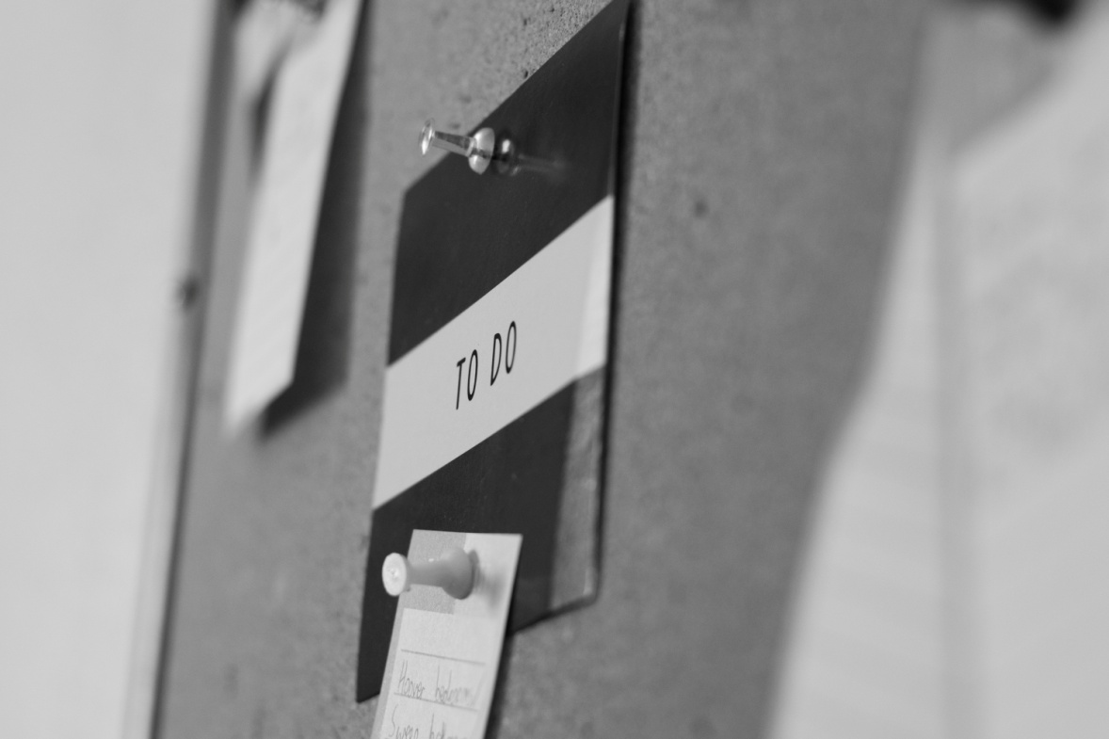
Today I created a to do list to help me remember things I need to do around the house. The photo was taken using a Nikon D3300 camera and edited in Lightroom.
9th
April
2020

Slide 12
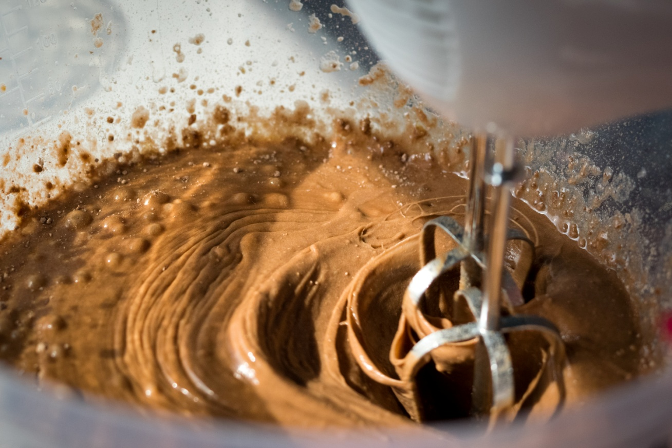
Today we made an Easter cake ready for the weekend. Taken with a Nikon D3300 and edited in Lightroom.
10th
April
2020

