Slide 1
Tegan’s lockdown photo diary

Slide 2
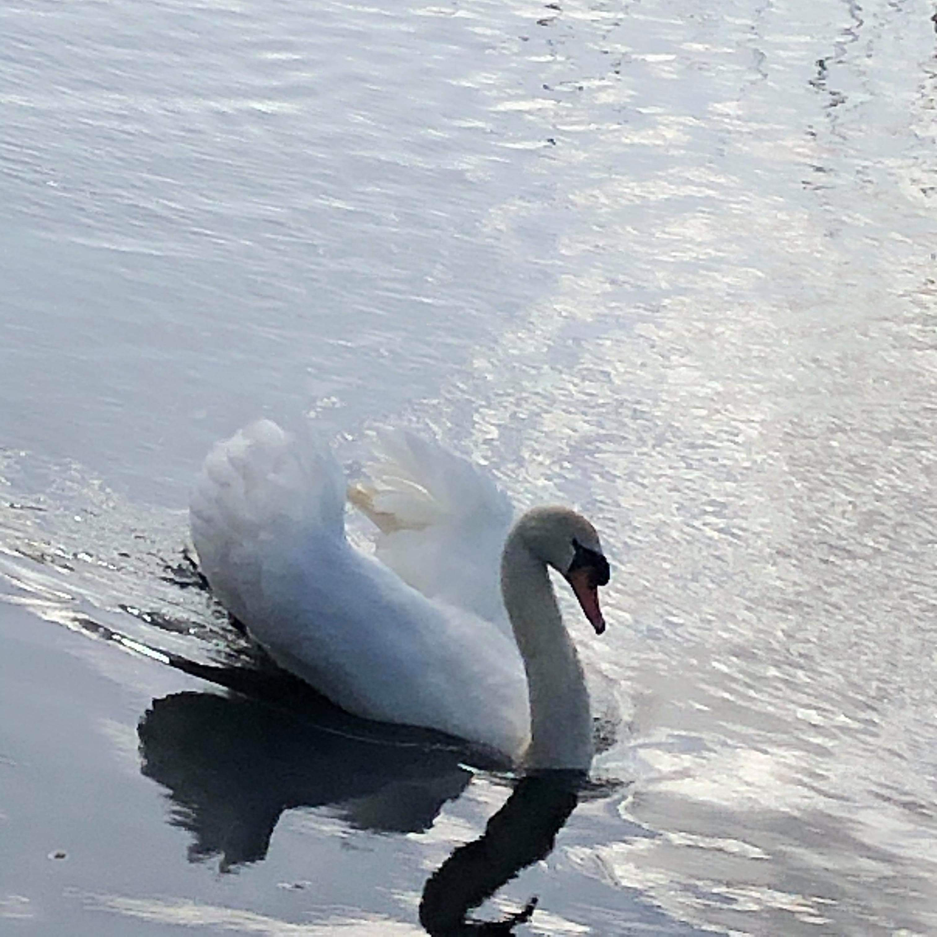
I took this while I was out walking my dog along the canal on my 1 hour of outdoor exercise. After spotting two swans swimming along I focused my phone on this one as its wings were out and it looked very elegant with the way its neck was positioned. I also liked the ripples that it left behind when it moved through the water which I feel added more texture to the image. Lastly the reflection in the water is another feature of the image that adds more texture but also a contrast with the black shadow and white swan.

Slide 3
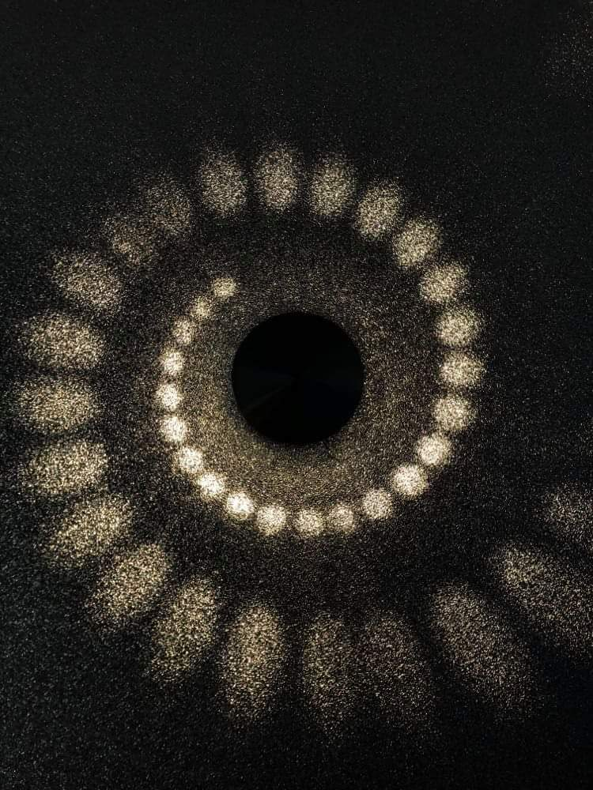
I took this photograph because we’ve been doing a lot of decorating lately and even though the wall light isn’t new the wallpaper its on is. Also I wanted to take this picture as the glitter really shines when the light hits it and I love the pattern of the lights and how the dots get bigger and bigger in a swirl. To take this picture I made sure I was level with the wall light to get a nice effect and as I took it on my I phone 8 I selected a focus point and I took the brightness slightly down so the light circles would stand out more and have a darker background kind of like a vignette effect.

