Slide 1
This morning…
First up – your Edge tutor will give you a copy of your individual Mock Exam timetable right now…
DO NOT LOSE IT – KEEP IT IN YOUR BAG and use it to plan your revision at home during the mocks

Slide 2
Period 7s
The next two slides present the Period 7s which are currently running…
Your school timetable now have Period 7s on them. You can check it on the SIMS Parent App to see if you are required to attend.
Check with your subject teacher or ask Mr Cordwell who has the full list of all Period 7s and who is attending.

Slide 3
Current Period 7 timetable – Week 1 Option Subjects
 | Mondays Option A | Tuesdays Option B | Thursdays Option C
Geography | Mr Foulkes in H2 |  | Mr Foulkes in H2
History |  | Ms Grellier in H5 | Mr Sale in H5 Mr Cook in H1 Mr McHugh H3
Spanish |  | Ms Fowler in L1
French |  | Ms Jordan L2
Computer Science |  |  | Mr Bell in C2
Art | Ms Sulek (fashion) in A3 Ms Shaw (art) in A1 |  | Ms Sulek (photography) in A3
Drama |  | Ms Higgins in PA1 24/11/20 only
Sports Studies |  | Ms Ely in G5 Ms Bannister in C3 Mr Welch in G3
Music BTEC | Mr Cornish in PA3

Slide 4
Current Period 7 timetable – Week 2 Core Subjects
Mondays Science | Tuesdays English | Thursdays Science
Ms Hargreaves in S6 Mr Rowlinson in S4 Mr Harte in S2 Ms Craven in S8 Mr Davanzo in S1 | Mr Lloyd in E3 Ms Calvert in E5 Ms Hutchinson in E1 Mr Reynolds in E6 | Ms Hargreaves in S6 Mr Rowlinson in S4 Mr Harte in S2 Ms Craven in S8 Mr Davanzo in S1
Wednesdays – Maths Period 0: Ms Costello in M4

Slide 5
Revising at home
By now you should have submitted your Revision Planner onto the Year 11 Steps to Success Google Classroom class and should be engaged in two 45 minute sessions each night.
Well done to those who have – we know who you are!!!
Google Classroom code: rpwmlbu
Coming up is a little memory test...

Slide 6
In Perfect Climate 1, how many of the 9 revision study tips can you remember?
You have 1 minute!
Your Edge tutor will ask for feedback.
The next slide shows you the 9…

Slide 7
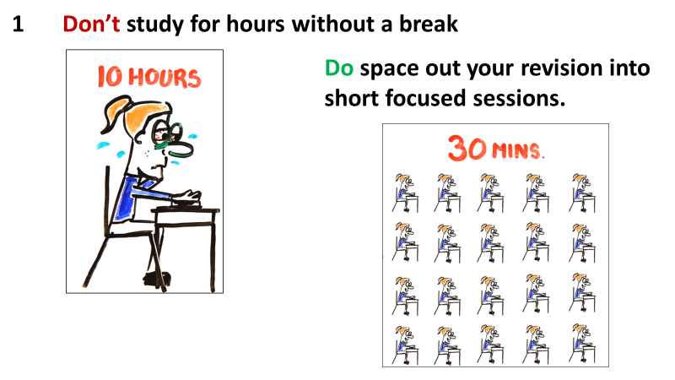
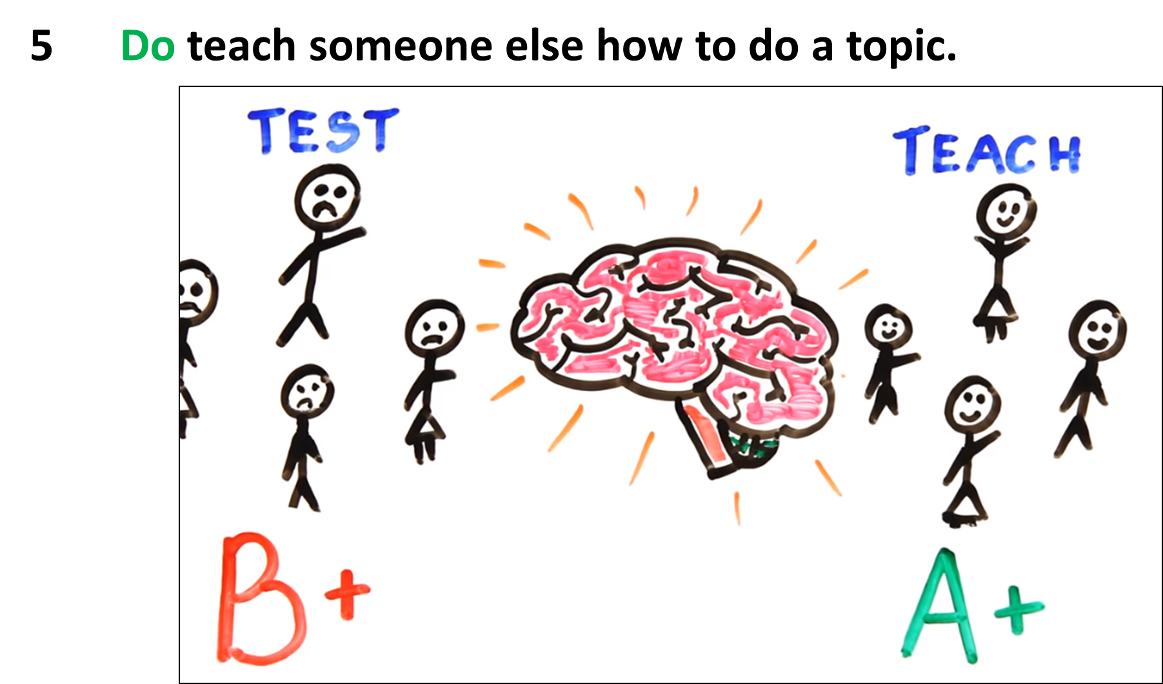
Notes:
Study session are most effective in short chunks

Slide 9
Why do we do mock exams?

Slide 10
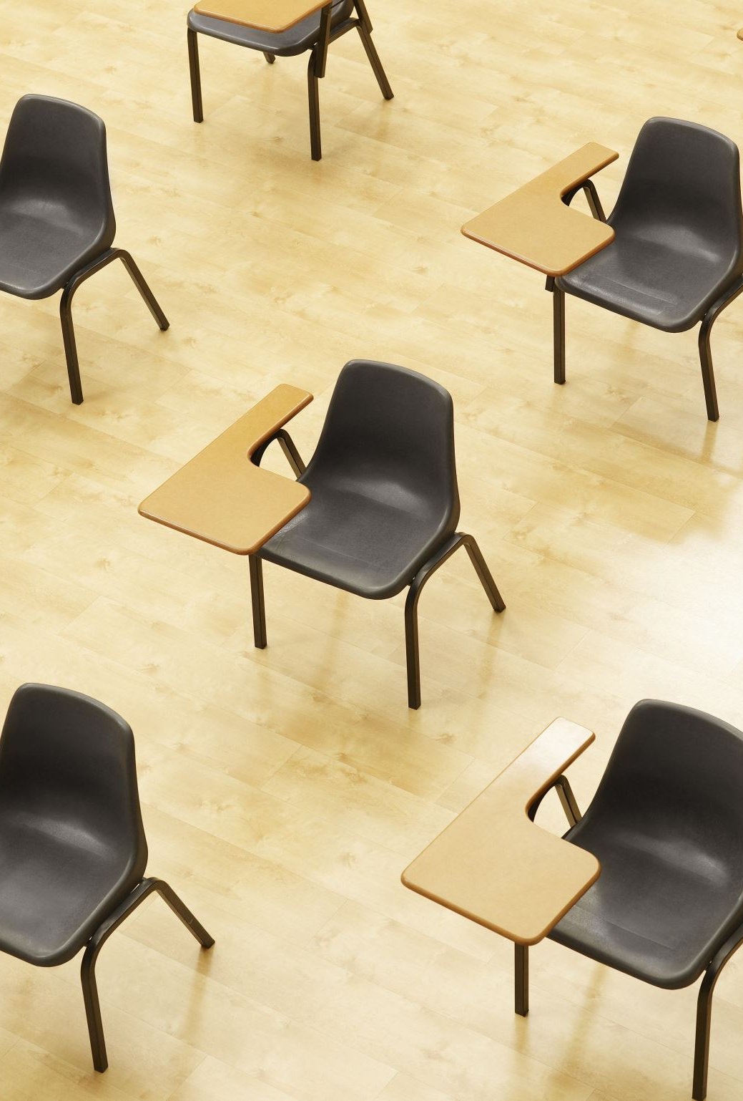
Demonstrate how much you have learnt so far in your GCSE courses.
Your strengths and weaknesses will be clearly identified.
Your teachers will analyse your results to plan our lessons and revision schedule.
To hone your exam technique and prepare you for the real thing.

Slide 11
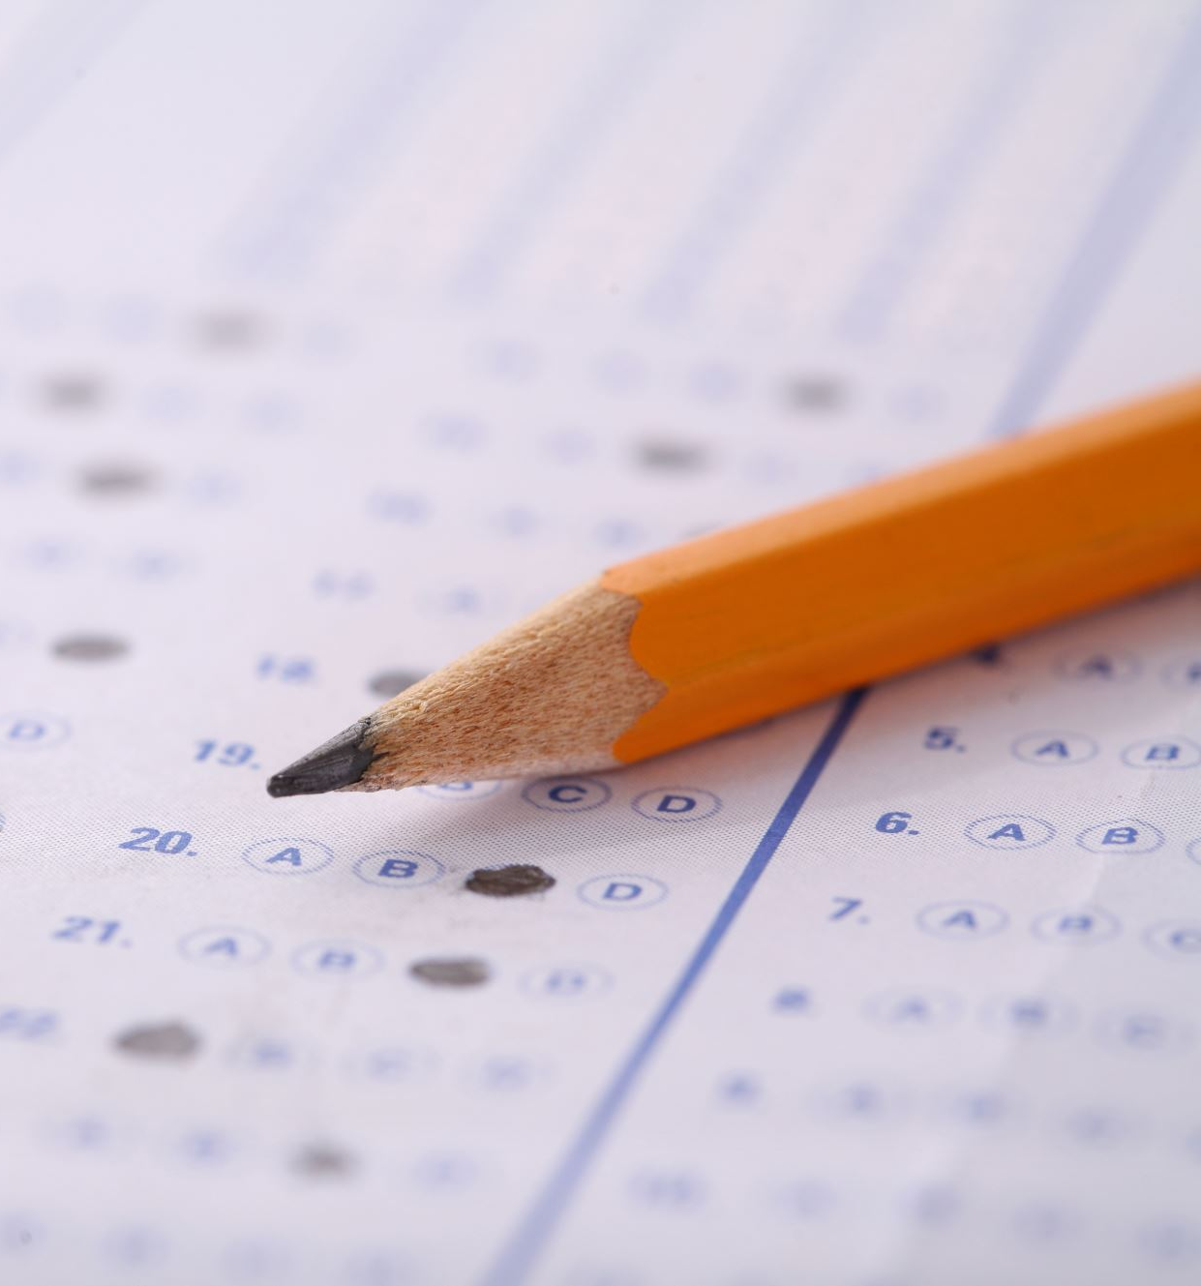
Centre Assessed Grades! They might yet happen!
Here are 4 things your teacher will use to decide on your GCSE grades:
December Mock results
February Mock results
Your effort in class and performance in class test, step assessments
What you are doing beyond the classroom: homework, evidence of revision, nightclub, attending Period 7s, interventions

