Slide 1
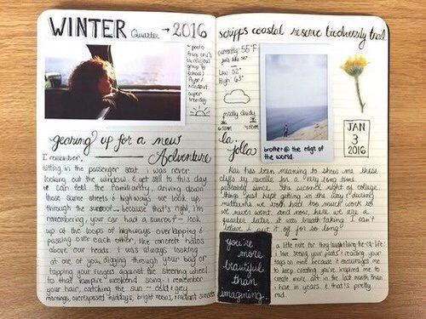
Easter activity my lockdown photo diary

Slide 2
BRIEF
Many photographers use the medium of photography to document their day-to-day life, using it as a diary of events, thoughts and moments. With this in mind, the aim of this activity is for you to use photography as a way of recording and documenting your life through this very unusual and different time we find ourselves in. During the period we are all in lockdown in our homes, take a daily photograph which captures your own activities, feelings and experiences.
To get this activity started, please go to these useful website articles, which takes you through how to create a Photo Diary and what sort of photographs you could take.
https://digital-photography-school.com/4-steps-make-creative-photo-diary/
https://expertphotography.com/photo-journal/
What do I have to do?
Set up a format such as a PowerPoint, Word document, an online album or an actual diary or scrapbook in which you will present a minimum of 10 photographs of various subject matter taken from your lockdown life – portraits, selfies, objects, a favourite meal, views from windows, pets, anything which catches your eye.
You may edit the photographs if you wish using any editing software or apps you may have, or you can keep the photographs natural.
Next to each photograph you are to write a diary entry. It may be a paragraph about what you did that day, a comment about how you are feeling, thoughts about the lockdown itself or a simple description of the photo itself and why you took it.
Once you’ve presented your photo and diary entry, you can email it to one of art staff: Ms Sulek bsu@little-lever.bolton.sch.uk, Ms Shaw ash@little-lever.bolton.sch.uk or Mr Cordwell sco@little-lever.Bolton.sch.uk
Check out some examples on the next two pages… WE CAN’T WAIT TO SEE WHAT YOU COME UP WITH!

Slide 3
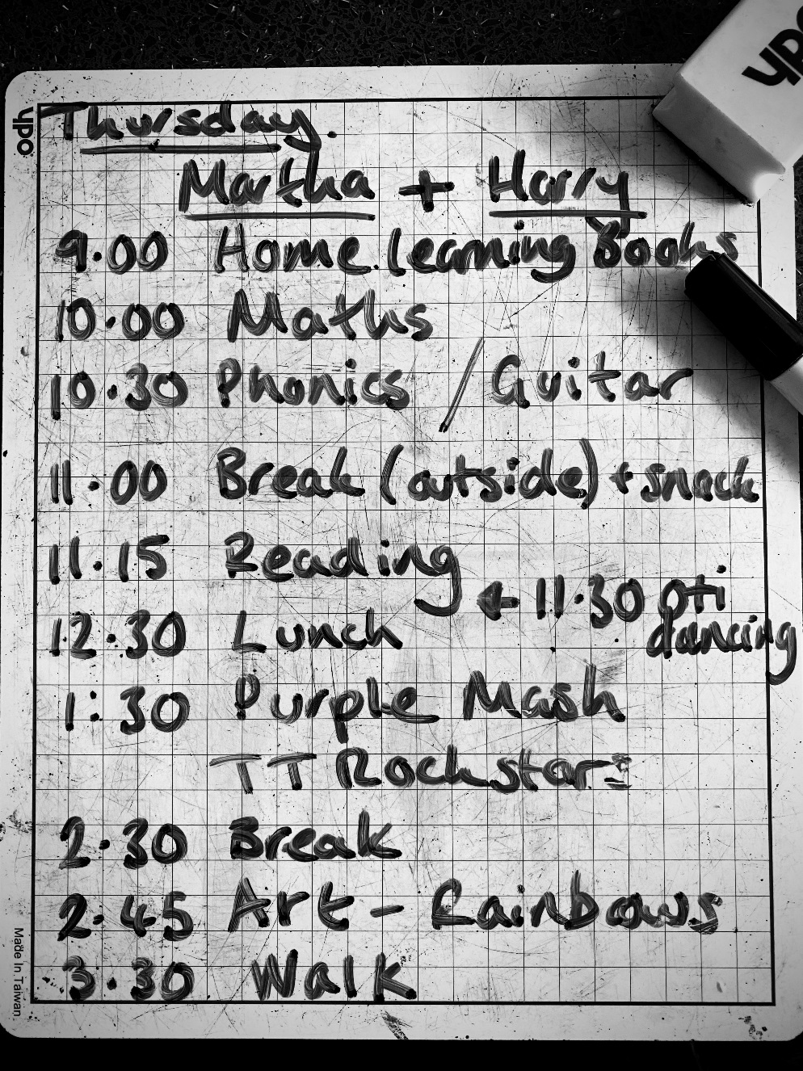
WAGOLL – what a good one looks like
Thursday 26th March
So it’s my second full day at home. My wife and I decided to make a timetable for my two children, Harry and Martha so we all knew what to do and when. We are keeping them busy in order for us to get on with our school work as well!
I can’t wait for our 3.30pm walk – our once a day explore beyond the house. It’s a beautiful, sunny day for it.
Shot using iPhone 11 Pro – edited in Adobe Photoshop Express

Slide 4
WAGOLL – what a good one looks like

