Slide 1
Year 9 Maths
Remote Learning Planner Contents
Page 1 – Hegarty Maths Guide
Page 2 – This week’s Remote Learning Plan
Page 3 – Google Classroom - Extension Activities and Challenges

Slide 2
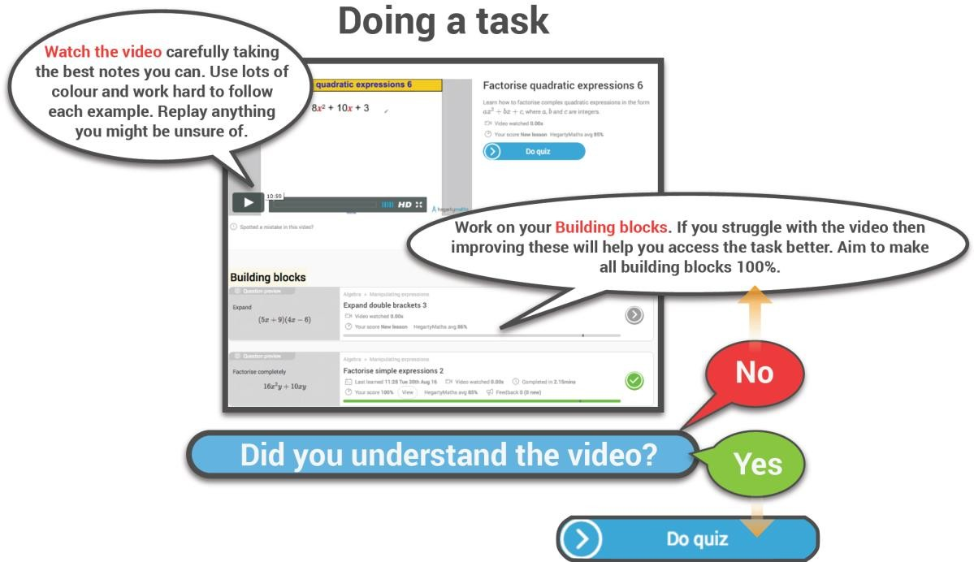
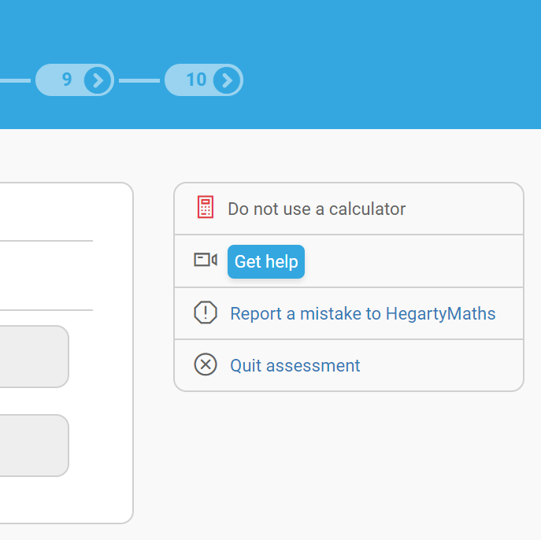
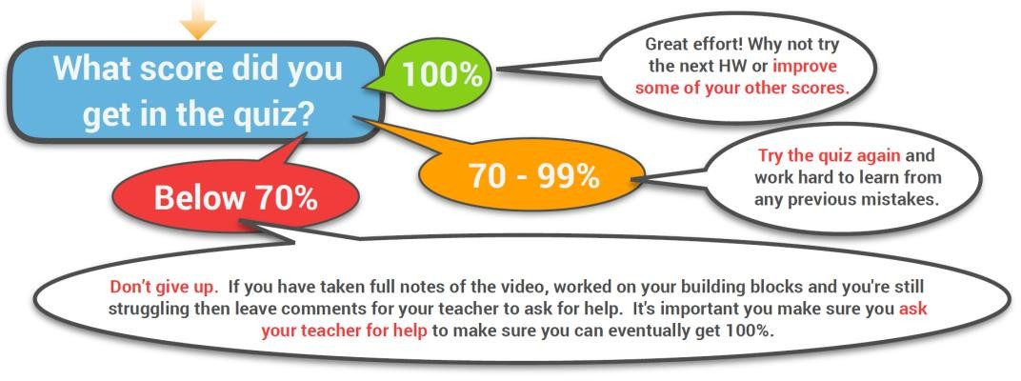
Hegarty Maths Guide
Page 1
Before looking at your Remote Learning Planner read the Hegarty guide below as to how best to use Hegarty Maths.
Need help during a quiz?
Show all of your working out on a separate piece of paper as this is where most the marks are awarded in an exam.
Click ‘Get help’ during a quiz and you will be taken to the exact same example in the Hegarty Maths video.

Slide 3
Week 5 – Remote Learning Plan
Page 2
Class | Task | Task Description | Hegarty Clip | Learning Map Reference | Relevant Link
9Ma1 | 1 | Solve Equations with x on both sides 3 | 186 | 2b-2 | https://hegartymaths.com
 | 2 | Compound Shapes | 555 | 7a-2
 | 3 | Area of a Circle | 539 | 7a-6
 | 4 | Cylinders 2 | 573 | 7b-5
 | 5 | MemRi |  | Revision
9Ma2 | 1 | Simplify Ratio | 329 | 4c-1 | https://hegartymaths.com
 | 2 | Share In a Ratio 1 | 332 | 4c-5
 | 3 | Share In a Ratio 3 | 334 | 4c-6
 | 4 | Rearrange (2 step) | 281 | 2b-4
 | 5 | Rearrange (x both sides) | 285 | 2b-4
9Ma3 | 1 | Solve 1-step equations (balancing) | 178 | 5a-4 | https://hegartymaths.com
 | 2 | Solve 2-step equations (multiplcation) | 179 | 5a-4
 | 3 | Solve 2-step equations (division) | 180 | 5a-4
 | 4 | Solve 2-step equations (x on denominator) | 181 | 5a-4
 | 5 | Solve 2-step equations (x is negative) | 182 | 5a-4
9Ma4 | 1 | Fractions as pictures | 58 | n/a | https://hegartymaths.com
 | 2 | Generate Equivalent Fractions | 59 | 4a-1
 | 3 | Simplify Fractions | 61 | 4a-1
 | 4 | Improper Fractions to mixed numbers | 63 | 4a-3
 | 5 | Mixed numbers to improper fractions | 64 | 4a-3

Slide 4
Google Classroom (Preparing for the GCSE)
Page 2
There are lots of brilliant resources to help prepare for GCSE Maths on the Year 10 Maths Google Classroom (www.classroom.google.com).
Every student in Year 9 has been invited to the class using their school email address.
What’s in the classroom?
Learning Maps – with links to Exam Questions for each topic
Weekly Maths Challenge
Times Table Rock Stars
Corbett Maths (5-a-day)
Practice GCSE Exam Papers

