Slide 1
at
Kindness

Slide 2
“Doing something towards yourself and/or others, motivated by genuine desire to make a positive difference”.
What is kindness?

Slide 3
What is Mental Health Awareness Week?
Poor mental health can affect anyone, at any time. We believe that mental health is everyone’s business.
So, for one week, The Mental Health Foundation campaign is around a specific theme, and this year it’s kindness!
The campaign reaches millions of people every year. With our support at Little Lever, we want to reach out to the community and support the students of our school.

Slide 4
Why kindness?
One thing that we have seen all over the world is that kindness is prevailing in uncertain times.
I think we can all agree that among the fear and uncertainty at the moment, there is also a community of support and hope.
There is also a bonus that by supporting others this will have a positive impact on our own mental health and wellbeing, which can help reduce stress and improve emotional wellbeing.

Slide 5
Each day this week there will be several kindness tasks for you to choose from on the Support Google Classroom.
Pick one or as many of these tasks as you like and spread as much kindness as you can!
Google Classroom code: dzyousd

Slide 6
Monday 18th May 2020
Task:
🌈 Call a friend that you haven’t spoken to for a while.
⭐️ Send a motivational text to a friend who is struggling.
⭐️ Send an inspirational quote to a friend.
🌈 Send someone you know a joke to cheer them up.
⭐️ Send someone you know a picture of a cute animal.

Slide 7
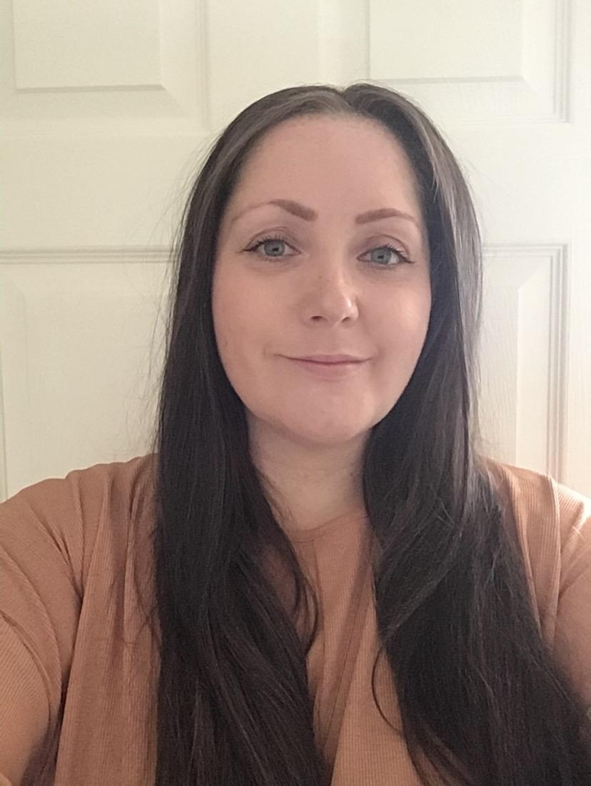
I hope you have enjoyed spreading kindness today.
Remember to join the classroom to get Tuesday’s kindness task!
Miss May, SEMH Specialist Teaching Assistant at Little Lever School
Or if you are already a member, come back tomorrow to spread more kindness!
Come and say hello on our Google Classroom: dzyousd

