Slide 1
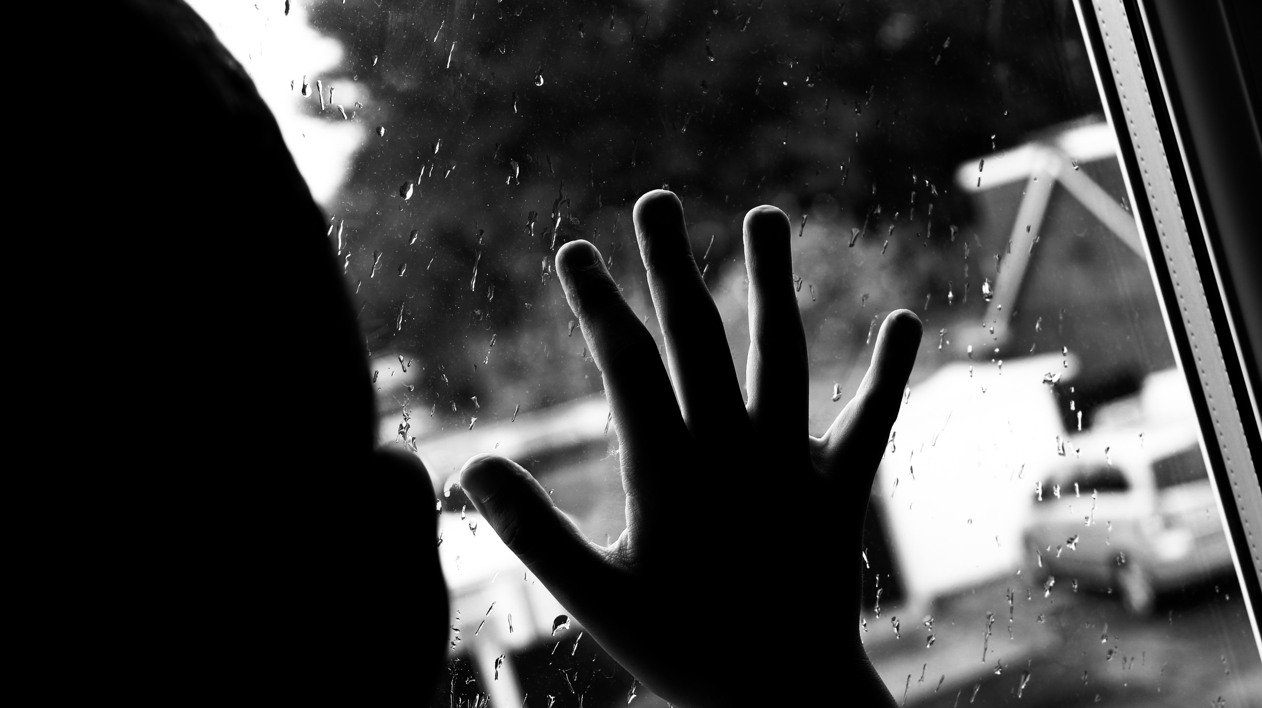
My Lockdown photo diary
By Gracie Lowe
Year 10

Slide 2
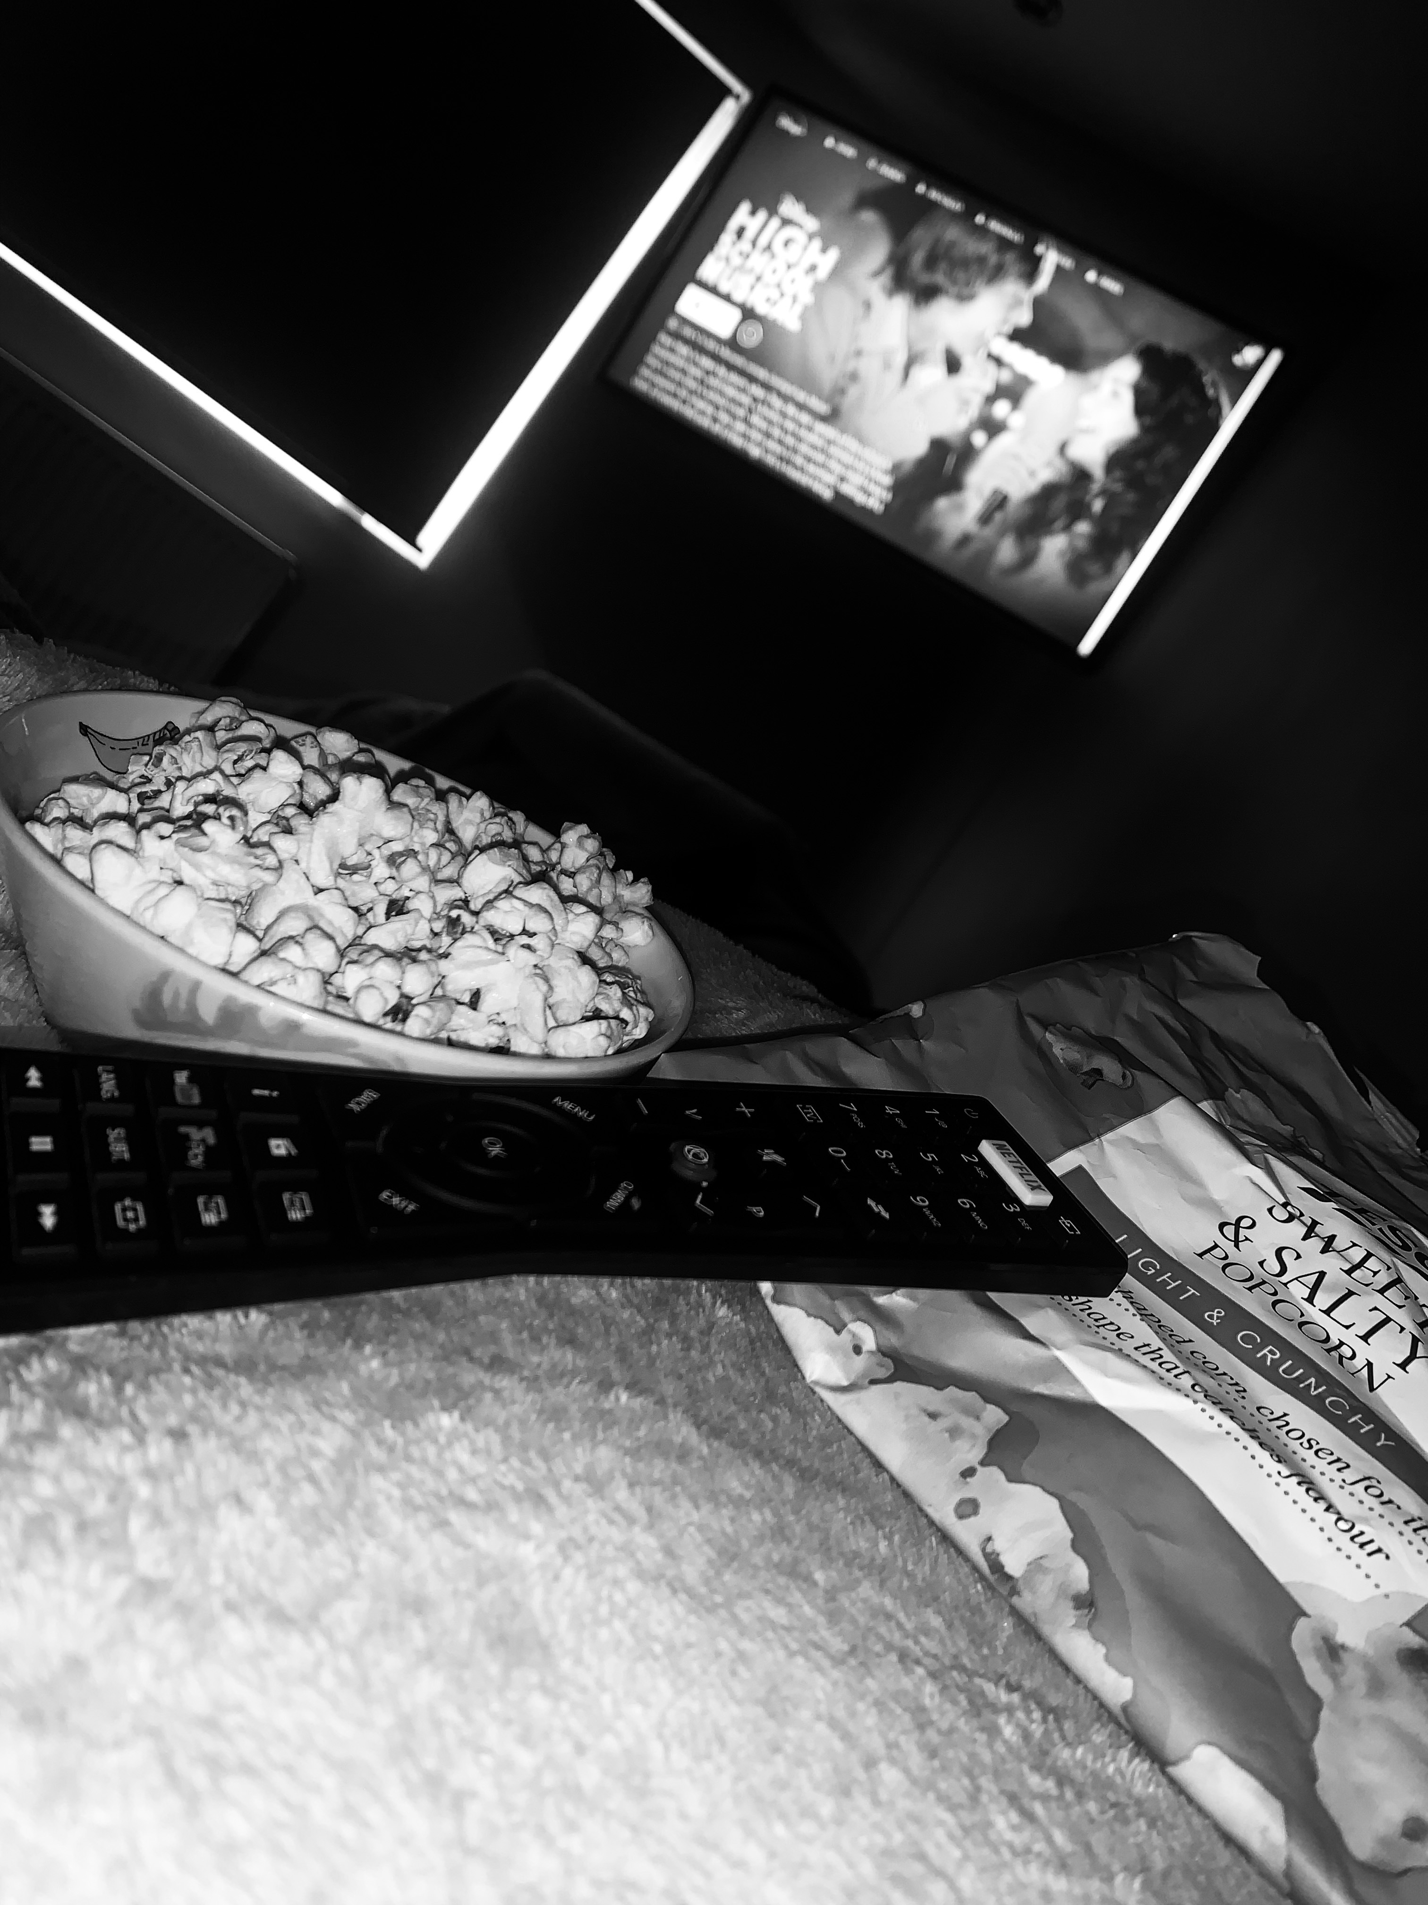
After a rather late night last night, I only awoke at 11am! My mum had signed up for Disney plus therefore that meant that it was movie day!! I spent the whole day in bed watching all 3 of the High School musicals! It made me realise how much I missed school and how I wish I could just go back and get things back to normal.
Week 1 ,Day 1
I used my I Phone XR to create this shot.
I then edited them by using Adobe Photoshop Express.
To get the dark, moody effect I first of all turned my image into black and white and increased the contrast and decreased the brightness to almost make it almost look like a cinema room.

Slide 3
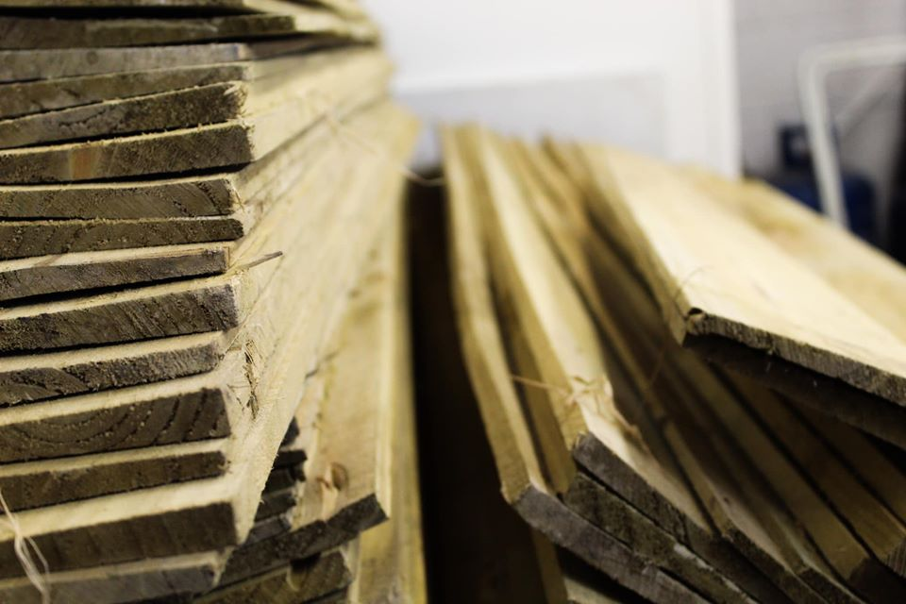
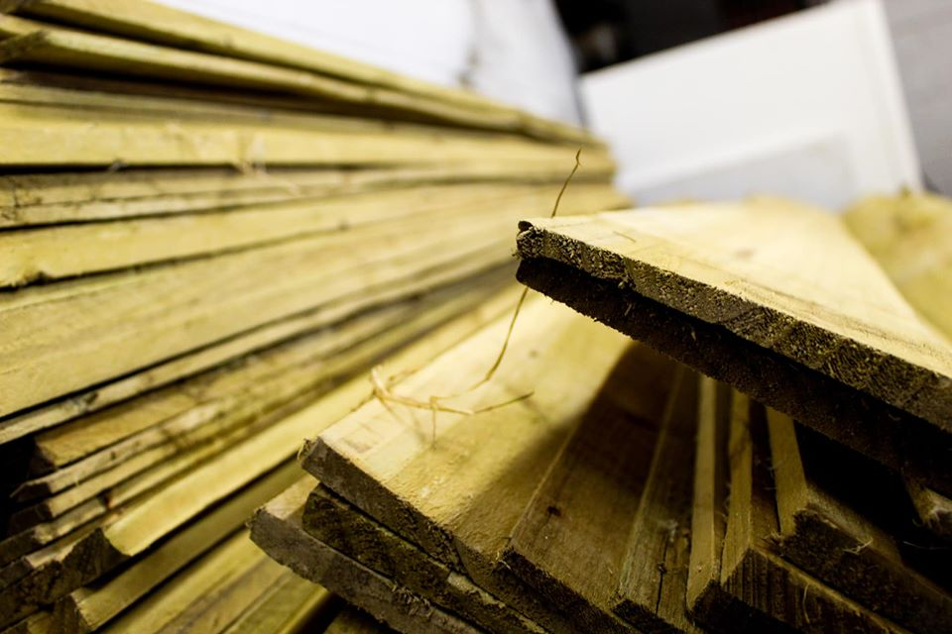
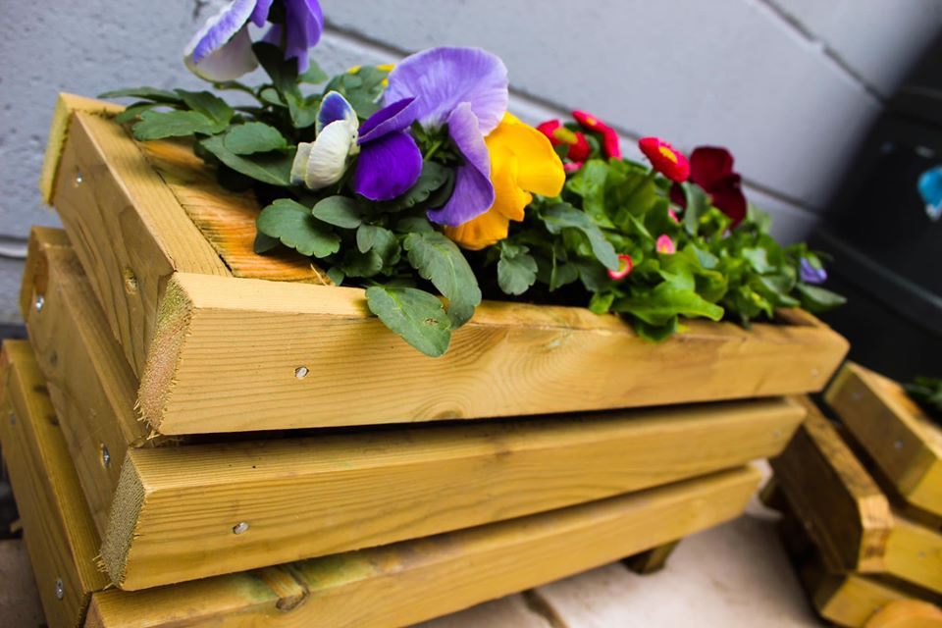
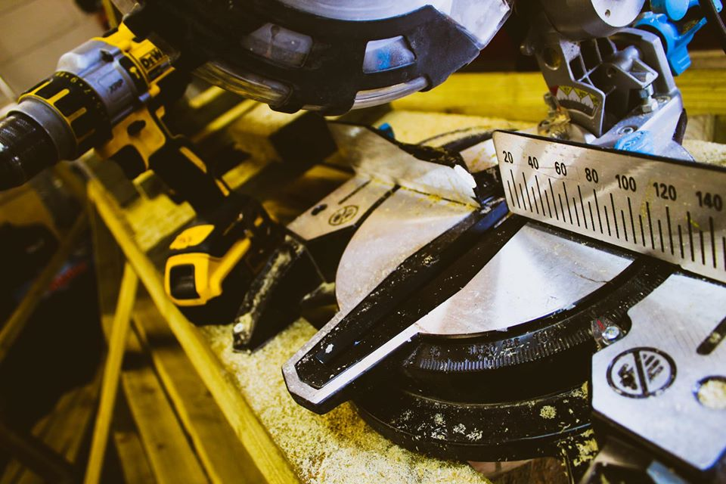
As I had a rather lazy day yesterday, I thought I would be a bit more productive today. Using spare old wood, me, my brother and sister made our own plant boxes. We all created different styles, for example; I made the long rectangular plant box, my sister made a small square plant box and my brother created a plant box in the style of a go-kart! After hours spent outside creating the boxes I did my daily workout and finished the day by watching the tv.
I used my Canon SLR Camera to take these shots.
I then edited them by using Adobe Photoshop Express.
Week 1, Day 2
For this edit, I used the vibrance tool to boost the colours of these images.

Slide 4
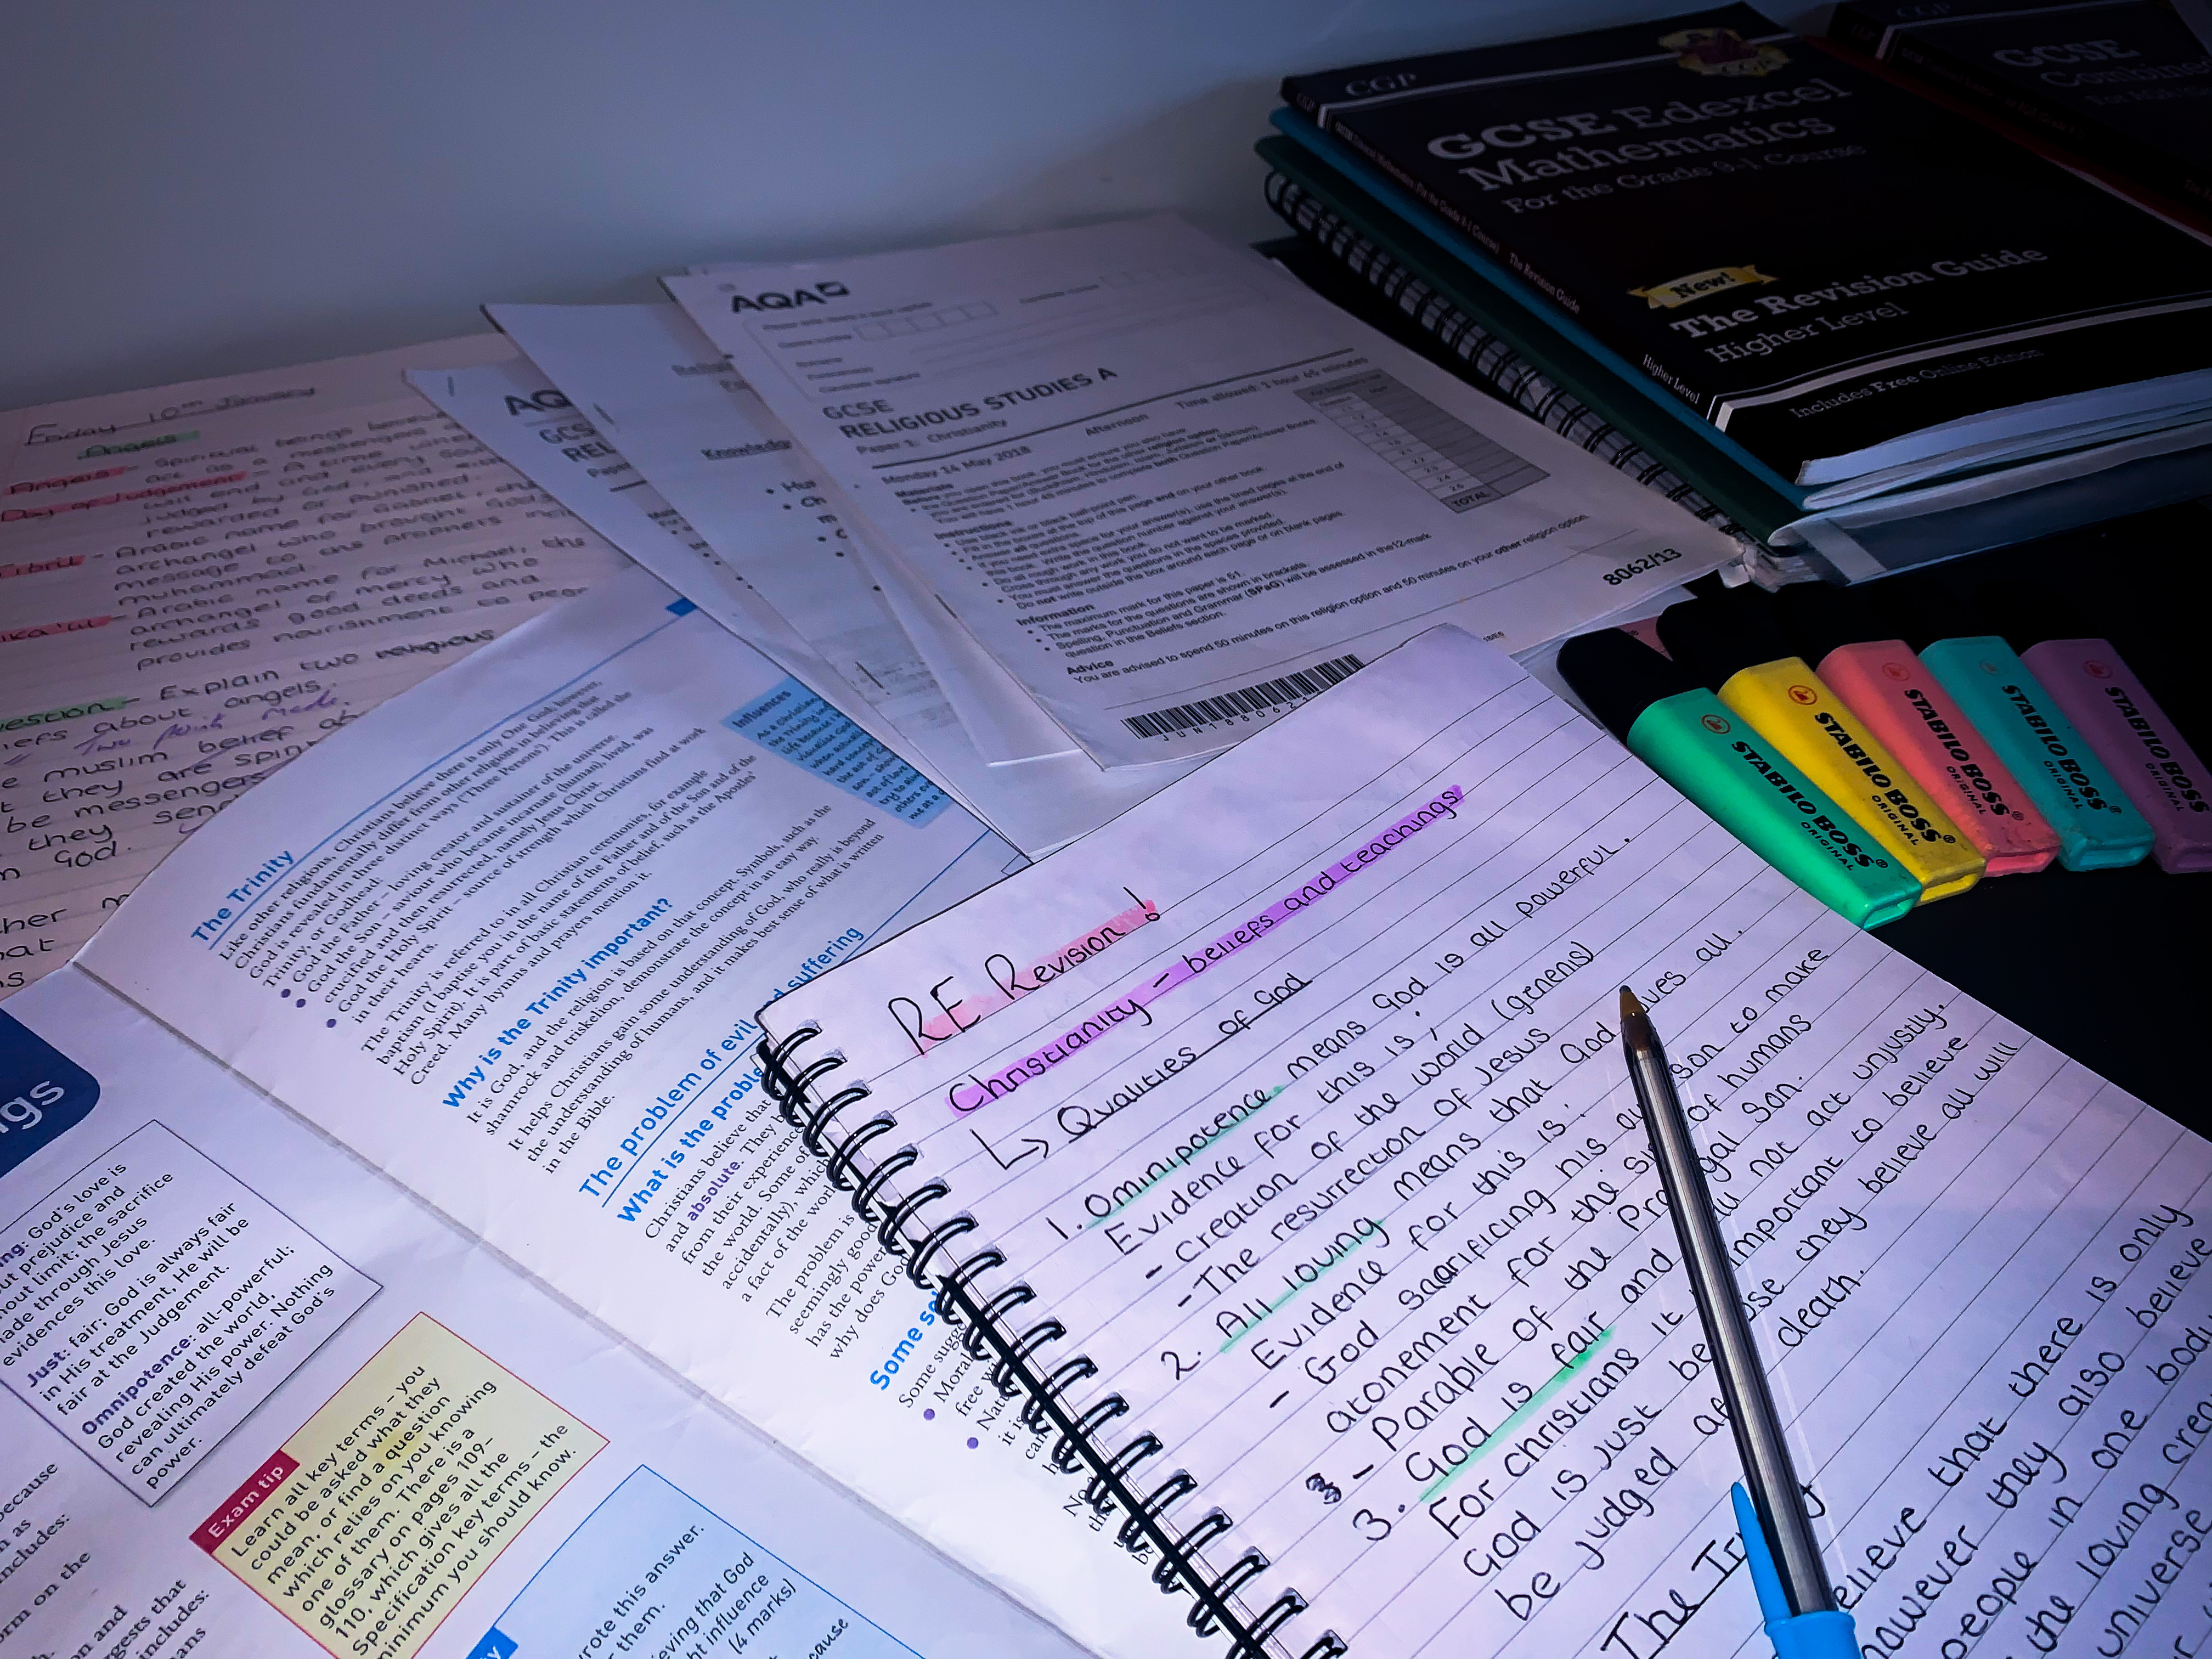
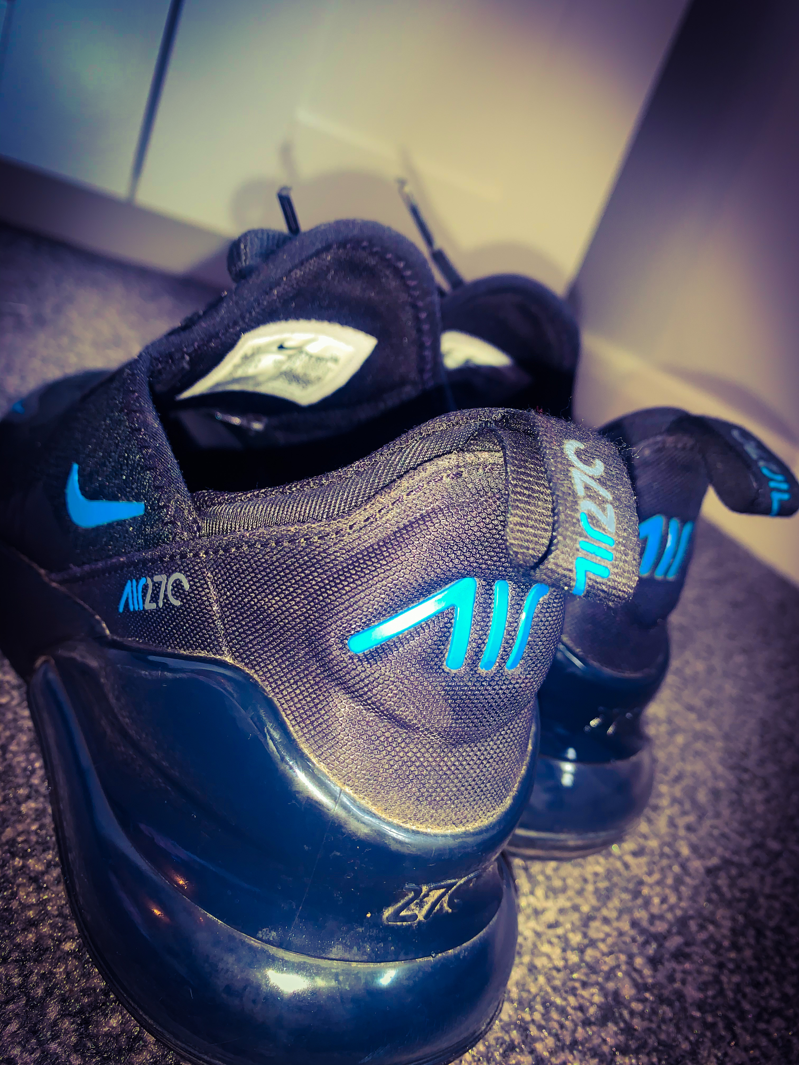
This morning, I watched a few more episodes of the ‘Originals’ and then decided to revise some RE topics and complete some revision tasks on Seneca learning. Then around 3pm I wanted to get some fresh air so I went out on a run! At 8pm it was time to clap and appreciate all the hard work and effort the NHS are doing for us. It was amazing to see everyone in our community taking part.
Week 1, Day 3
I used my I Phone XR to take these shots.
I then edited them by using Adobe Photoshop Express.
For both of these images when editing I tinted them a slight blue colour and increased the contrast on both images.

Slide 5
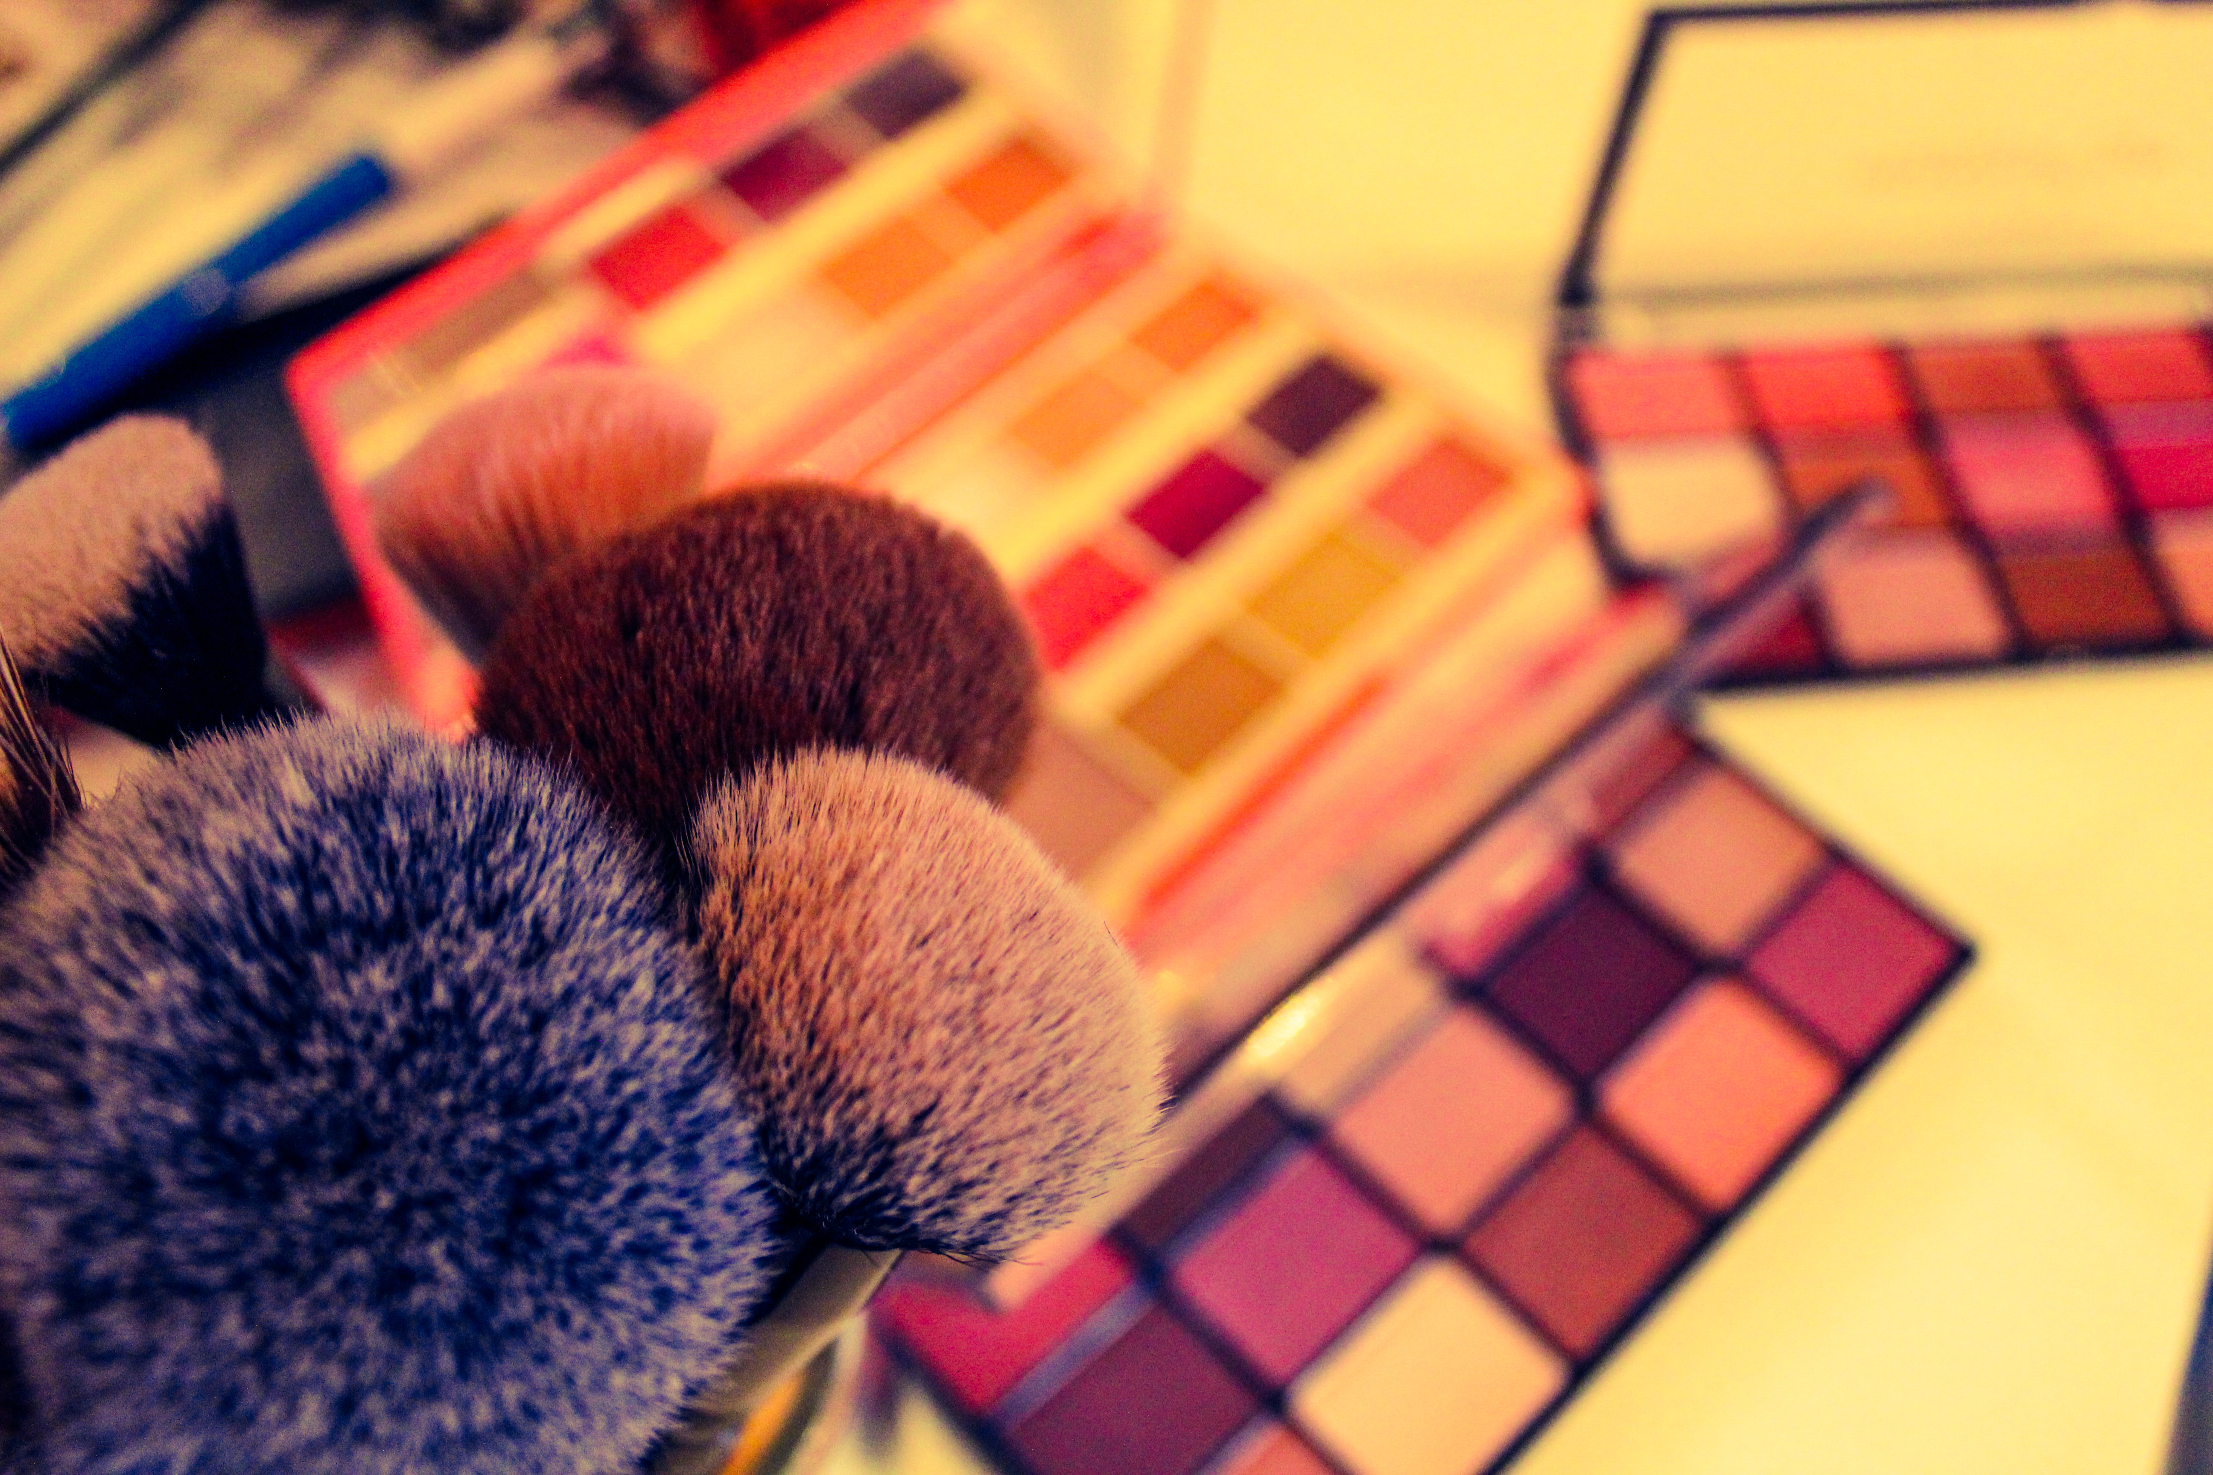
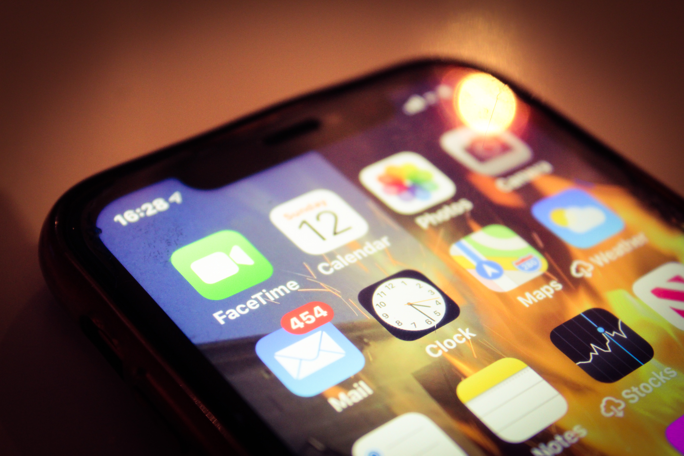
My mum and dad thought it would be a good idea for us all to have a “party” tonight and for us to have a group facetime with all my family. She wanted us all to get dressed and for me and my sister to do her makeup & hair! I went for my afternoon run and completed my workout but then it was time for me to start getting ready! There was lots of laughs and singing whilst we facetimed our family. It was so fun!
Week 1, Day 4
I used my Canon SLR Camera to take these shots.
I then edited them by using Adobe Photoshop Express.
For the top image, I increased the brightness of the image and adjusted the contrast slightly.
However for the bottom image I decreased the brightness and added a dark shadow around the edges.

Slide 6
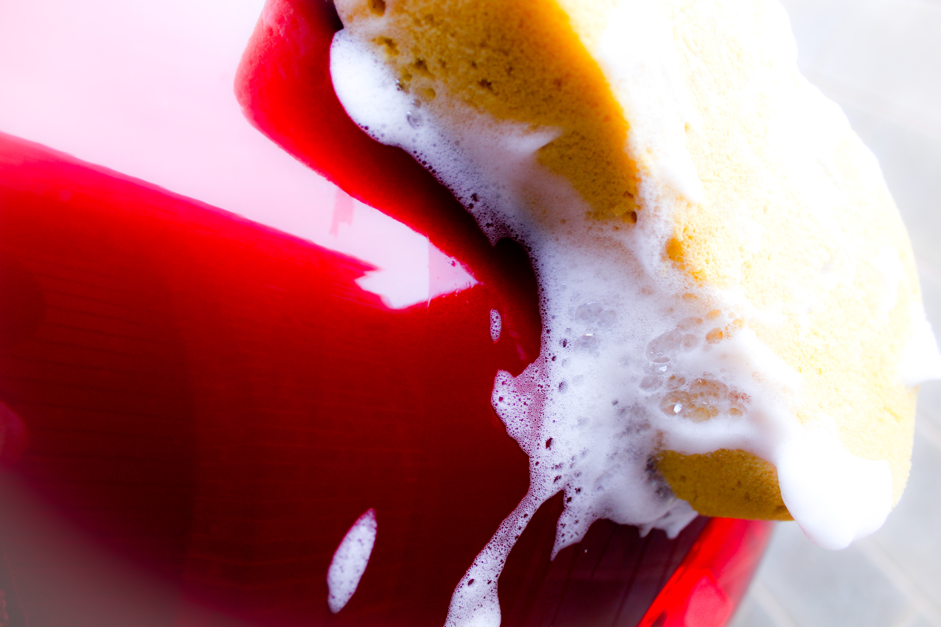
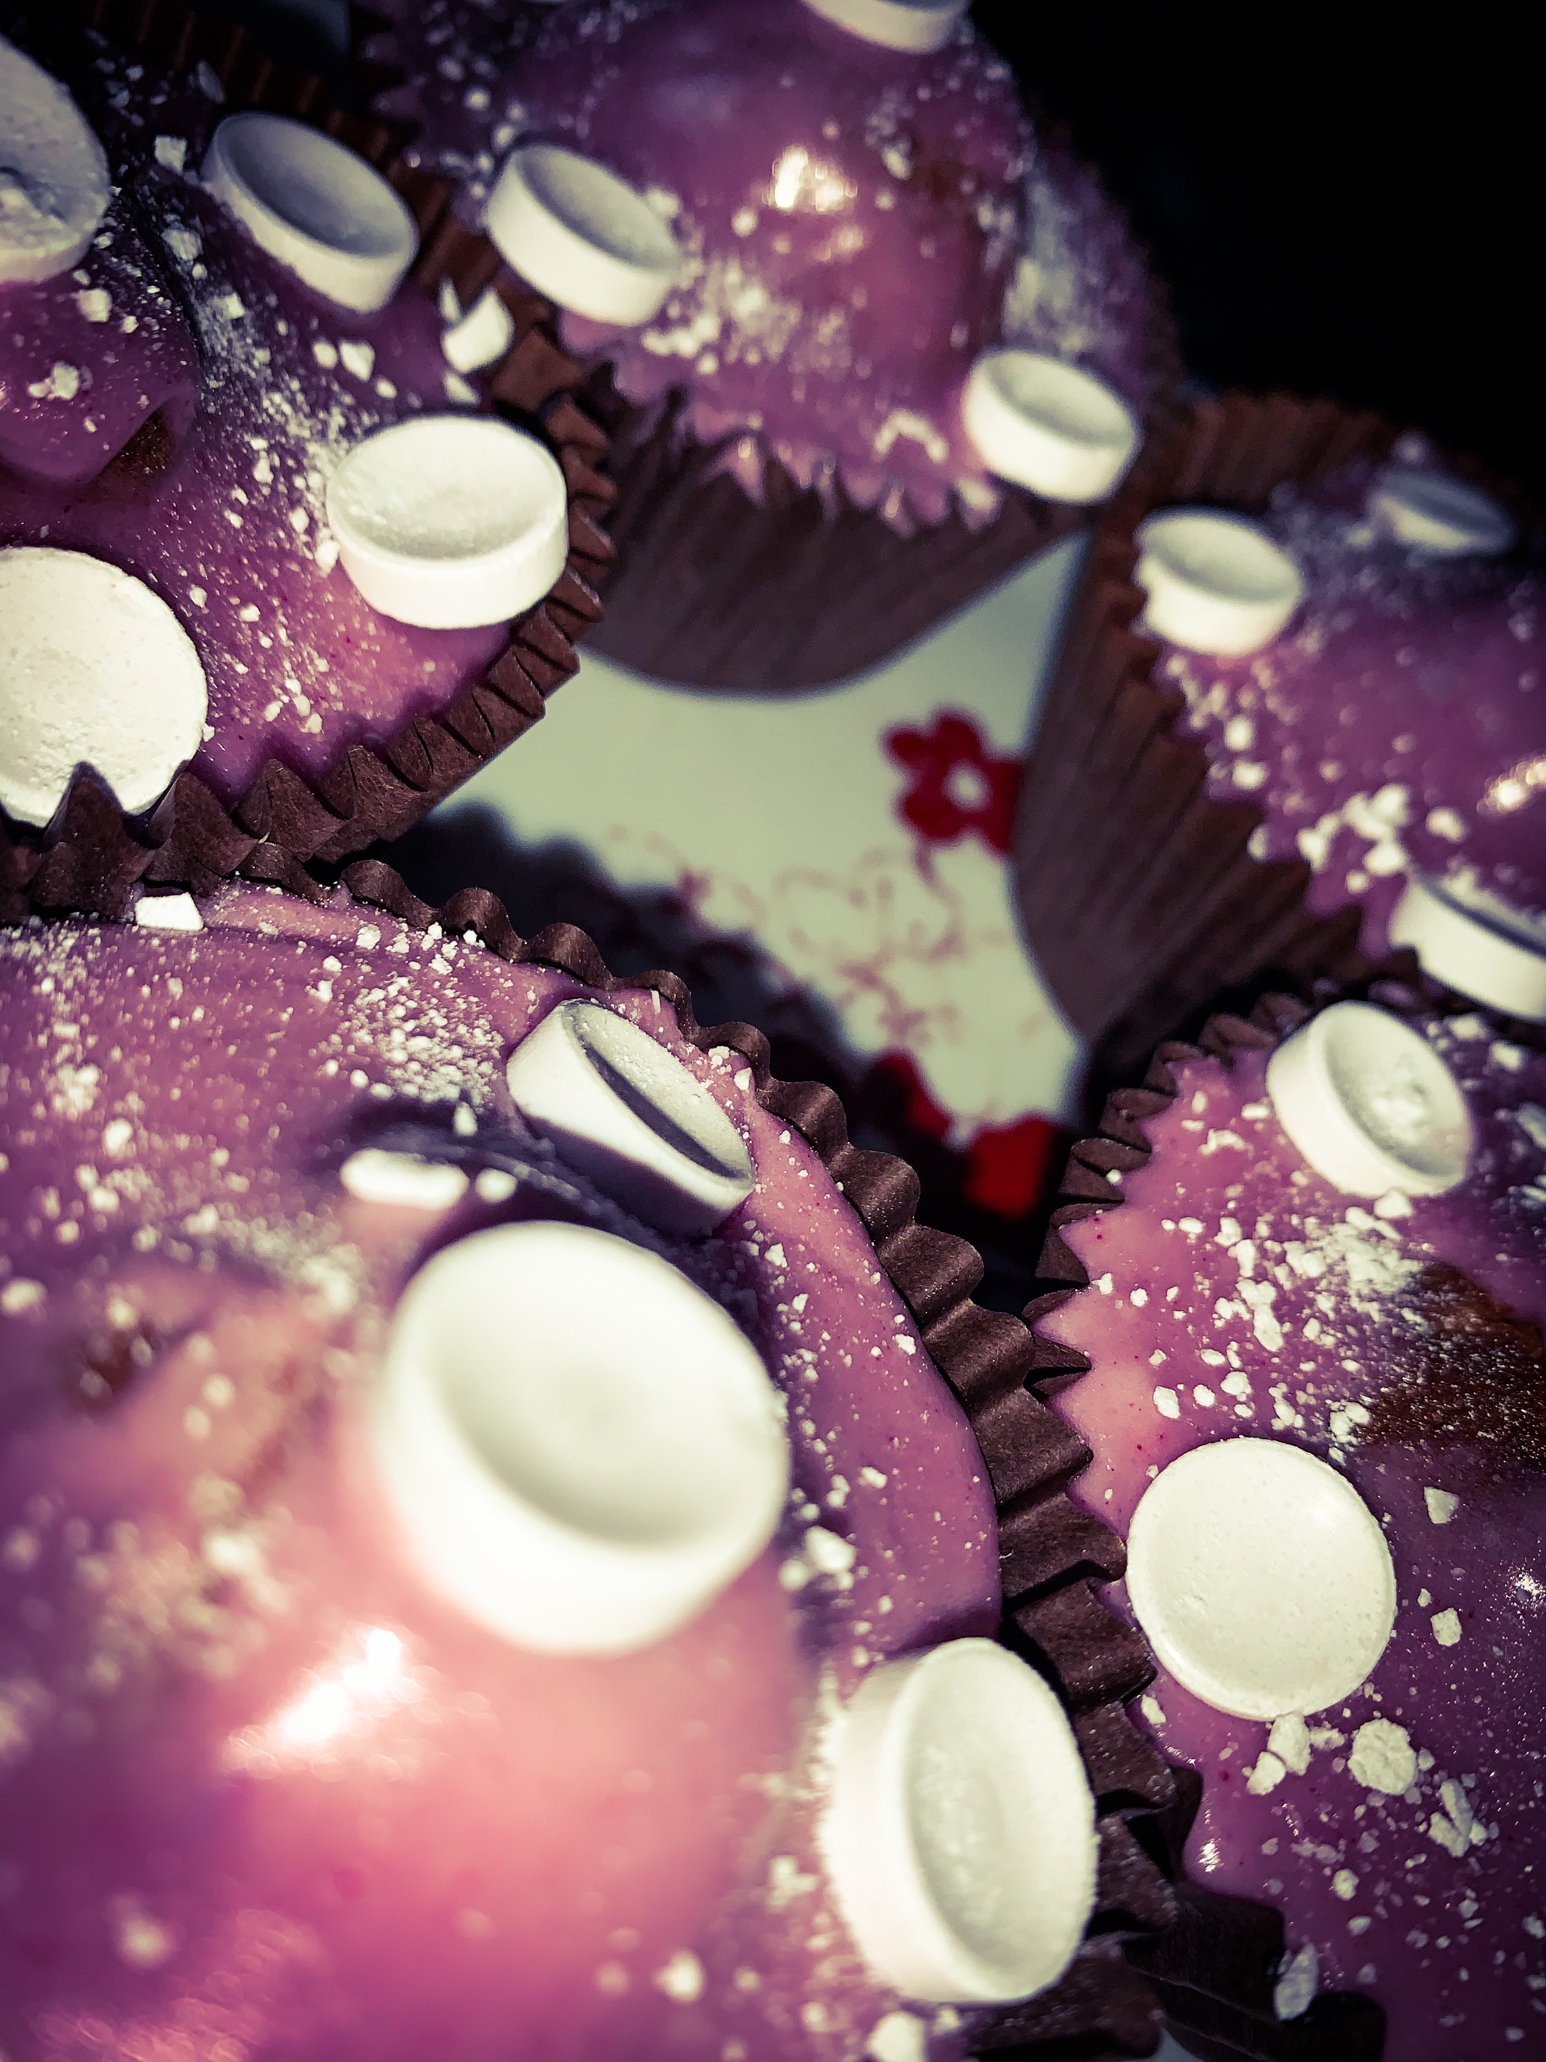
As it was a nice, spring morning I thought it would be a nice idea to wash my mums car! It took us ages and I was soaked at the end but it was lots of fun. Then later on I wanted to do some baking. So I made some Parma violet cupcakes – they were delicious. Even though I cooked them for a bit longer than I should have, they still turned out alright.
Week 1,Day 5
I used my Canon SLR Camera to take these shots.
I then edited them by using Adobe Photoshop Express.
I thought it would look really effective if I adjusted the highlights of the image and reduced the dark shadows.
In the second image I increased both the contrast and saturation.

Slide 7
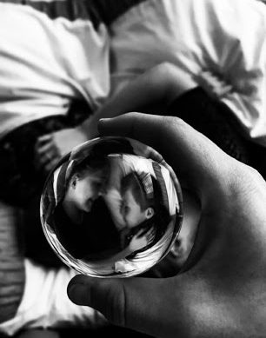
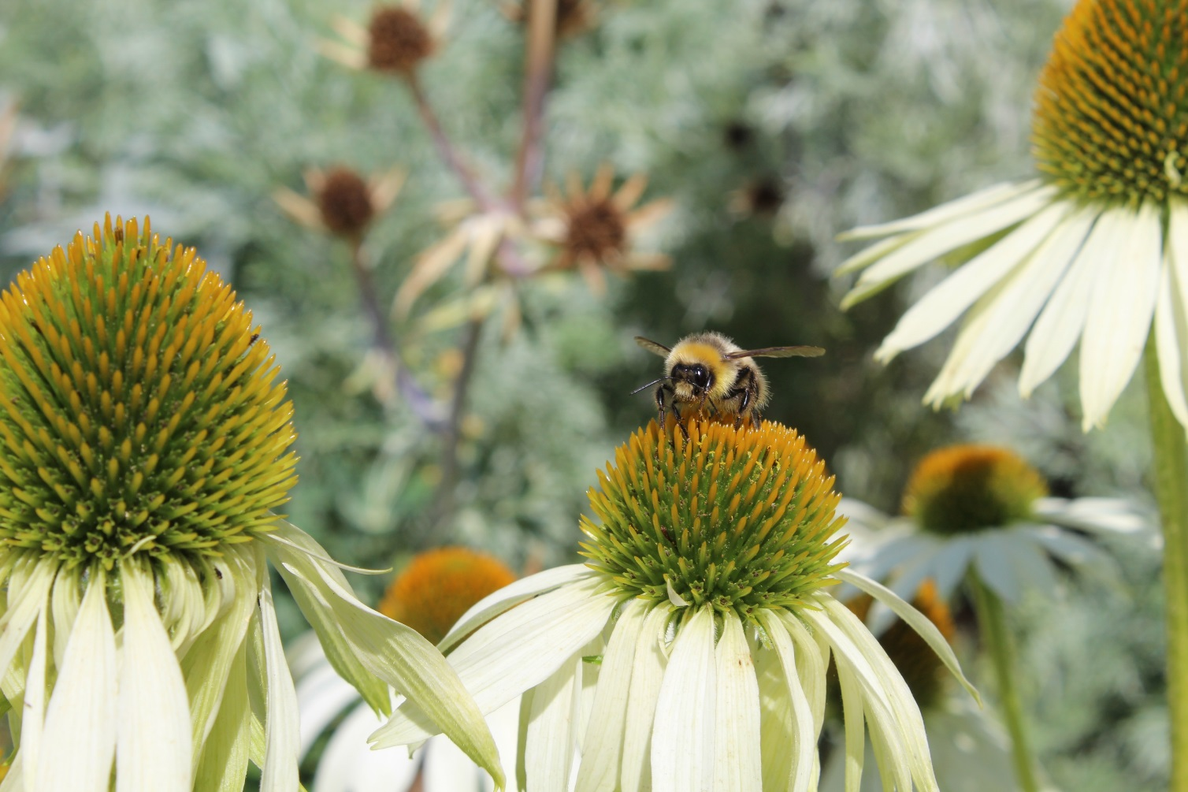
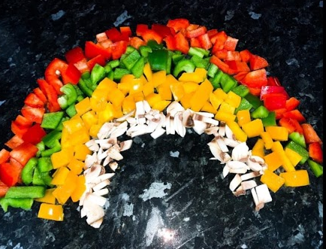
Week 1, Day 6
I used my Canon SLR Camera to take these shots.
I then edited them by using Adobe Photoshop Express.
This morning was quite fun as I had been busy helping my brother with his school work! However this afternoon I had found out that a local photographer had started a photography challenge! The aim was to take a shot based on the theme for that particular day. Then at the end of everyday she will choose a winner and they will be given a discount code, however at the end of the week, she was going to choose an overall winner. These are some of the images I entered into the competition and I actually ended up winning with one of my photographs!!
I edited the black and white image by using the ‘HiContrast’ effect and then making the image a lot sharper.
For the rainbow image, I decided to increase the saturation to show of the different colours of the image.
Then for the final image, I thought it would be best to actually leave it as the original image.
(This was my winning image)

Slide 8
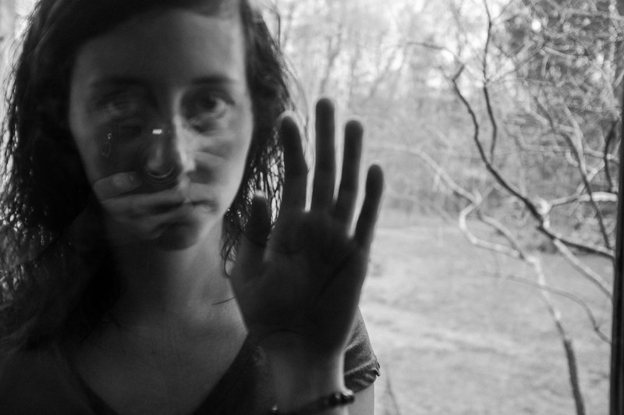
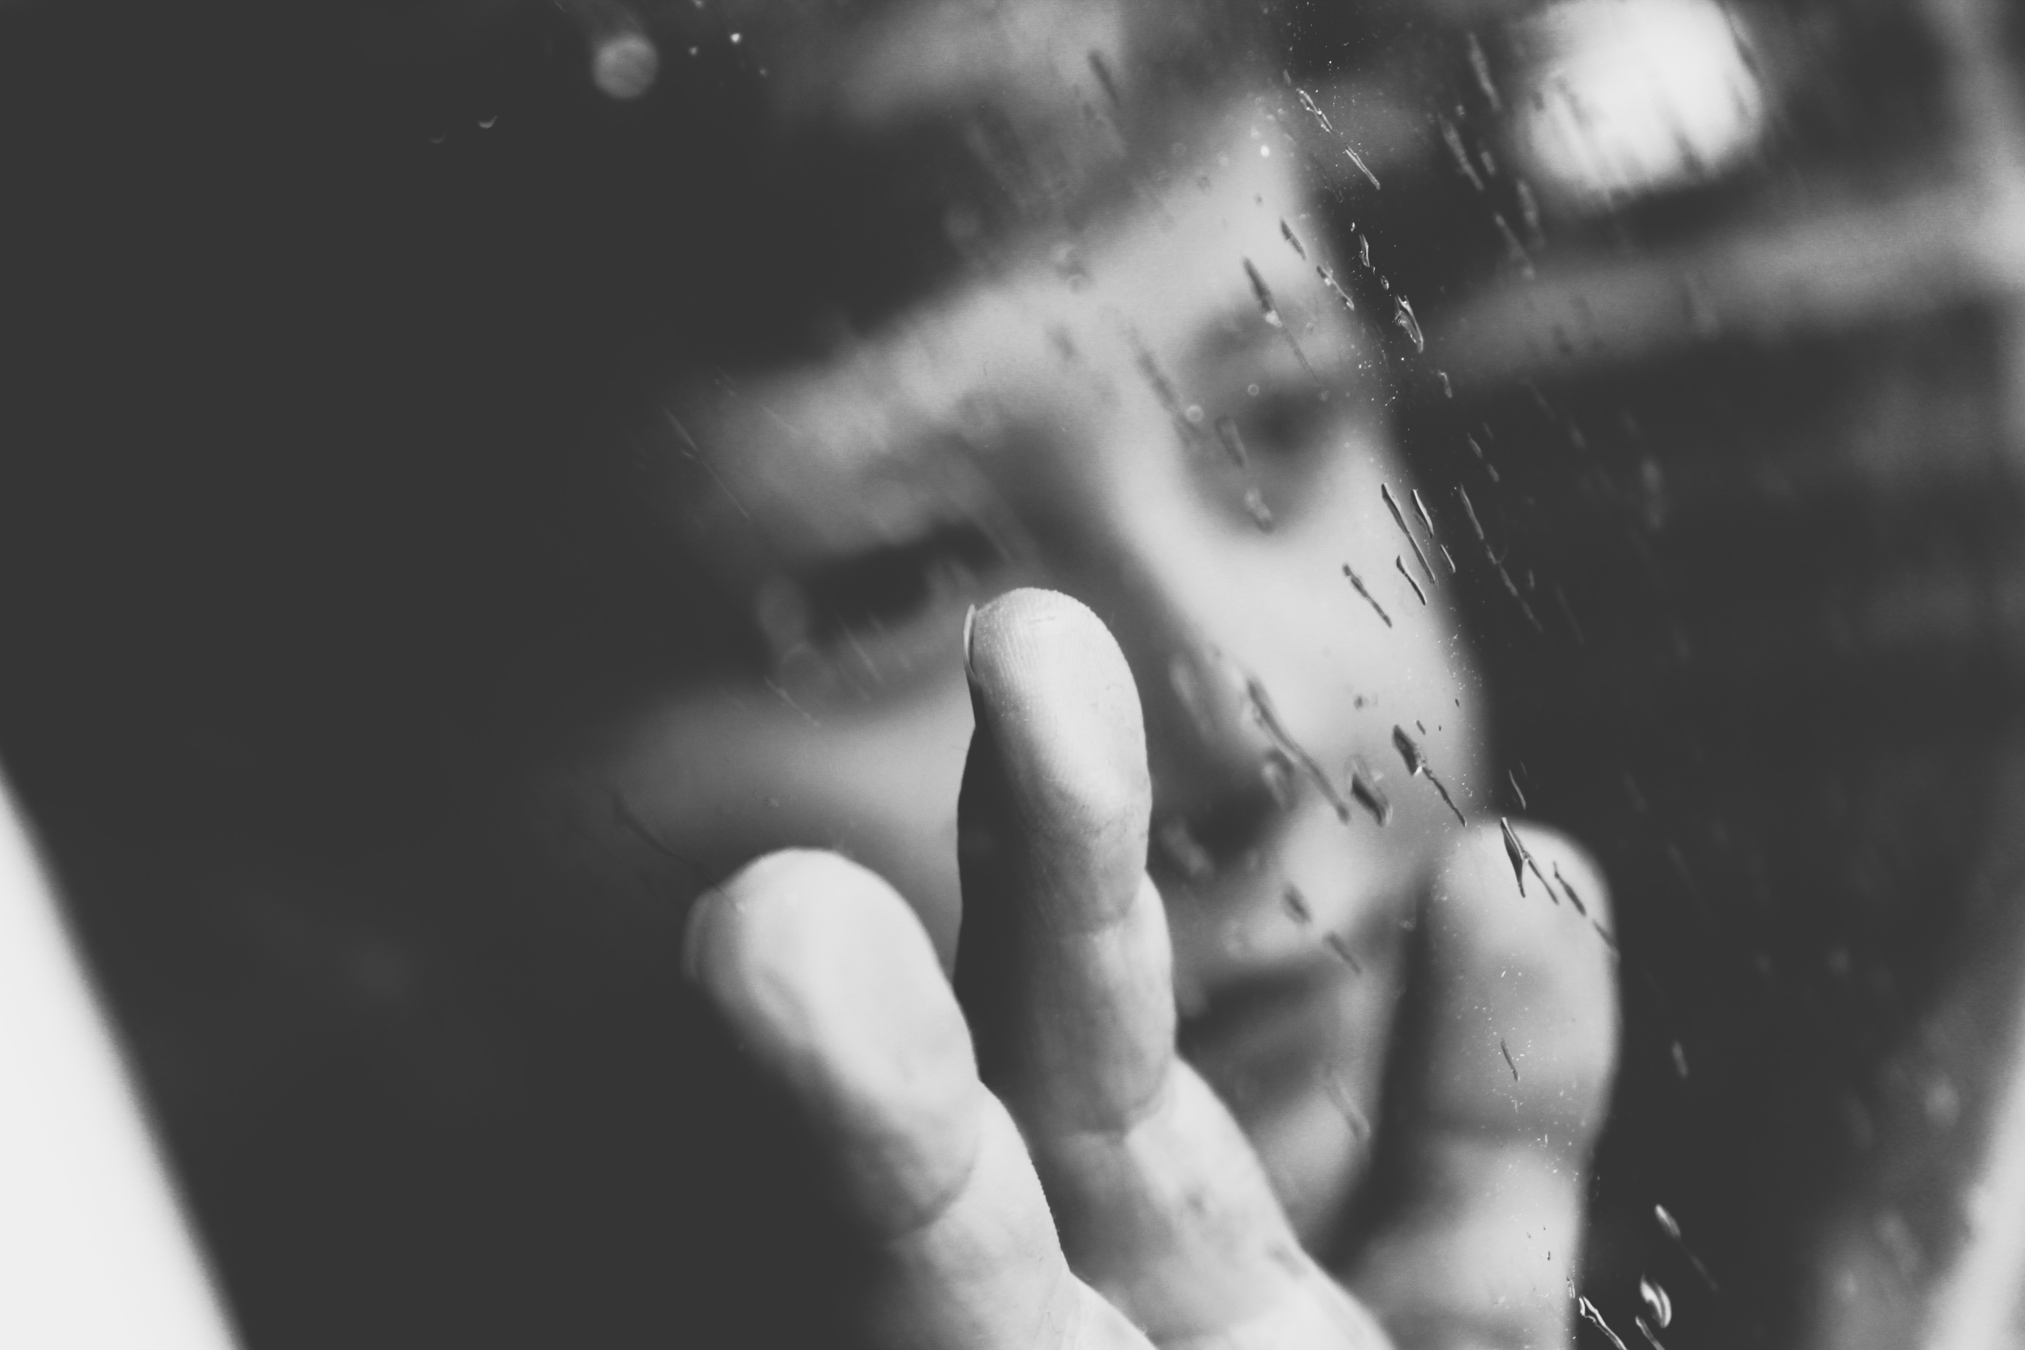
PETE KIEHART – COVID 19 PORTRAITS
‘Lockdown in the eyes of a 7 year old’
Today was like all the other days we have spent in lockdown, however instead today, the weather has been awful unlike the past few weeks! This meant we couldn’t go outside and play like we normally would. My 7 year old little brother has been so bored, he’s been getting his school work done but the boredom has just taken over. I captured some shots of him sitting at the window wondering when he will be able to go back to school and play with all his friends.
This picture shot by Pete Kiehart inspired me to take these shots as I thought the image shows a lot of emotion. The strong contrast in the black and white edits gives people a clearer understanding of what life is like for young children during this period of time.
I used my Canon SLR camera to take these shots.
I then edited them by using Adobe Photoshop Express.
They were shot through the glass window on a cloudy rainy day.

Slide 9
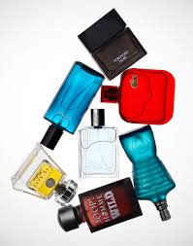
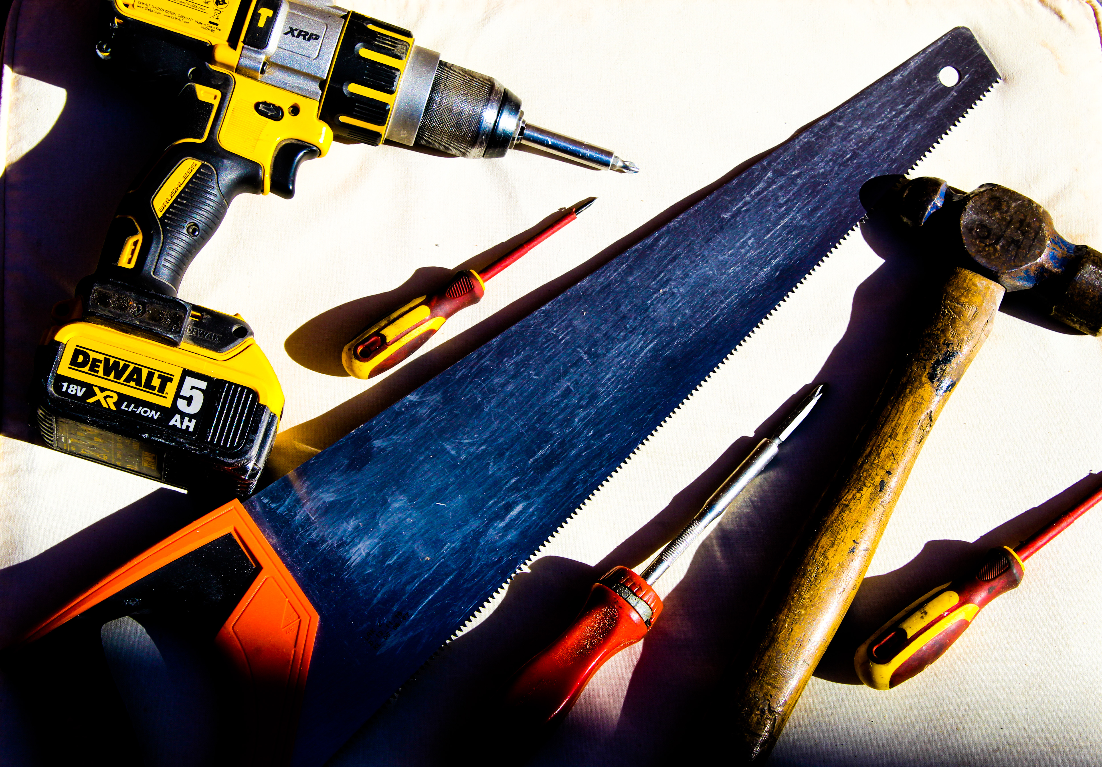
STEVE GALLAGHER– STILL LIFE
My photography task this week was to take two shots of still life objects that I have been frequently using during my time of lockdown! As I have been using a lot of tools to build different things, I thought it would be a really good idea to take some shots of the different coloured tools I have used. I had to take the shot from a birds eye view perspective so I stood on a chair and stood above the tools with my camera and took the shot.
This image shot by Steve Gallagher really inspired me. I love the simplicity in the photographs. The way the objects are positioned is very effective in this photograph. I will be creating my own image in the style of this.
I used my Canon SLR camera to take these shots.
I then edited them by using Adobe Photoshop Express.
I increased the brightness and contrast of the image so it would look a lot more bolder and effective.

Slide 10
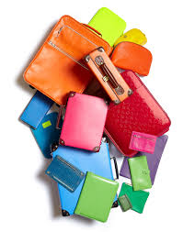
STEVE GALLAGHER– STILL LIFE
‘A busy week at school’
Even though we may be in lockdown, I have still been carrying on with lots of school work to keep me busy!
This morning, I was busy learning all about Beta Decay in science so whilst I had the chance I decided to get out my camera and take a few shots of all my equipment. After all, the task for this week was to take some images of things that I have used the most during this lockdown – this was the perfect opportunity!!
This image shot by Steve Gallagher really inspired me. I love the way the image is set out with all the different objects layout on top of each other. The vibrant colours make the image really stand out on top of the white background.
I used my Canon SLR camera to take these shots.
I then edited them by using Adobe Photoshop Express.
When editing this image, I used the vibrance tool to make sure the colours stood out.

Slide 11
I used my I Phone XR to take these shots.
I then edited them by using Adobe Photoshop Express.
ALPHABET PHOTOGRAPHY
I used my initiative to think of different ways I could produce the letters of the alphabet whilst actually taking the shot.
I have produced the letters by using a range of different objects and even fruit within my household, which can be seen in the letters…
A, B, C, D, F, K, O, P, R, T, Y
I had already found some pre-formed letters on a number of things such as wallpaper, drink cans, stickers, books and ornaments.
These can be seen in the letters…
E, G, J, M, N.
Finally, some of the letters were already formed into the letters of the alphabet, which can be seen in the shots..
H, I, L, Q, S, U, V, W, X, Z.
After I had completed the alphabet, I formed my own personal positive message which best describes my lockdown life!! This can be seen on the next slide.

