Slide 1
Lockdown photo diary
Lucy Naisbitt

Slide 2
Entry Number one
This photo was from one of my first full days at home. My sister and I both decided to bake a cake to pass time and this was the outcome. We try to bake or cook something at least once every week.
Shot using iPhone 7 – edited in snapseed.

Slide 3
Entry Number two
During the week, last week, my dad and I striped the wallpaper from a wall in my living room and then put up the new wallpaper that you can see in the photo. I enjoyed doing this as it gave me something to do during quarantine, and it is different that what I would normally be doing.
Shot on iPhone 7 – edited in snapseed.

Slide 4
Entry number three
This picture is of a fire that happened near Ainsworth late on the 21st of April. We first saw a post about it on Facebook and went to go see it – however we never got out of the car and only me and my dad went. I took this picture to show my mum but decided to edit it and put it in this power point as I think it is interesting.
Shot on iPhone 7 – edited in Snapseed.

Slide 5
Entry number four
During this quarantine, me and my dad cleaned out the shed in our back garden. We then decided to put up our hot tub that was in the shed. This is a picture from when we first put it up and the sun was shining on it.
Shot on iPhone 7 – edited in Snapseed.

Slide 6
Entry number five
This is a picture from the same day as the last entry, as this is everything that we and going to throw away out of the shed after quarantine. I decided to take and edit this picture as the colours of the bikes, the slide and the cage contrasted as I changed the tones.
Shot with iPhone 7 – edited in Snapseed.

Slide 7
Entry Number six
This is my take on the task this week, which was to try Pete Kiehart Black and White portraits. I took this picture in my back garden using a mirror from my house. I liked this picture because it shows the outline of the mirror and the figure and background.
Shot on iPhone X – edited in Snapseed.

Slide 8
Entry number seven
This is another on of my takes on this weeks task of create a black and white image by taking inspiration from Pete Kiehart. I also look this picture in my back garden but this time I put the mirror on the outdoor table and placed the model in the eye line of the mirror. I like this picture because you can see how the colour of the sky contrast with the rest on the image when it is black and white and I like that the umbrella that is next to the mirror lines up with the umbrella seen in the mirror.
Shot using iPhone X – edited in Snapseed.

Slide 9
Entry number eight
This is my take on this weeks task that was based on Steve Gallagher’s real still life objects. For this image I used six sprays from my collection that I have, and I made sure they were all different colours so there would be a contrast to work with. I then spread they out along the surface of my desk and took a picture of them from a top view. I then edited the image to really bring out the contrast of the colours.
Shot using iPhone 7 – edited using Snapseed.

Slide 10
Entry number nine
This is my favourite for my take on this weeks task as these books are all different colours yet are very much related to each other. I don’t have a white surface in my house big enough to fit these six books on so I had to take this picture in my backgarden on the grass. This, however, made the photo look better, in my opinion, as there is a contrast between the colours of the books and the grass.
Shot using iPhone 7 – edited using Snapseed.

Slide 11
Entry number ten
This is my third of four takes on this weeks task and I think this is the closest to what someone would describe as on of Steve Gallagher’s still life objects. I think this because it is on a white background and it is just one single object. I edited this purely to bring out the red colour of the shuttlecock that was just in my garden.
Shot using iPhone 7 – edited using Snapseed.

Slide 12
Entry number eleven
This is my final attempt at this weeks task using still life objects. I took this photo because I use this head band nearly everyday and it reminds me of when I went to France. I also took this photo as it would be an easy object to photograph and edited as it is mostly all black and would contrast well on the white background.
Shot using iPhone 7 – edited using Snapseed.

Slide 13
Entry number twelve
This week’s task was to attempt alphabet photography so this is my take on that. For most of these I used inanimate objects from my room and put them together to make the 26 letters of the alphabet.
All shot using iPhone 8 – edited using Snapseed.

Slide 14
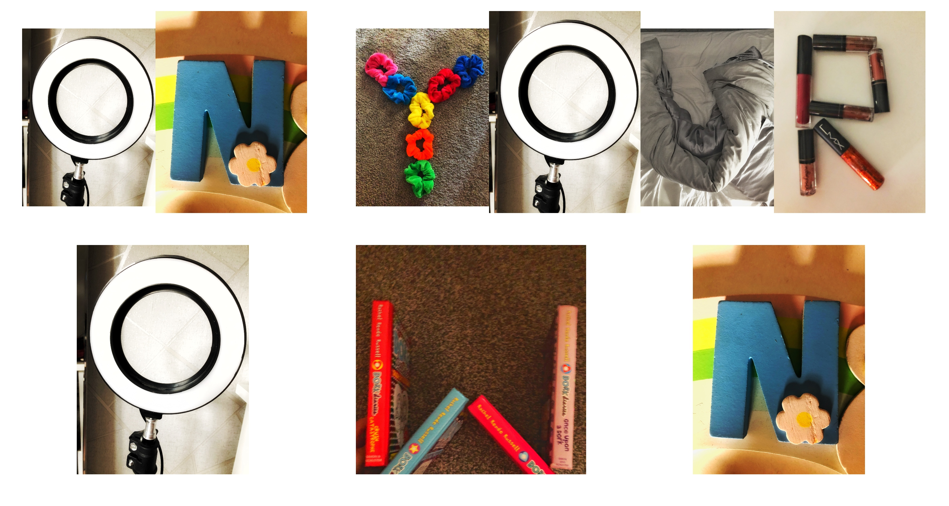
Entry Number thirteen
‘REMEMBER YOU ARE NEVER ON YOUR OWN’
I decided to write this using my alphabet photography because it reflects how I felt at one point during this lockdown and it reflects a positive message for people thinking there is no one that’s there for them. I also used this quote as it is a song lyric from one of my favourite One Direction songs.
All shot using iPhone 8 – edited using Snapseed.

Slide 15
Entry number fourteen
‘WE ALL HAVE A VOICE LETS USE IT’
I decided to write this message with my images because I feel passionately about what is going on in the world and especially in America right now, and I feel like we should all try to help in some way.
All shot using iPhone 8 – edited using Snapseed.

Slide 16
Entry number fifteen
‘HELP LOCK DOWN MIND’
I decided to write this with my alphabet photos because, during this lockdown, I feel like everyone thought they were going a bit crazy, so this is a way of expressing that feeling.
All shot using iPhone 8 – edited using Snapseed.

