Slide 1
Lines in photography
with an insight into vertical lines
Lucy naisbitt

Slide 2
What is line photography?
When in photography, a line is a point that moves our attention towards something. Our eyes are naturally drawn along the lines that we see.
These lines can be any shape; vertical, parallel, curved, diagonal and even horizontal. Some of these lines are obvious, however some are implied.
A line in an image moves the attention of the viewer from one part of the photo to another, just to move the focus along.

Slide 3

lines
As you can see in this image, there are multiple different lines. Some are implied and some are obvious.
The first lines we see are the vertical lines up the bench, from a viewers perspective. This leads the viewers eyes down these lines to the other end of the bench where we see buildings in the background.
We can also see the circular lines around the bench which do nit really lead anywhere but our yes focus on them anyway.
Finally, we can see lines from the buildings in the background of the photo, we do not see where these lead but it could make some people curious.

Slide 4
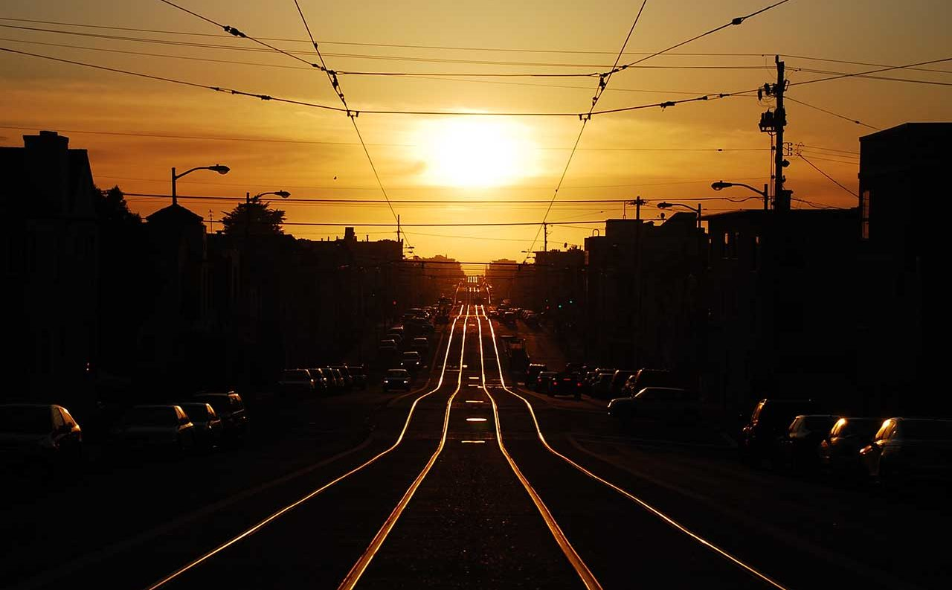
Lines
As you can see in this image there are two main types of lines; the lines on the floor leading up the hill which are vertical and diagonal, and the horizontal/diagonal lines in the sky, which are actually the overhead power lines.
The lines on the floor take our eyes on a journey up the hill, as that is where they lead.
However, the lines above take our eyes on a journey all over as they are horizontal, and horizontal lines represent movement.

Slide 5

lines
As you can see in tis photo, there are lines all over. The first lines that I can spit are the vertical ones on the decking. This takes my eyes up the decking and towards the building in the background.
I next see the lines on the benches leading my eyes towards the building as well.
Finally, I can see the vertical lines on the railings as the side of the image. This shows the height of the image.

Slide 6
Vertical lines in photography
Vertical lines in photography are strong and defined. They can represent height or even infinity, especially when you cannot see where they lead.
Vertical lines are rigid – they do not represent movement, unlike a horizontal line.

Slide 7

Vertical lines
There are vertical lines all over this picture as the buildings are straight. These lines in this picture show me the height that this picture is from and that there are lines absolutely everywhere.

Slide 8
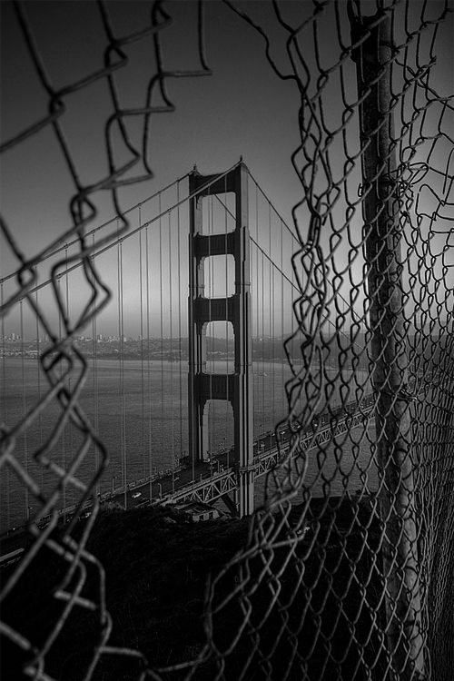
Vertical lines
In this picture, there are also vertical lines all over, as well as other versions of lines, like diagonal lines.
These vertical lines on the bridge show me the height of the bridge.
There is also a vertical line that makes up the pipe at the side of the image. This shows me infinity as we do not see where this pipe goes.

