Slide 1
Year 8 Maths
Remote Learning Planner Contents
Page 1 – Hegarty Maths Guide
Page 2 – This week’s Remote Learning Plan
Page 3 – Google Classroom - Extension Activities and Challenges

Slide 2
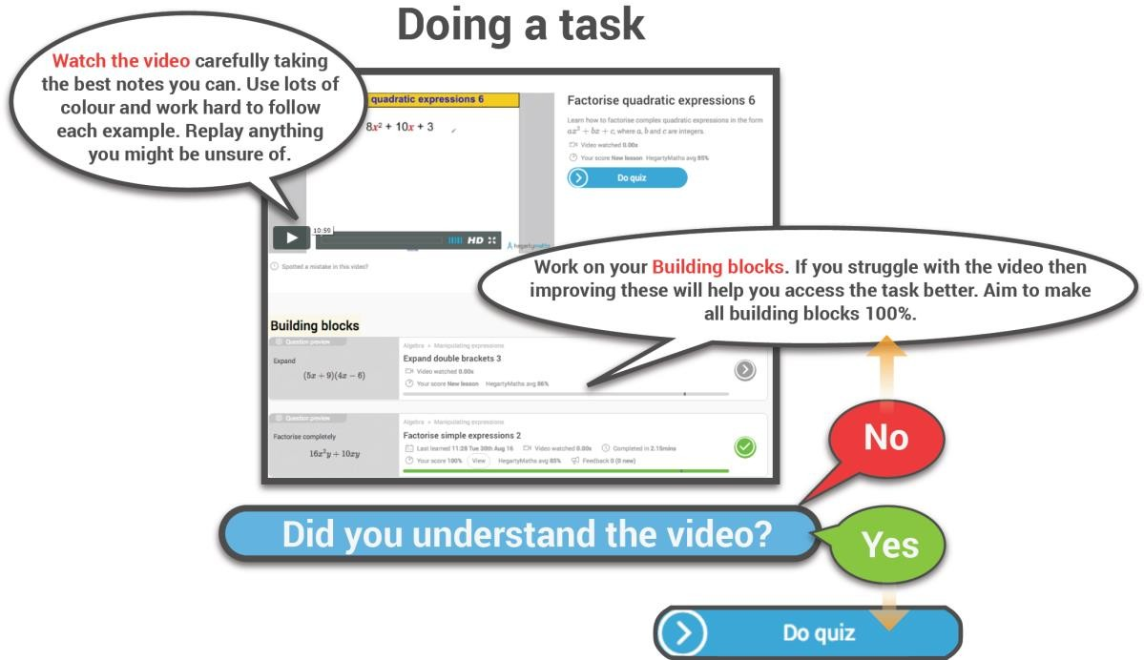
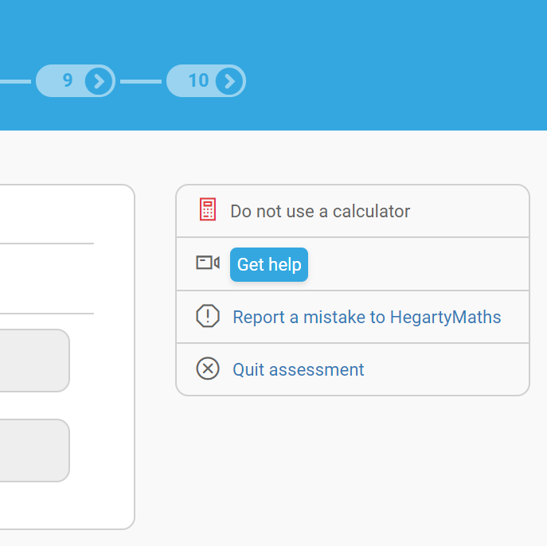
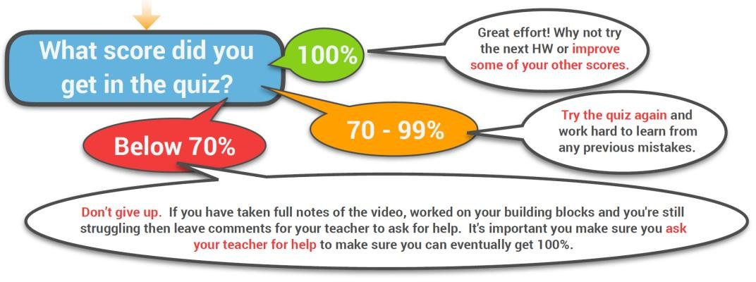
Hegarty Maths Guide
Page 1
Before looking at your Remote Learning Planner read the Hegarty guide below as to how best to use Hegarty Maths.
Due to the large volume of students in the country accessing Hegarty Maths, at times the site may run slow. This will improve as his team improve their servers. However, if you are experiencing problems then try using the site after 4pm when there will be fewer students logged on.
Need help during a quiz?
Show all of your working out on a separate piece of paper as this is where most the marks are awarded in an exam.
Click ‘Get help’ during a quiz and you will be taken to the exact same example in the Hegarty Maths video.

Slide 3
Week 8 – Remote Learning Plan
Page 2
Class | Task | Task Description | Hegarty Clip | Learning Map Reference | Relevent Link
8Ma1 | 1 | Truncation | 134 | 11-4 | https://hegartymaths.com
 | 2 | Circumference of a Circle | 534 | 12-1
 | 3 | Circumference of a Circle | 535 | 12-1
 | 4 | Forming Equations | 176 | 6-9
 | 5 | MemRi | - | Revision
8Ma2 | 1 | Truncation | 134 | 11-4 | https://hegartymaths.com
 | 2 | Circumference of a Circle | 534 | 12-1
 | 3 | Circumference of a Circle | 535 | 12-1
 | 4 | Forming Equations | 176 | 6-9
 | 5 | MemRi | - | Revision
8Ma3 | 1 | Truncation | 134 | 11-4 | https://hegartymaths.com
 | 2 | Circumference of a Circle | 534 | 12-1
 | 3 | Sequences from a picture | 196 | 2-1
 | 4 | MemRi | - | Revision
8Ma4 | 1 | Truncation | 134 | 11-4 | https://hegartymaths.com
 | 2 | Circumference of a Circle | 534 | 12-1
 | 3 | Sequences from a picture | 196 | 2-1
 | 4 | TT Rockstars | - | 2-4 | https://ttrockstars.com

Slide 4
Extension Activities and Challenges
Page 3
There are lots of Extension Activities and Challenges on Google Classroom (www.classroom.google.com).
Every student in Years 8 and 8 have been invited to the class using their school email address but you can also join the class using the following code - onowpq3 .
What’s in the classroom?
Weekly Maths Challenge
Times Table Rock Stars
Daily Maths Lessons (from White Rose Maths)
Maths Mastery Workbooks
Problem Solving Extension Tasks
Corbett Maths (5-a-day)

