Slide 1
Year 9 Maths
Remote Learning Planner Contents
Page 1 – This week’s Remote Learning Plan
Page 2 – Hegarty Maths Guide

Slide 2
Year 9 Maths – Remote Learning Planner
Mathematics work for all students in Year 9 is set on Google Classroom. Students have already been invited to their classes and therefore don’t need a code to join.
Once they have clicked on their Maths class within Google Classroom, students should click on the ‘Classwork’ tab at the top of the page to see the details for each lesson. They need to do this rather than simply looking at their ‘To Do’ list which will be missing a lot of tasks and information.
Details of how to access support from the Maths teachers are found on Google Classroom under the description ‘Feedback Friday’. It’s really important that students take advantage of this so that we can support them with any of the tasks. Outside of this time, students can email their teachers to ask for help, if required.

Slide 3
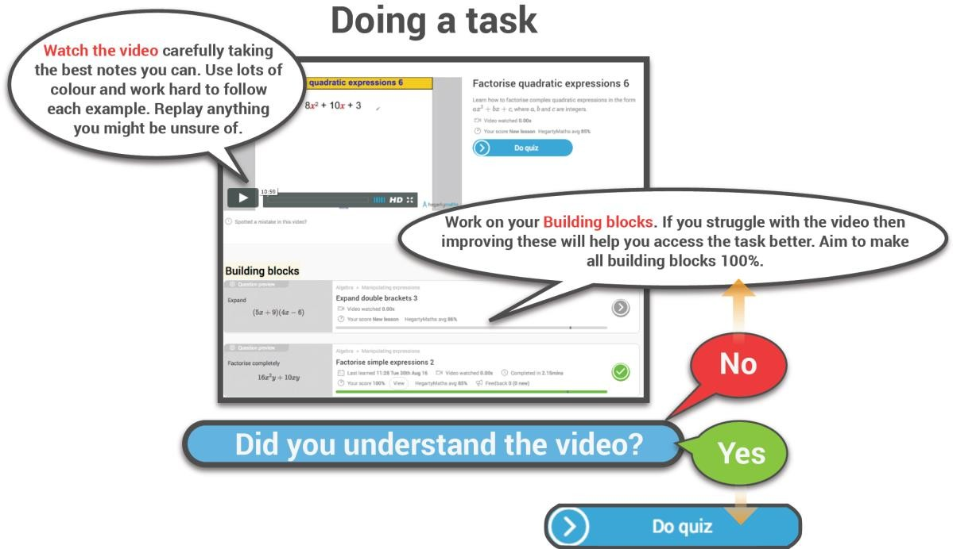
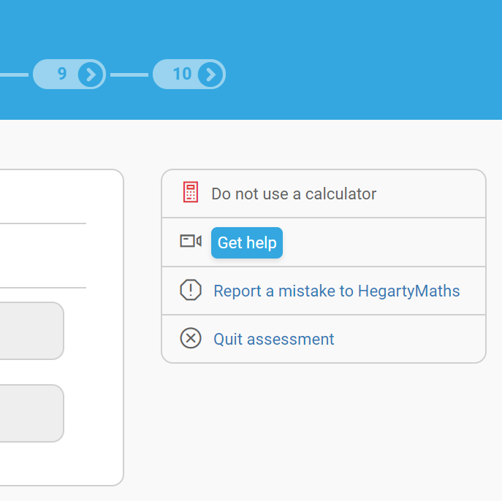
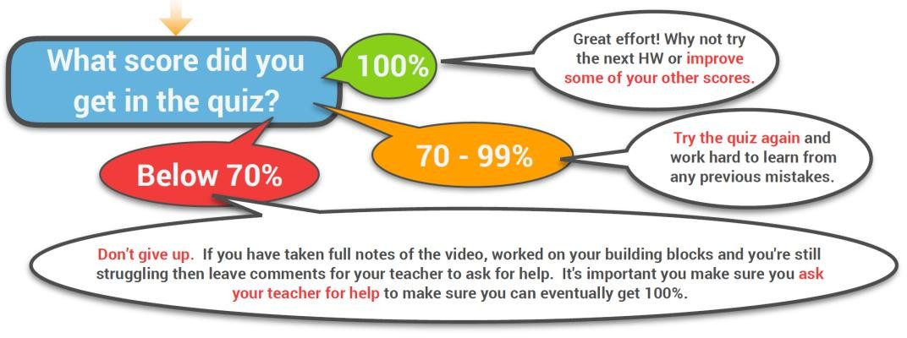
Hegarty Maths Guide
Page 2
Before looking at your Remote Learning Planner read the Hegarty guide below as to how best to use Hegarty Maths.
Need help during a quiz?
Show all of your working out on a separate piece of paper as this is where most the marks are awarded in an exam.
Click ‘Get help’ during a quiz and you will be taken to the exact same example in the Hegarty Maths video.

