Slide 1
My Lockdown Diary
Abby Downing

Slide 2
Brief
Over the next few slides I am going to show ten images I have taken whilst in lockdown. I am going to include the photo itself, the date the image was taken, a paragraph explaining why I took the image, what I took the image with and what I used to edit it.

Slide 3
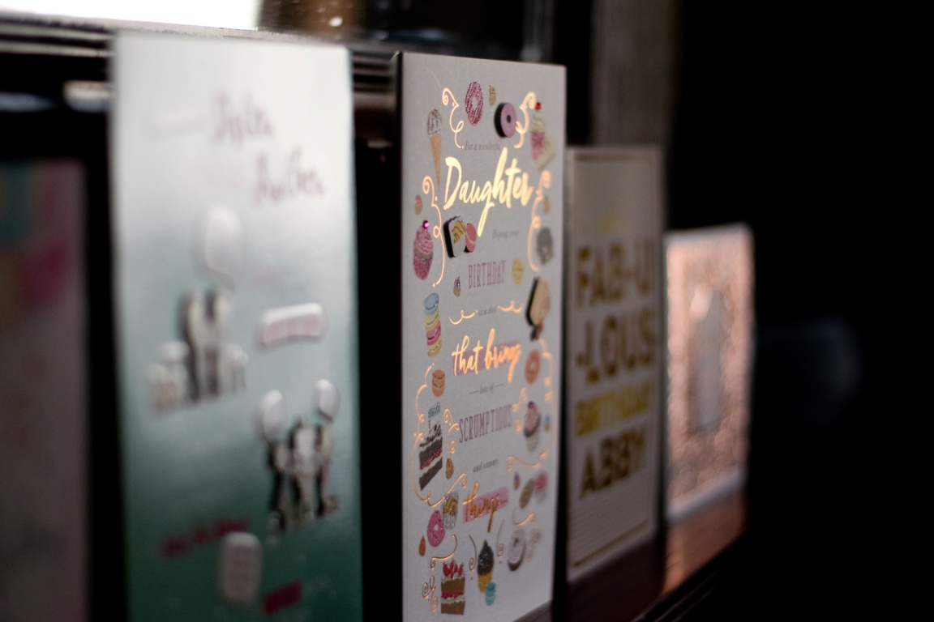
I took this image because yesterday I celebrated my birthday but wasn’t able to leave my house because of being in lockdown. The image was taken using a Nikon D3300 and edited in Lightroom.
1st
April
2020

Slide 4
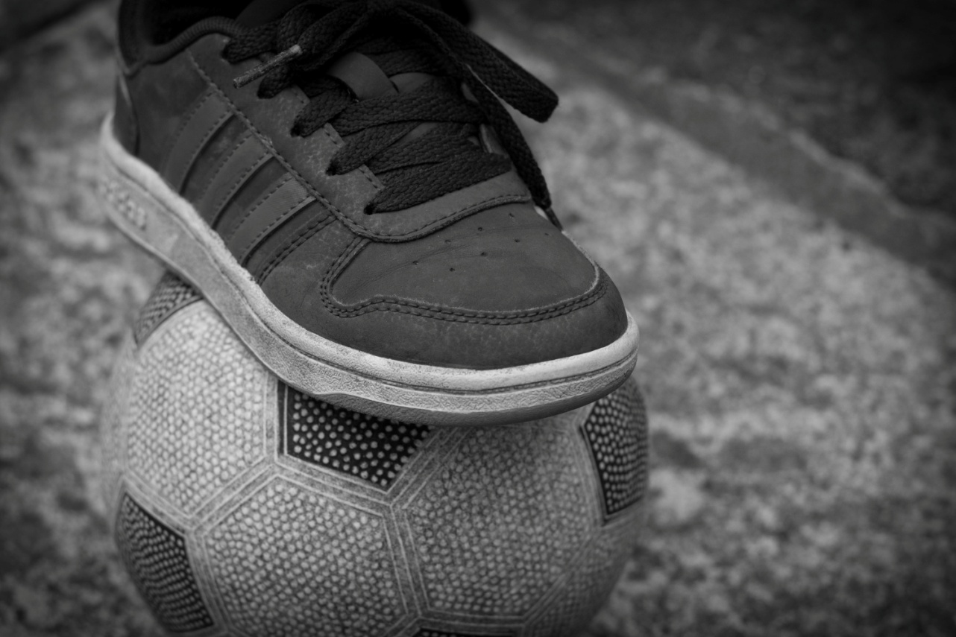
I took this picture because during lockdown I have spent a lot of time playing football with my brother. I used a Nikon D3300 to take the image. I used Lightroom to edit this image.
2nd
April
2020

Slide 5
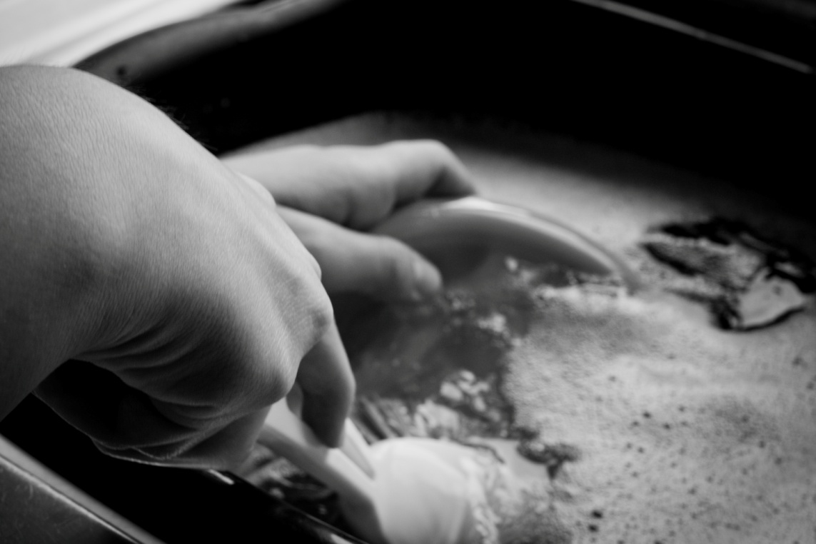
I took this image because this is a daily task that we still have to do even in lockdown. This image was taken using a Nikon D3300 and was edited using Lightroom.
3rd
April
2020

Slide 6
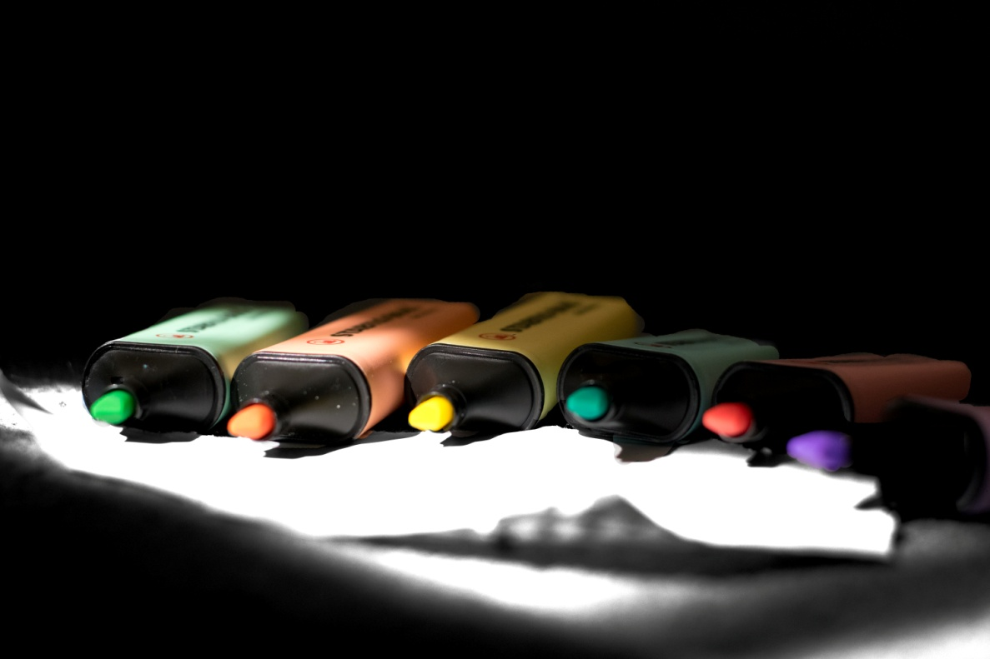
This was an image I decided to take to show that during lockdown we still have to work. This was taken using a Nikon D3300 camera and edited using Photoshop.
4th
April
2020

Slide 7
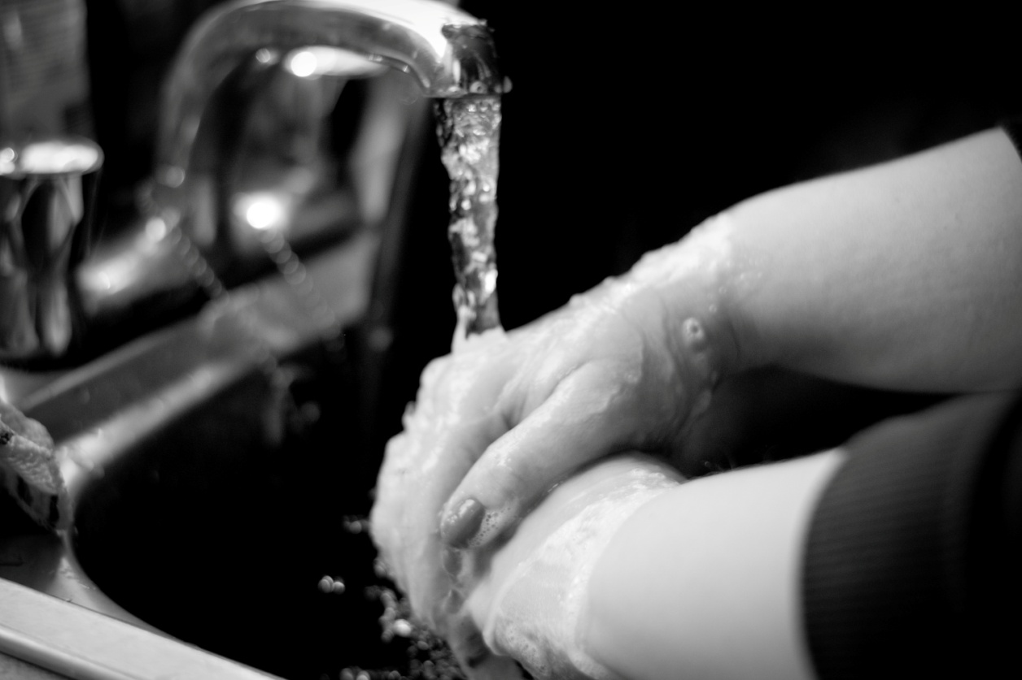
The purpose of this image is to show how careful we have to be and how we need to be keeping clean because of the virus. This image was taken with a Nikon D3300 camera and was edited in Lightroom.
5th
April
2020

Slide 8
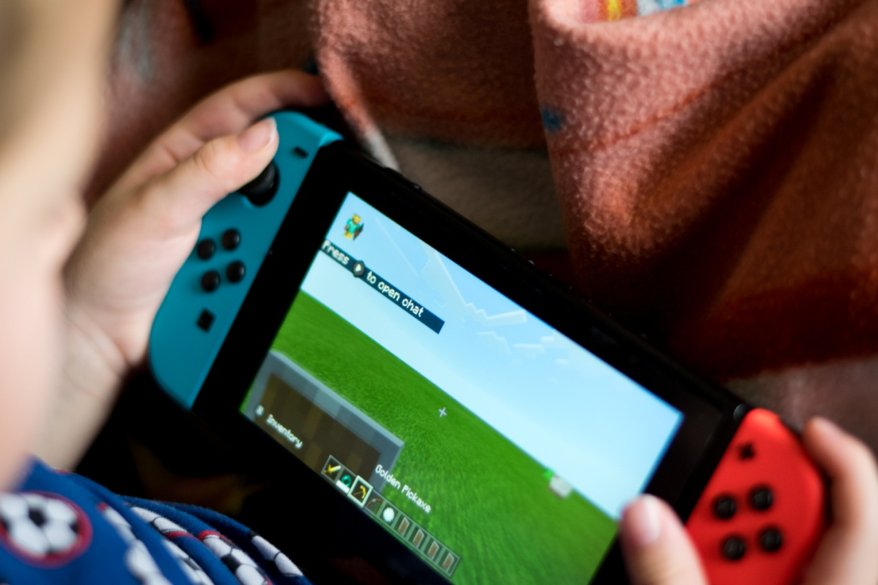
This image shows one of the things that we have been doing during lockdown. The image was taken with a Nikon D3300 camera and edited in Lightroom.
6th
April
2020

Slide 9
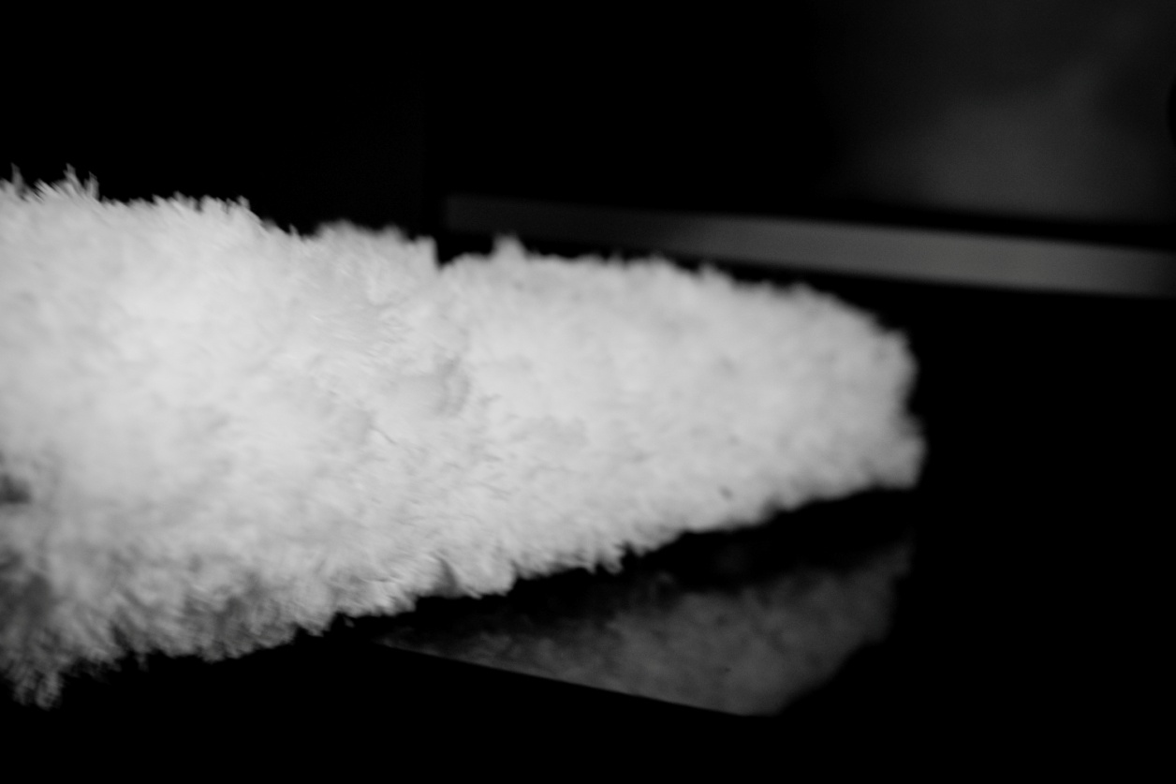
This image shows another daily task that has to be completed even when in lockdown. The image was edited in Lightroom and taken with a Nikon D3300 camera.
7th
April
2020

Slide 10
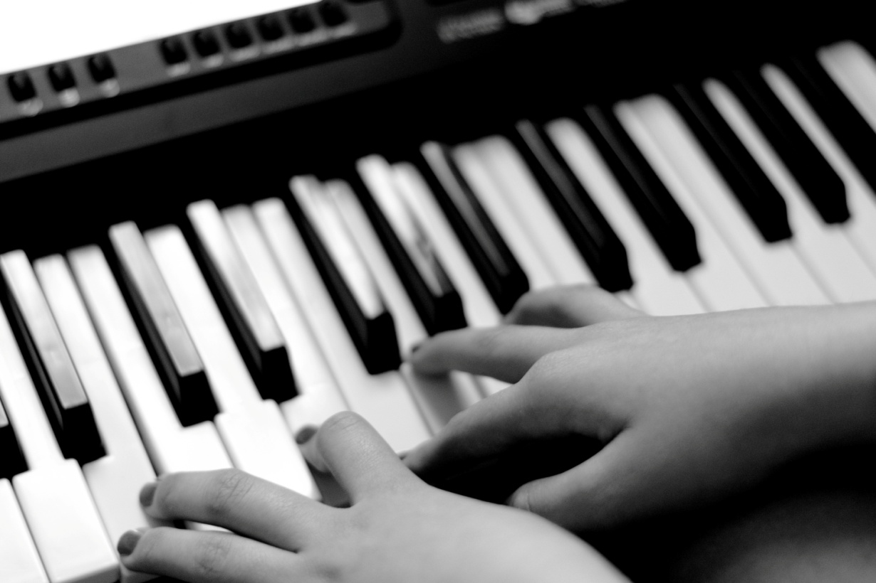
This shows another thing that my family have been doing to keep busy during lockdown. The photo was taken using a Nikon D3300 and edited with Lightroom.
8th
April
2020

Slide 11
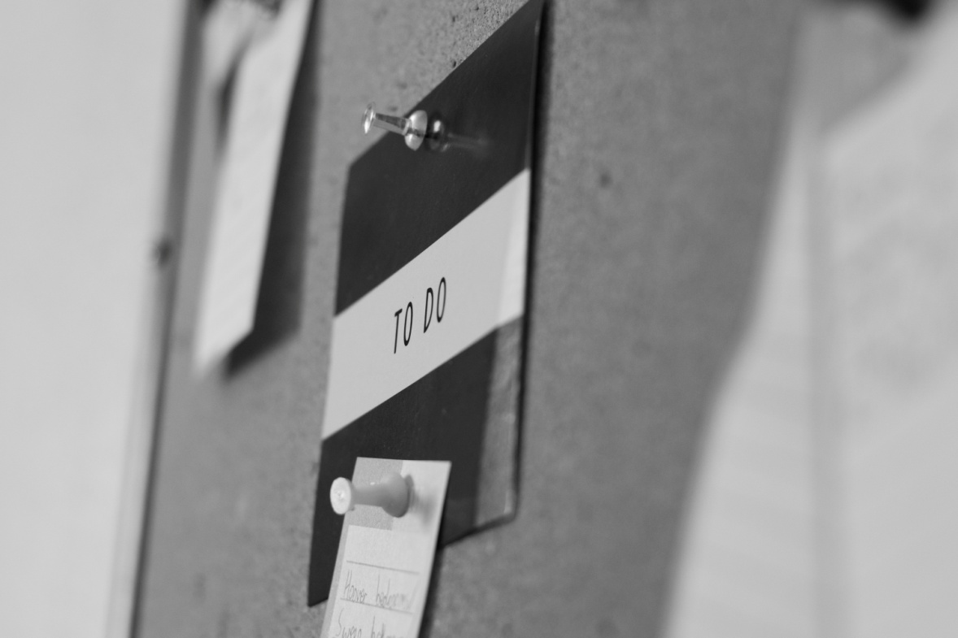
Today I created a to do list to help me remember things I need to do around the house. The photo was taken using a Nikon D3300 camera and edited in Lightroom.
9th
April
2020

Slide 12
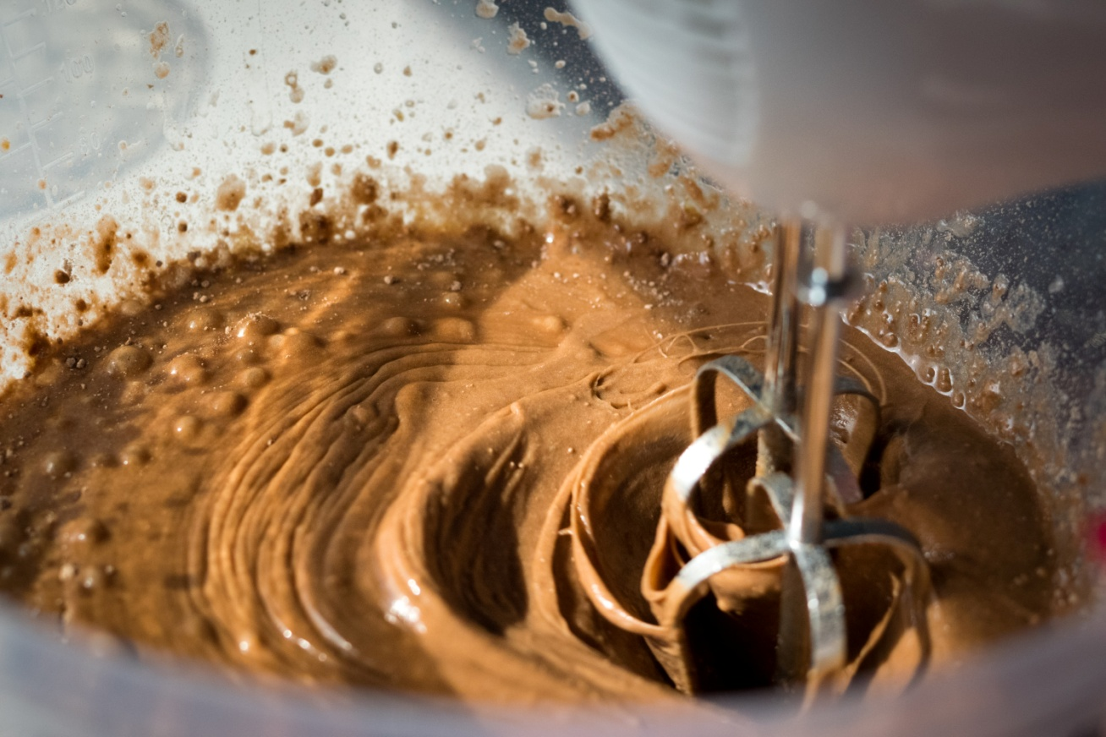
Today we made an Easter cake ready for the weekend. Taken with a Nikon D3300 and edited in Lightroom.
10th
April
2020

Slide 13
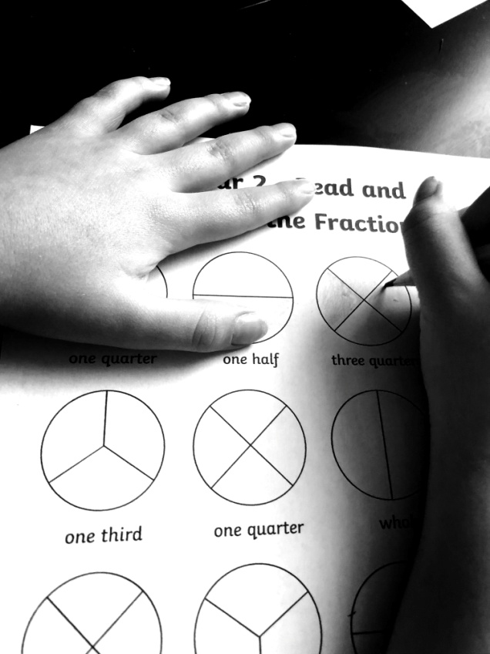
During lockdown I have been helping my brother with his school work at home. This image was taken using an iPhone 8 and edited in Photoshop.
20th
April
2020

Slide 14
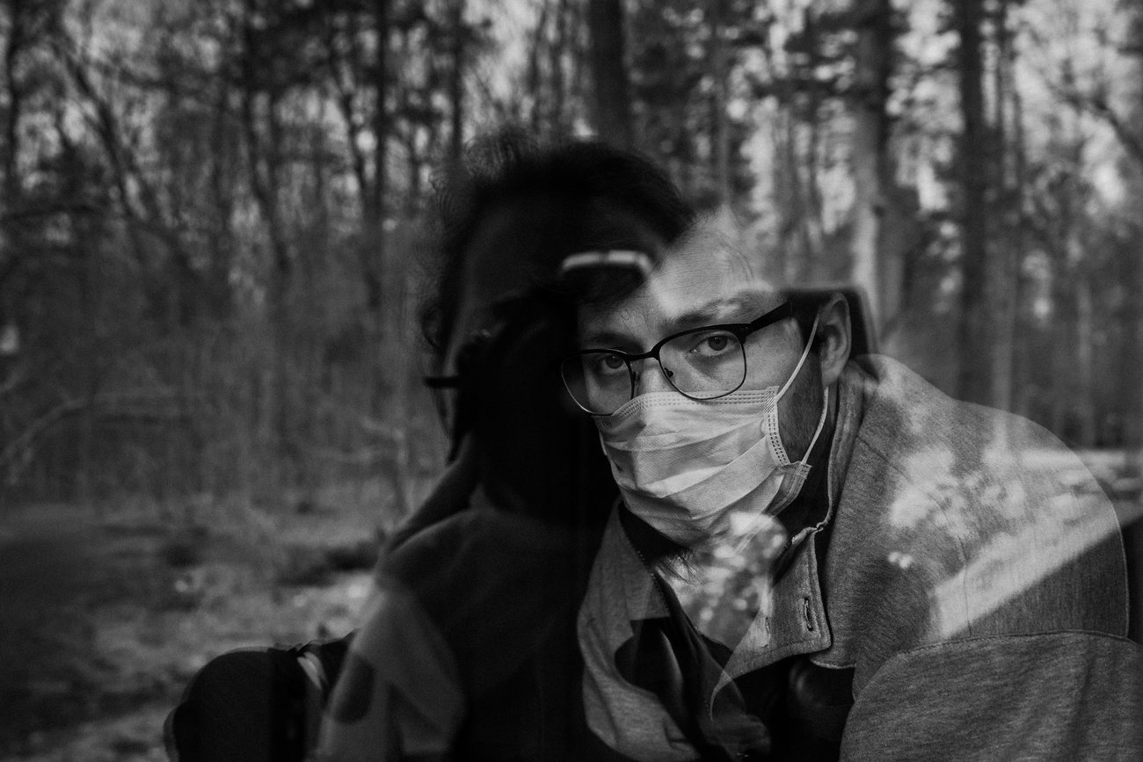
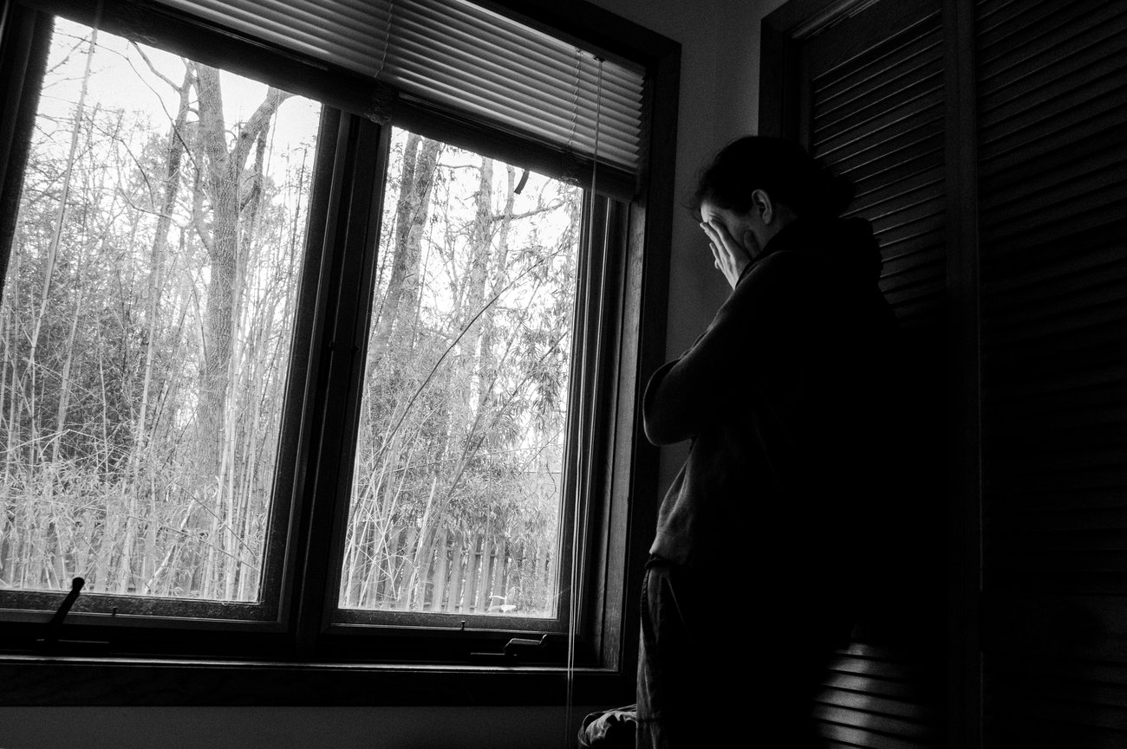
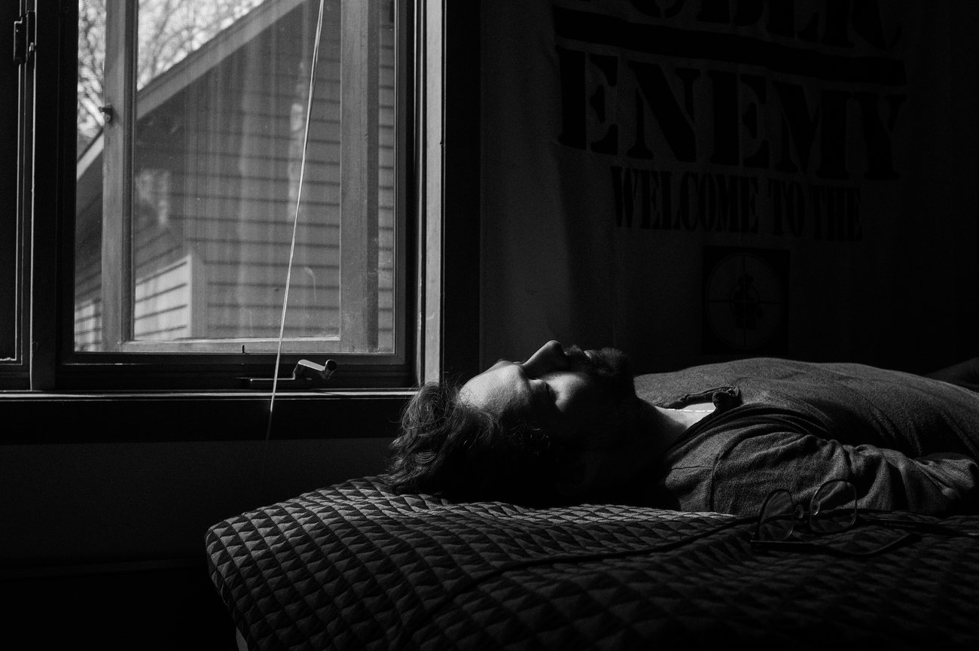
Pete Kiehart Black & White Portraits
The images on this slide are the images I used as inspiration for the images on the next two slides. Pete Kiehart has created a photography diary that he has taken through lockdown. He uses dark contrast and tones to set a moody tone for the image, showing what the mood is actually like in lockdown. I am going to use his photography as inspiration to create my own moody portrait shots.

Slide 15
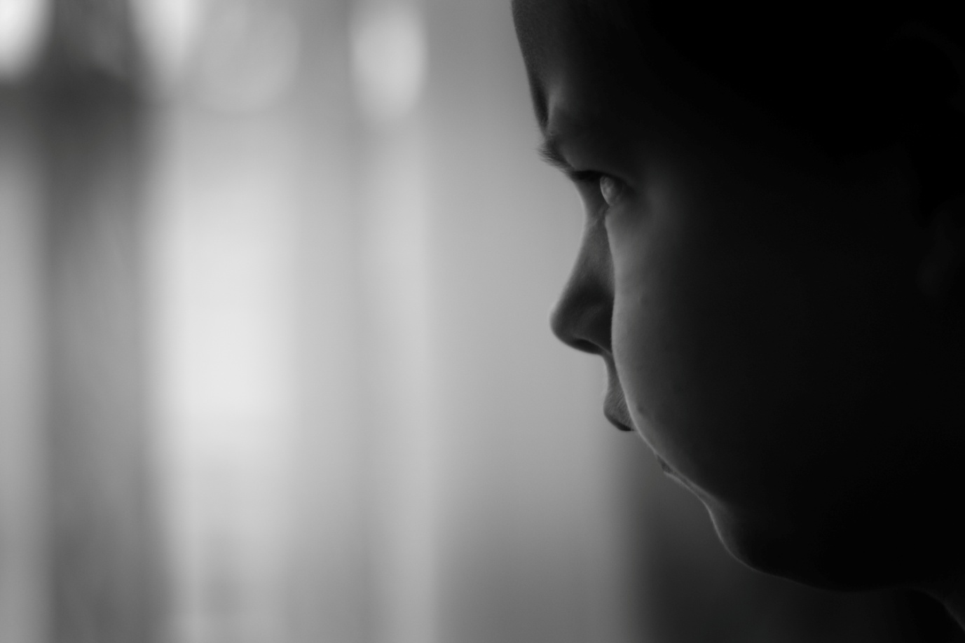
Pete Kiehart Black & White Portraits
During lockdown me and my siblings have been wanting to go out as before lockdown we would usually go out for day trips but since being in lockdown we can’t. Image taken with a Nikon D3300 camera.
28th
April
2020

Slide 16
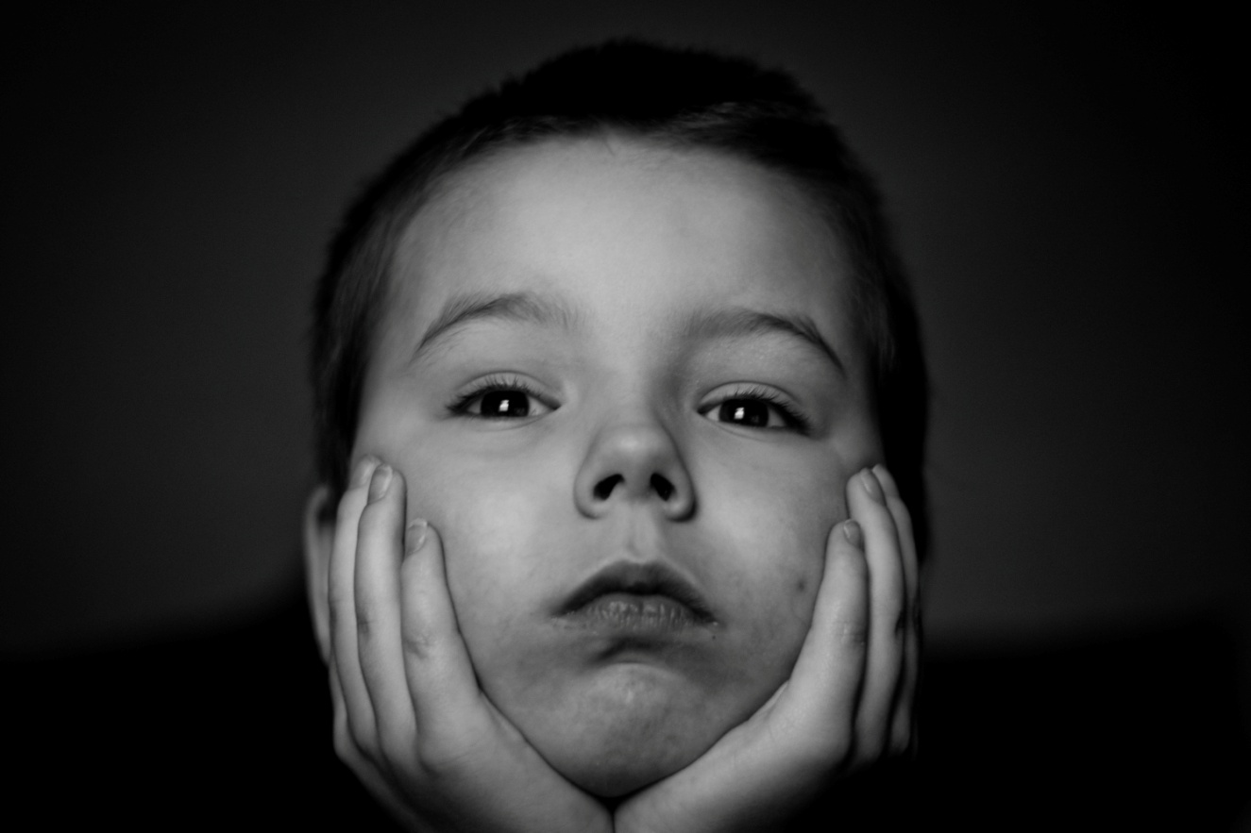
Pete Kiehart Black & White Portraits
During lockdown my brother has been getting bored and not knowing what to do with himself. Image taken with a Nikon D3300.
29th
April
2020

Slide 17
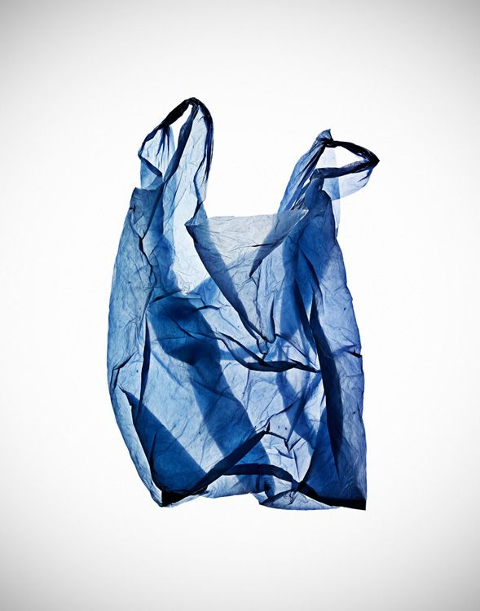
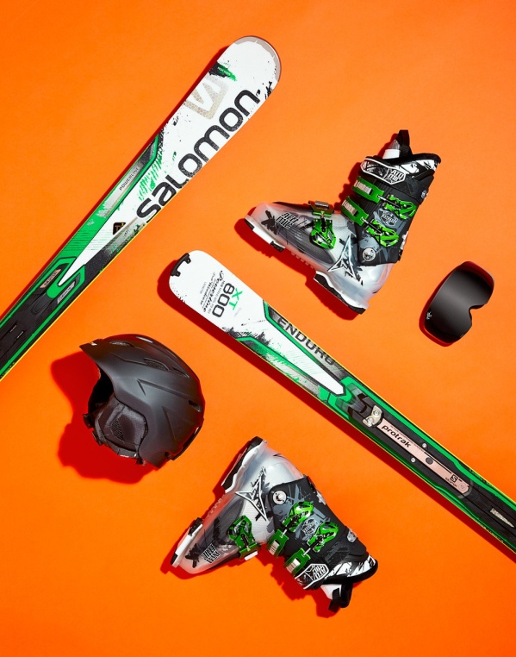
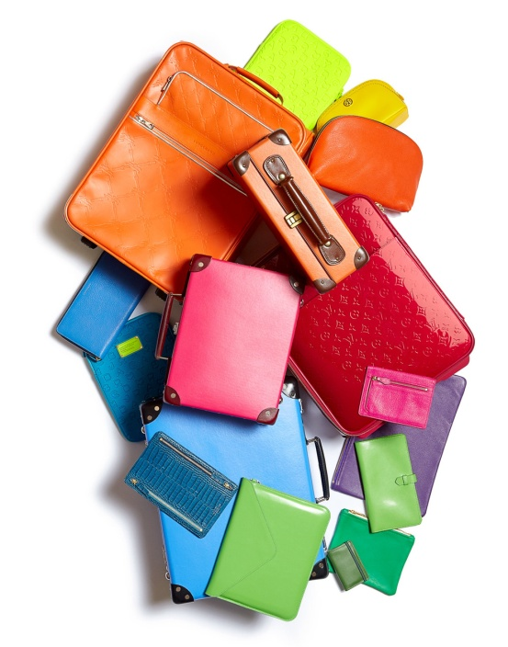
Steve Gallagher – Still Life Photography
Steve Gallagher is a photographer who focuses on taking images of still life objects against a plain background. He then enhances the colour to make the object stand out against the simple background. On the next two slides are images I have taken using Steve’s work as inspiration.

Slide 18
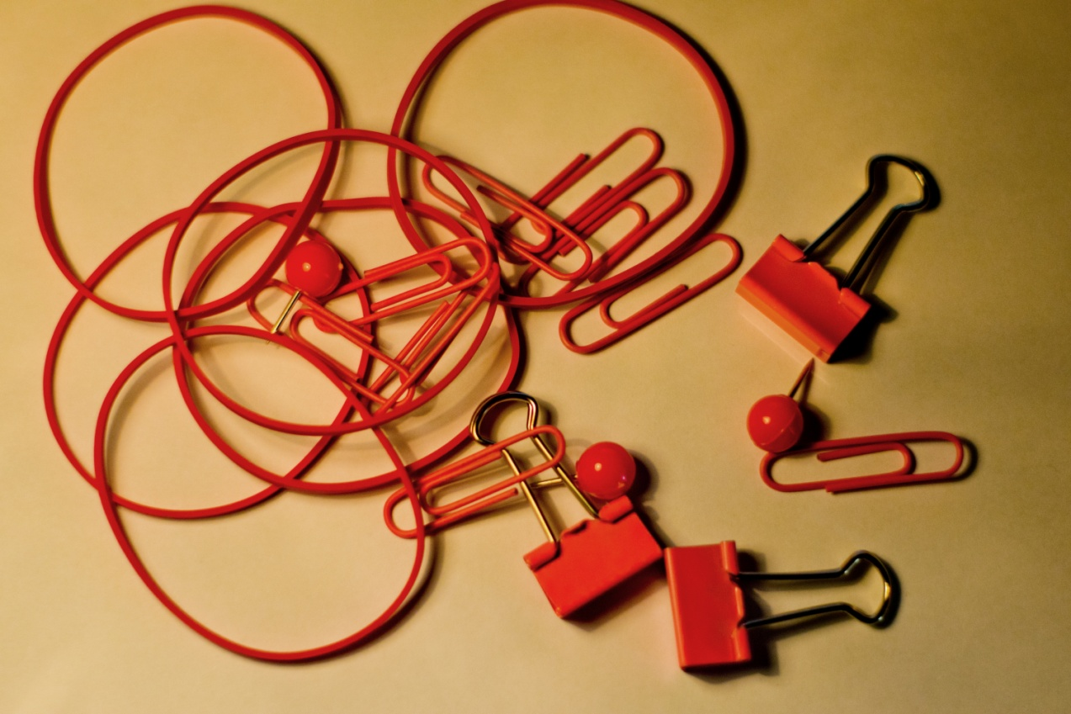
Steve Gallagher Still Life Objects
Throughout lockdown we have had to ensure to keep organised. Photo taken using a Nikon D3300 camera and edited in Lightroom.
5th
May
2020

Slide 19
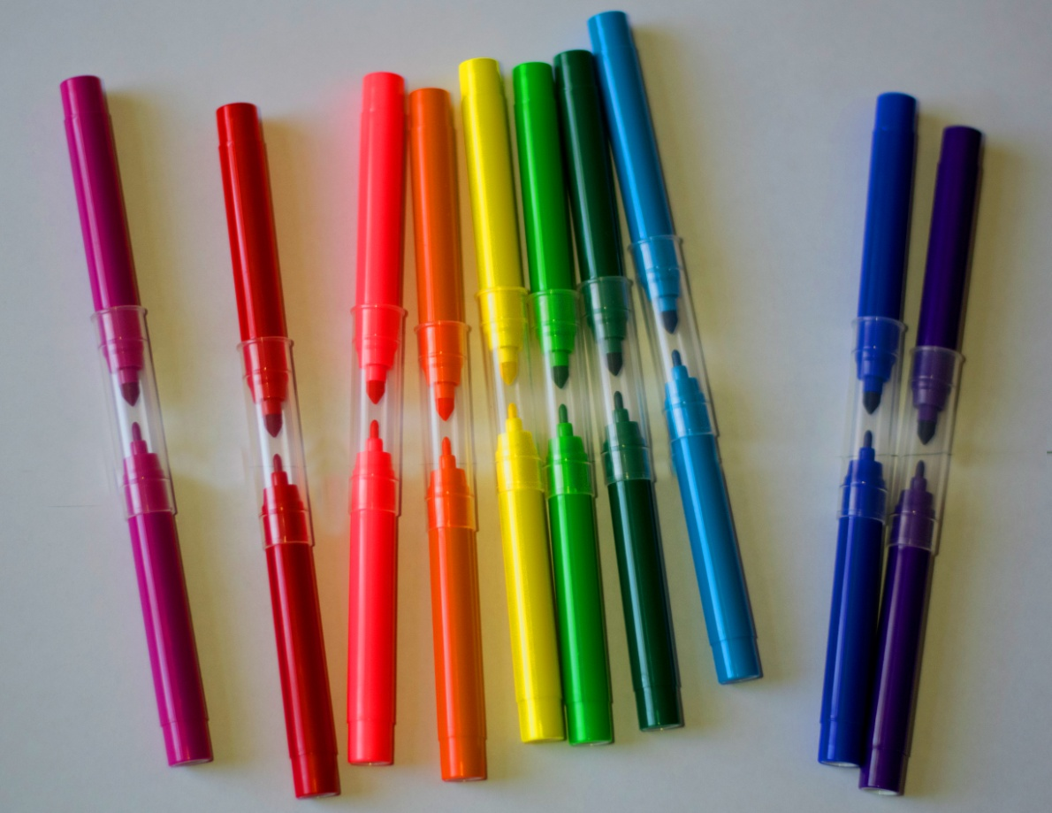
Steve Gallagher Still Life Objects
During lockdown I have done a lot of colouring with my brother. Image taken using a Nikon D3300 and edited in Adobe Photoshop.
6th
May
2020

Slide 20
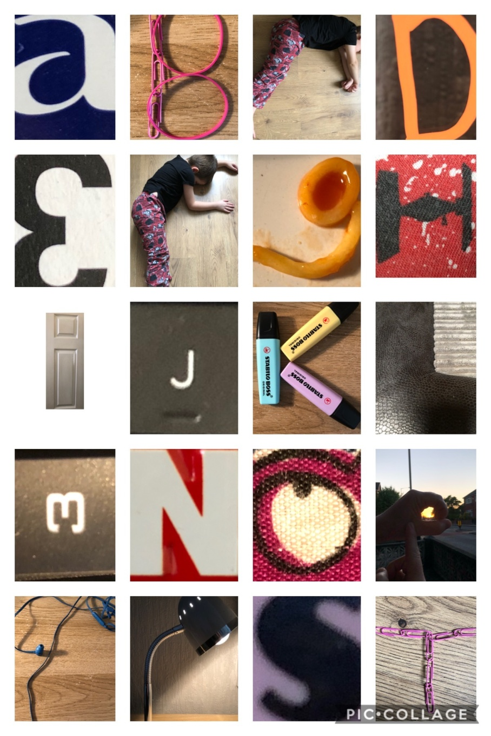
Alphabet Photography
For some of letters I have used people and objects found around the house:
B C F K P Q R T U V W Y
Some of the images have been taken using letters found on objects around the house:
A D E H J M N O S X
I have taken a few images of letters that were in structures:
I L Z
I also did the letter G using food.

Slide 21
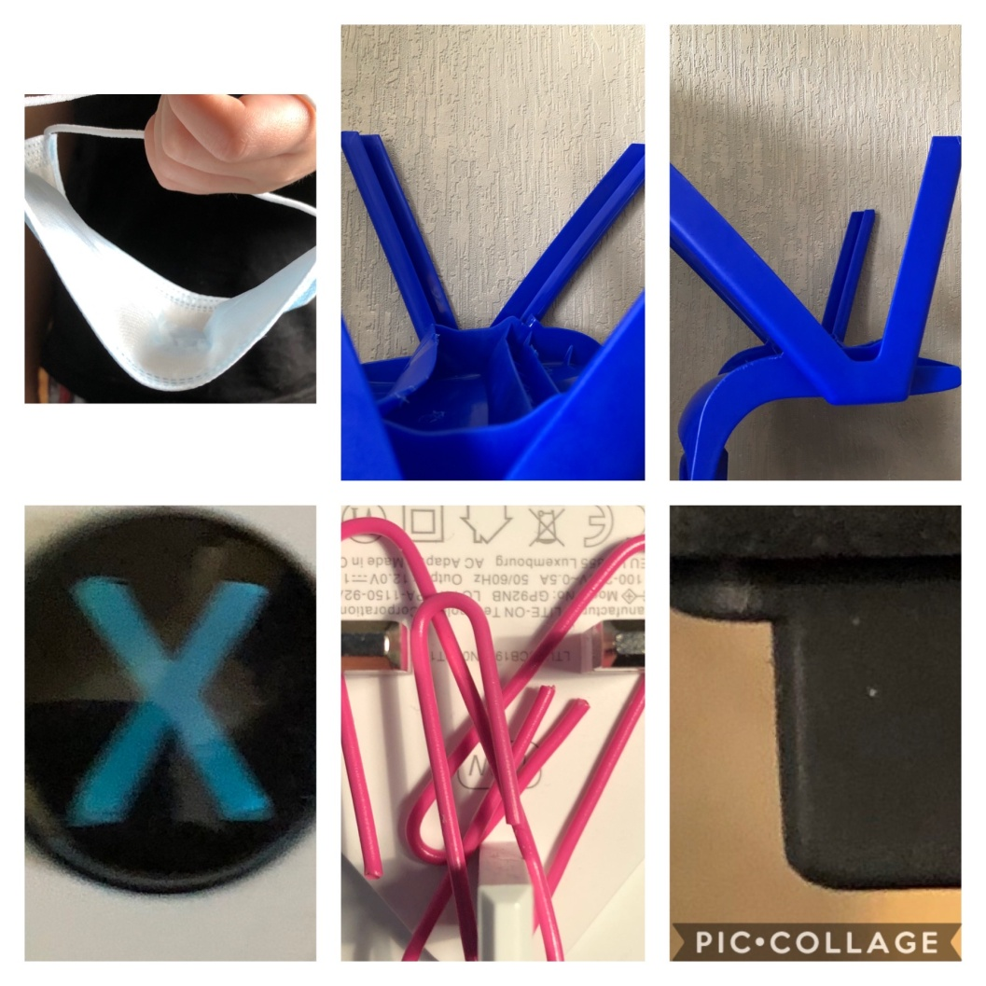
All images were taken using an iPhone 8. The collage was made on Pic Collage.

Slide 22
Creating Messages Using Alphabet Photography
This message is a phrase that a lot of people have used during lockdown because they are missing their families and friends. Images taken using an iPhone 8.

Slide 23
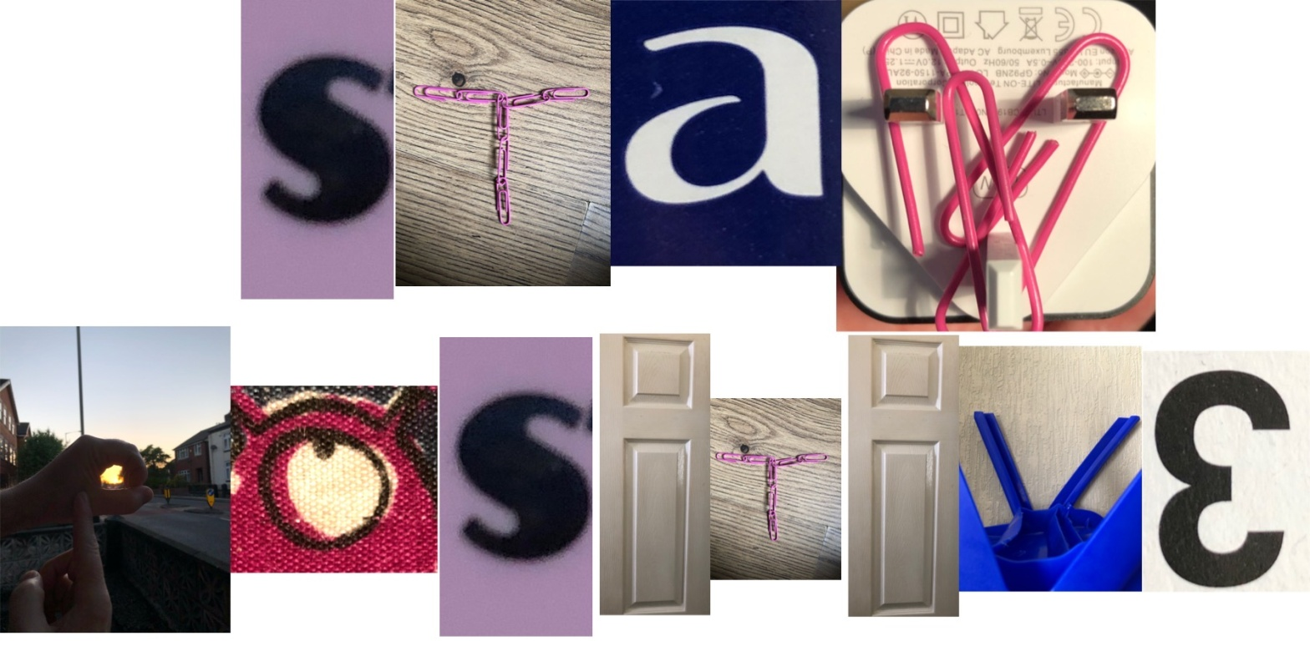
Creating Messages Using Alphabet Photography
This is another message a lot of people are using during lockdown. During lockdown you have to stay positive. Images taken using an iPhone 8.

