Slide 1
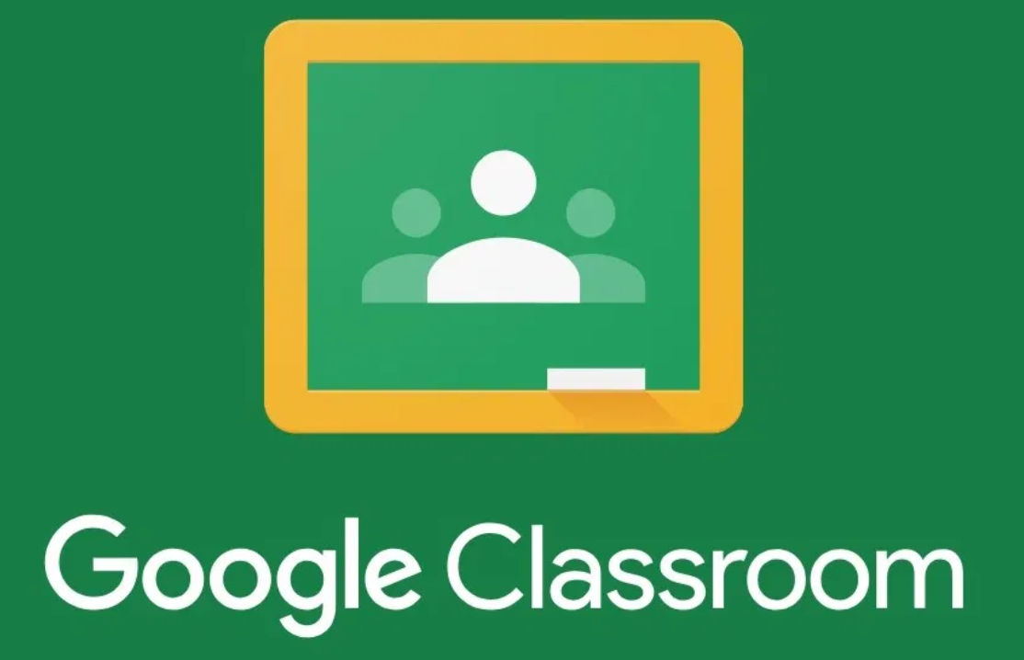
Year 10 Maths – Remote Learning Planner (from 20th April)
Mathematics work for all students in Year 10 is set on Google Classroom. Students have already been invited to their classes and therefore don’t need a code to join.
Once they have clicked on their Maths class within Google Classroom, students should click on the ‘Classwork’ tab at the top of the page to see the details for each lesson.
The Maths department will utilise different resources (such as Dr Frost Maths, Hegarty Maths, YouTube tutorial videos) but it is essential that students go to Google Classroom at the start of each lesson for details and do not go directly to these sites.
During lesson times (Tuesday 9:00am-11:30am and Friday 12:30pm-3:00pm) a Maths teacher will always be available to help students with questions. Details of how to access this support are found on Google Classroom under the description for that lesson. It’s really important that students take advantage of this so that we can support them with any of the tasks. Outside of lesson times, students can email their teachers to ask for help, if required.

