Slide 1
Baking
Flapjacks
(and ginger cake)

Slide 2
INGREDIENTS & METHOD
250g oats
175g brown sugar
175g unsalted butter
4 tbsp golden syrup
(I did 3 tbsp and 1 tbsp of honey)
Preheat oven to 140°C (fan oven) or (160°C for conventional oven)
Melt butter into the sugar over a low heat. Then transfer to a bowl.
Stir in the oats and golden syrup.
Line a rimmed baking sheet with greaseproof paper and spread out the mixture flat.
Bake for 30-40 minutes, check after 30 minutes.

Slide 3
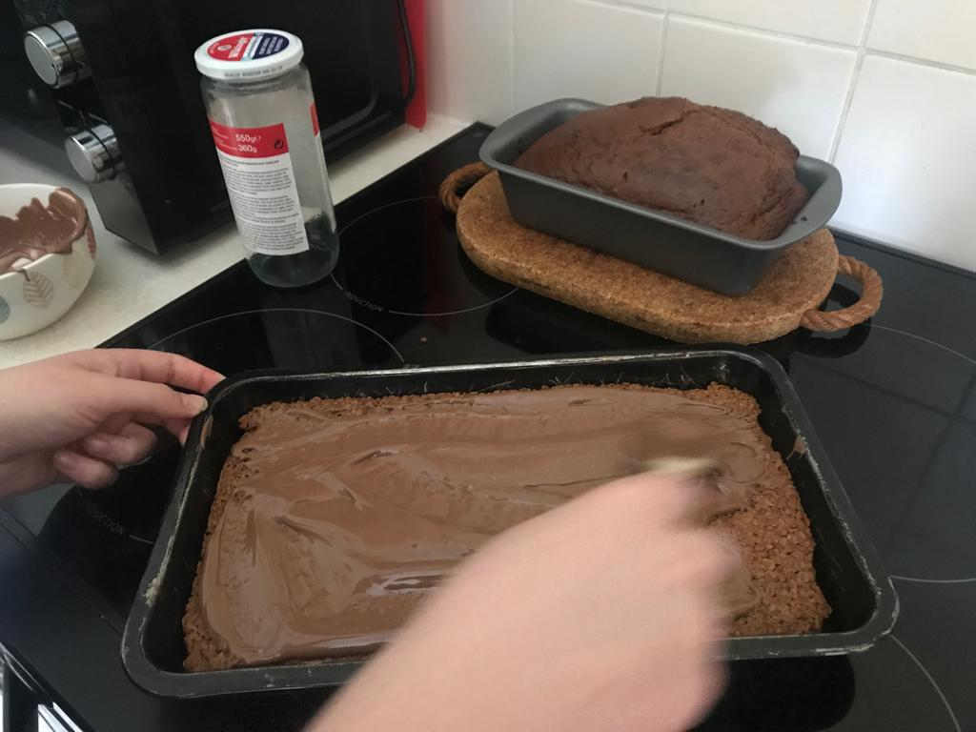
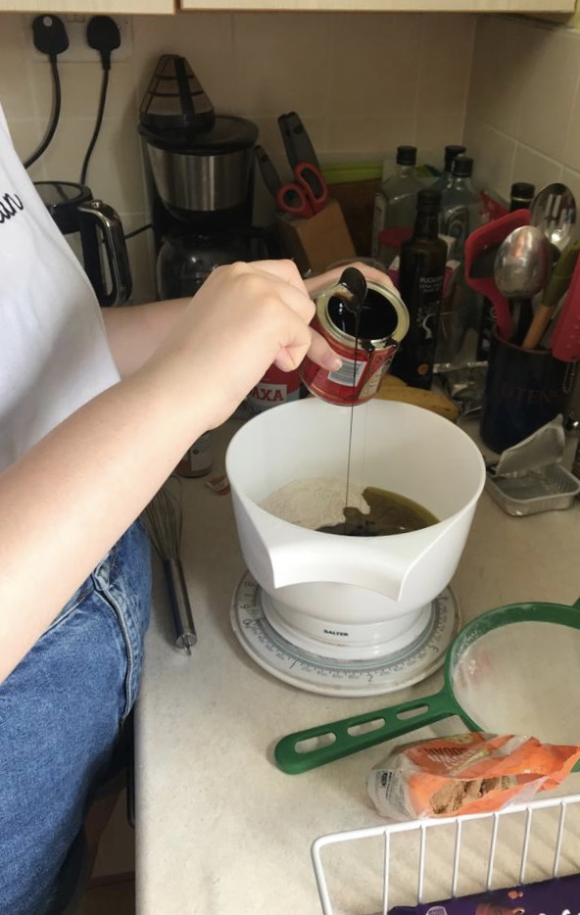
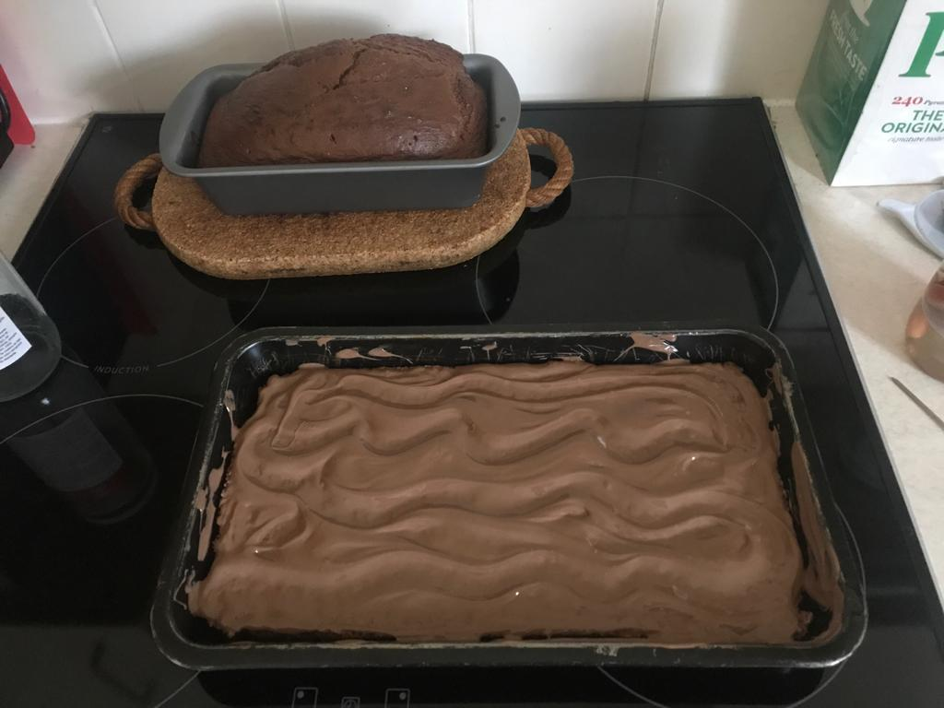
What did I enjoy?
Add photo here
I enjoy baking as it breaks up the day, and is an overall fun thing to do, I learn a new recipe and it’s rewarding when other people enjoy something you made.
Add photo here
Add photo here

