Slide 1
My Marble Run
Marble Towers

Slide 2
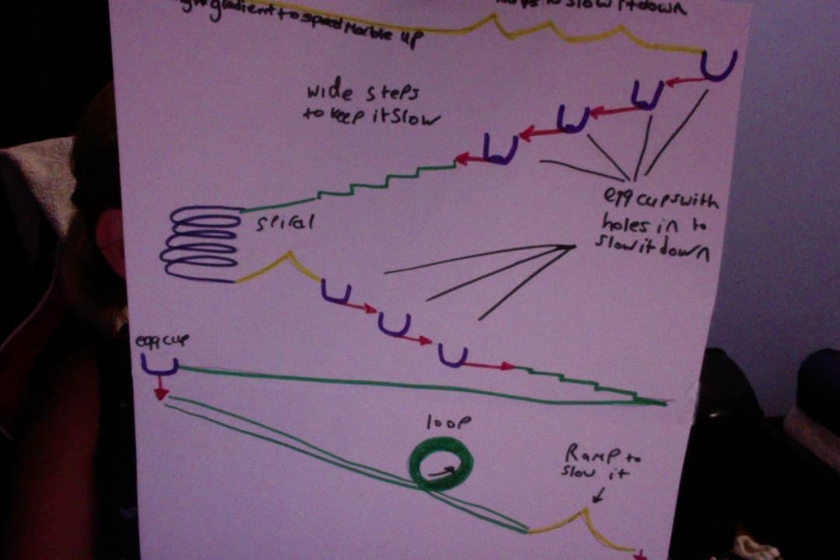
Sketch design
I designed my run to go flat on the wall so the marble could work it's way through diffeetn things like steps and ramps to get to the bottom.

Slide 3
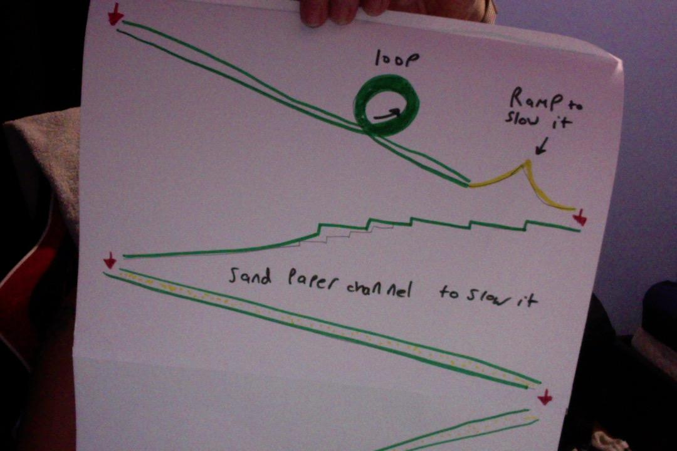

Slide 4
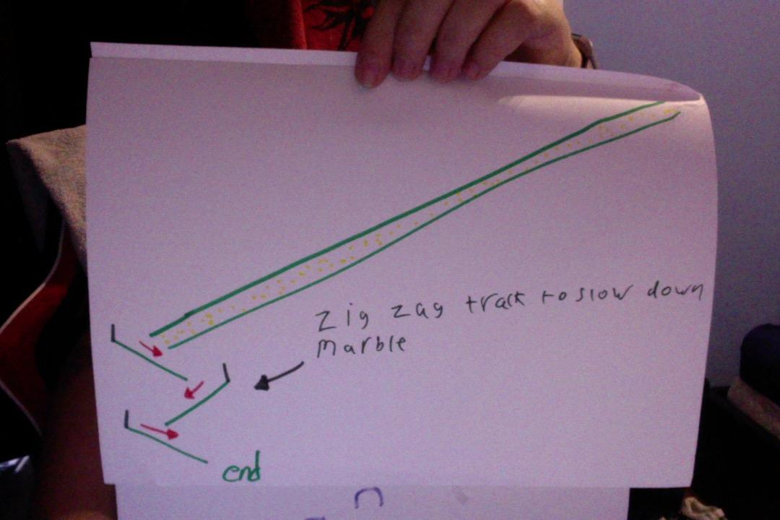

Slide 5
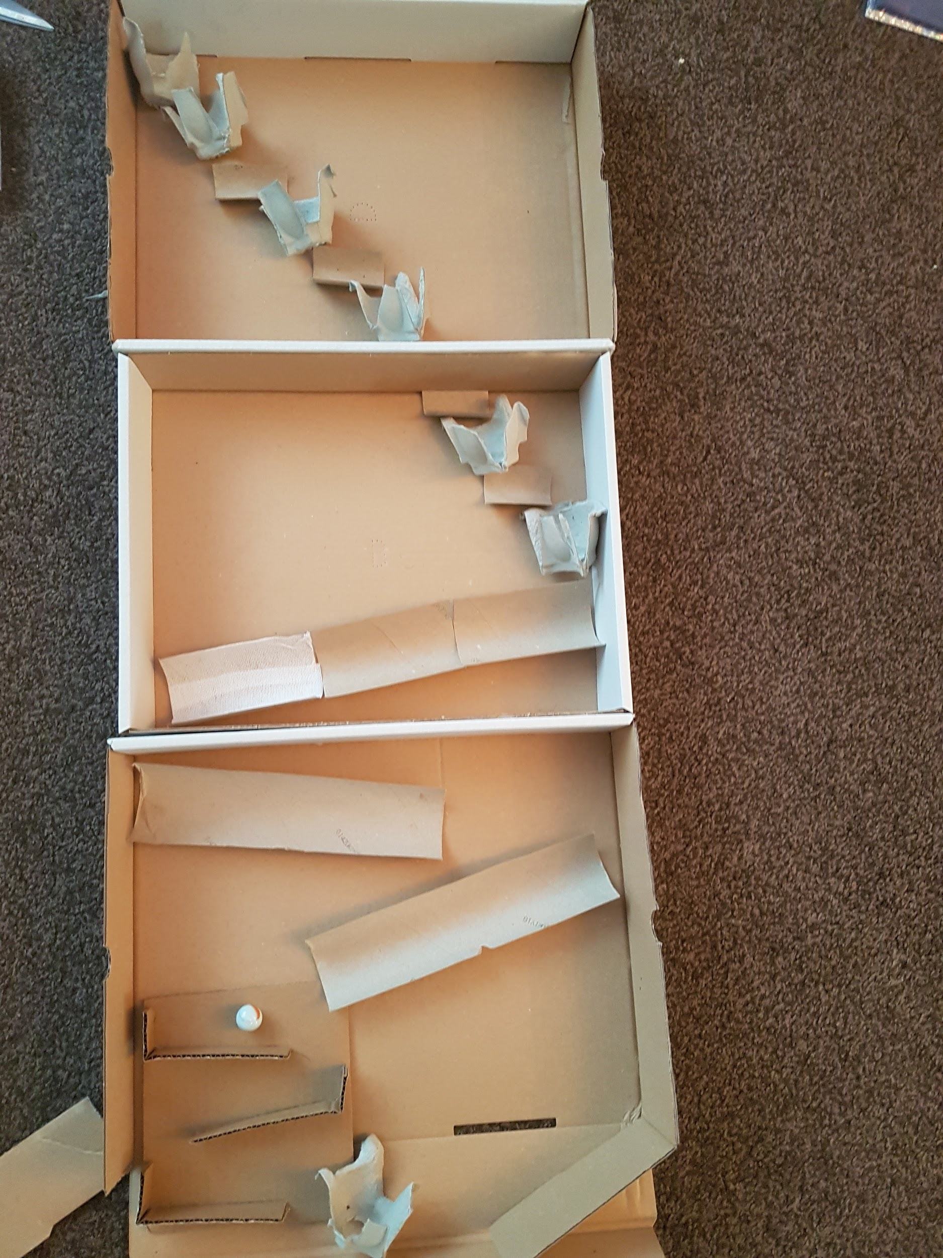
My basic initial idea.

Slide 6
Friction
I added some sandpaper to half a toilet roll tube and left the other half with none. I expected it to slow the marble down at least a little bit with the friction caused by the marble rubbing against it but it didn't appear to. I added a wavy line of hot glue on top of the sandpaper and when it dried this did a better job at slowing the marble as it had more larger to bumps to get over. I also had a half tube with some dressing plaster in it and I think that worked better than the sandpaper at slowing the marble.

Slide 7
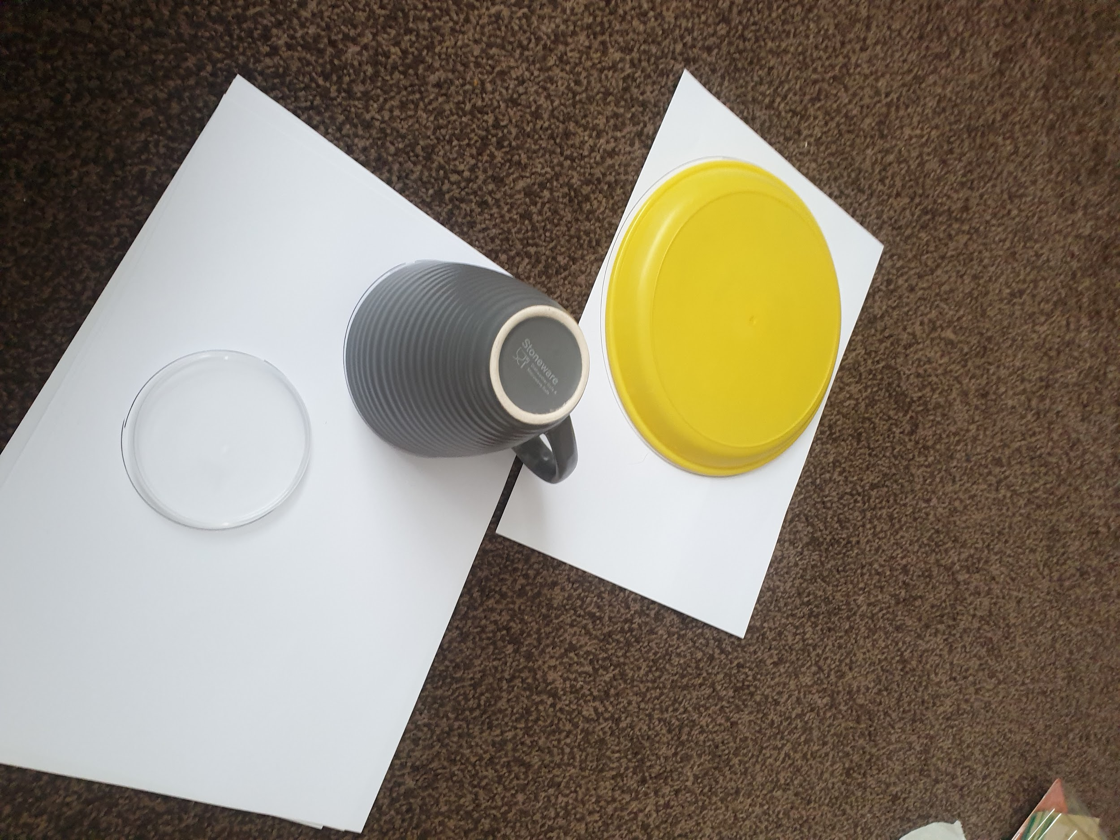
Structures
I tried to use paper for some of my ideas but the paper wasn’t strong enough to hold the marble and it wasn’t easy to make the shapes I wanted.
I drew around some circle shapes to try and make some cone shapes of different sizes.

Slide 8
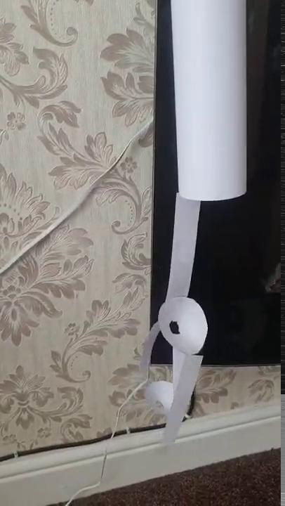
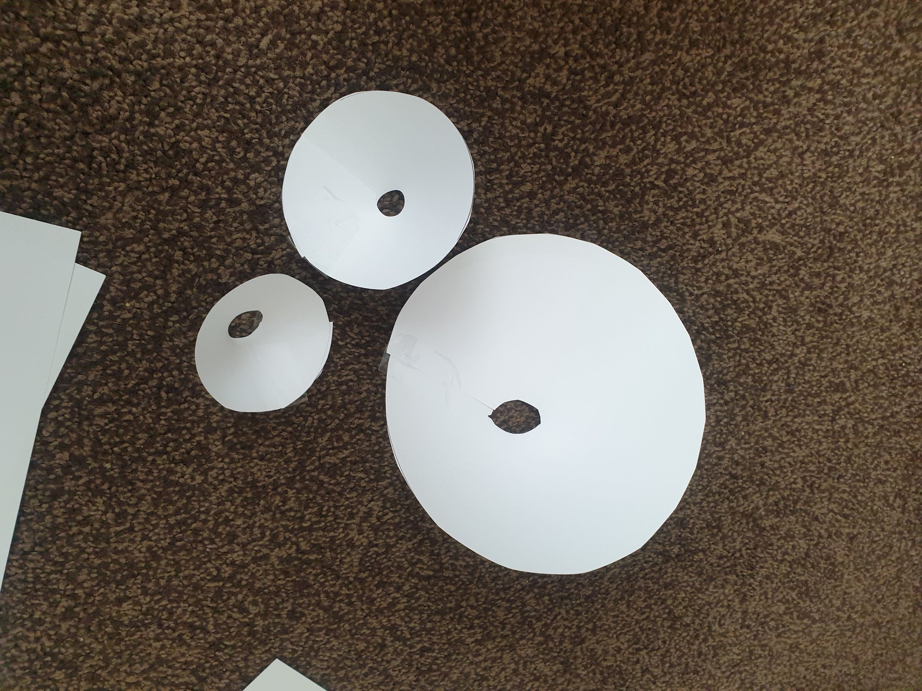
Paper Experiments
I made some cone shapes and then made a mini marble run to see how they would work out but the marble was too heavy and it kept breaking so i decided to use egg cartons made of card instead of the paper and i used cardboard in all of my run as it was much stronger and was able to take the weight of the marble over and over again.

Slide 9
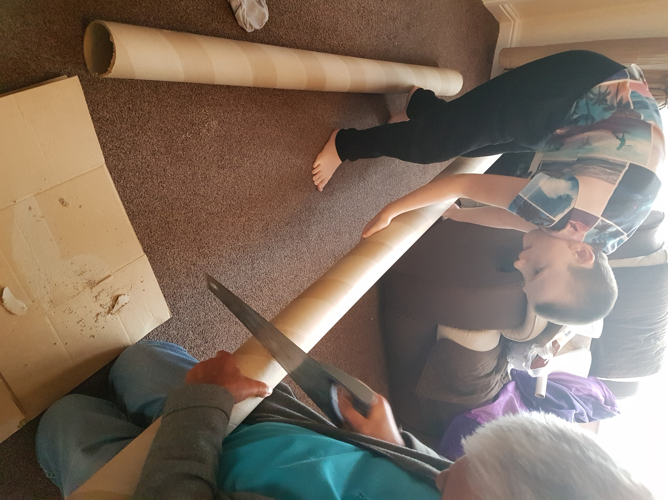
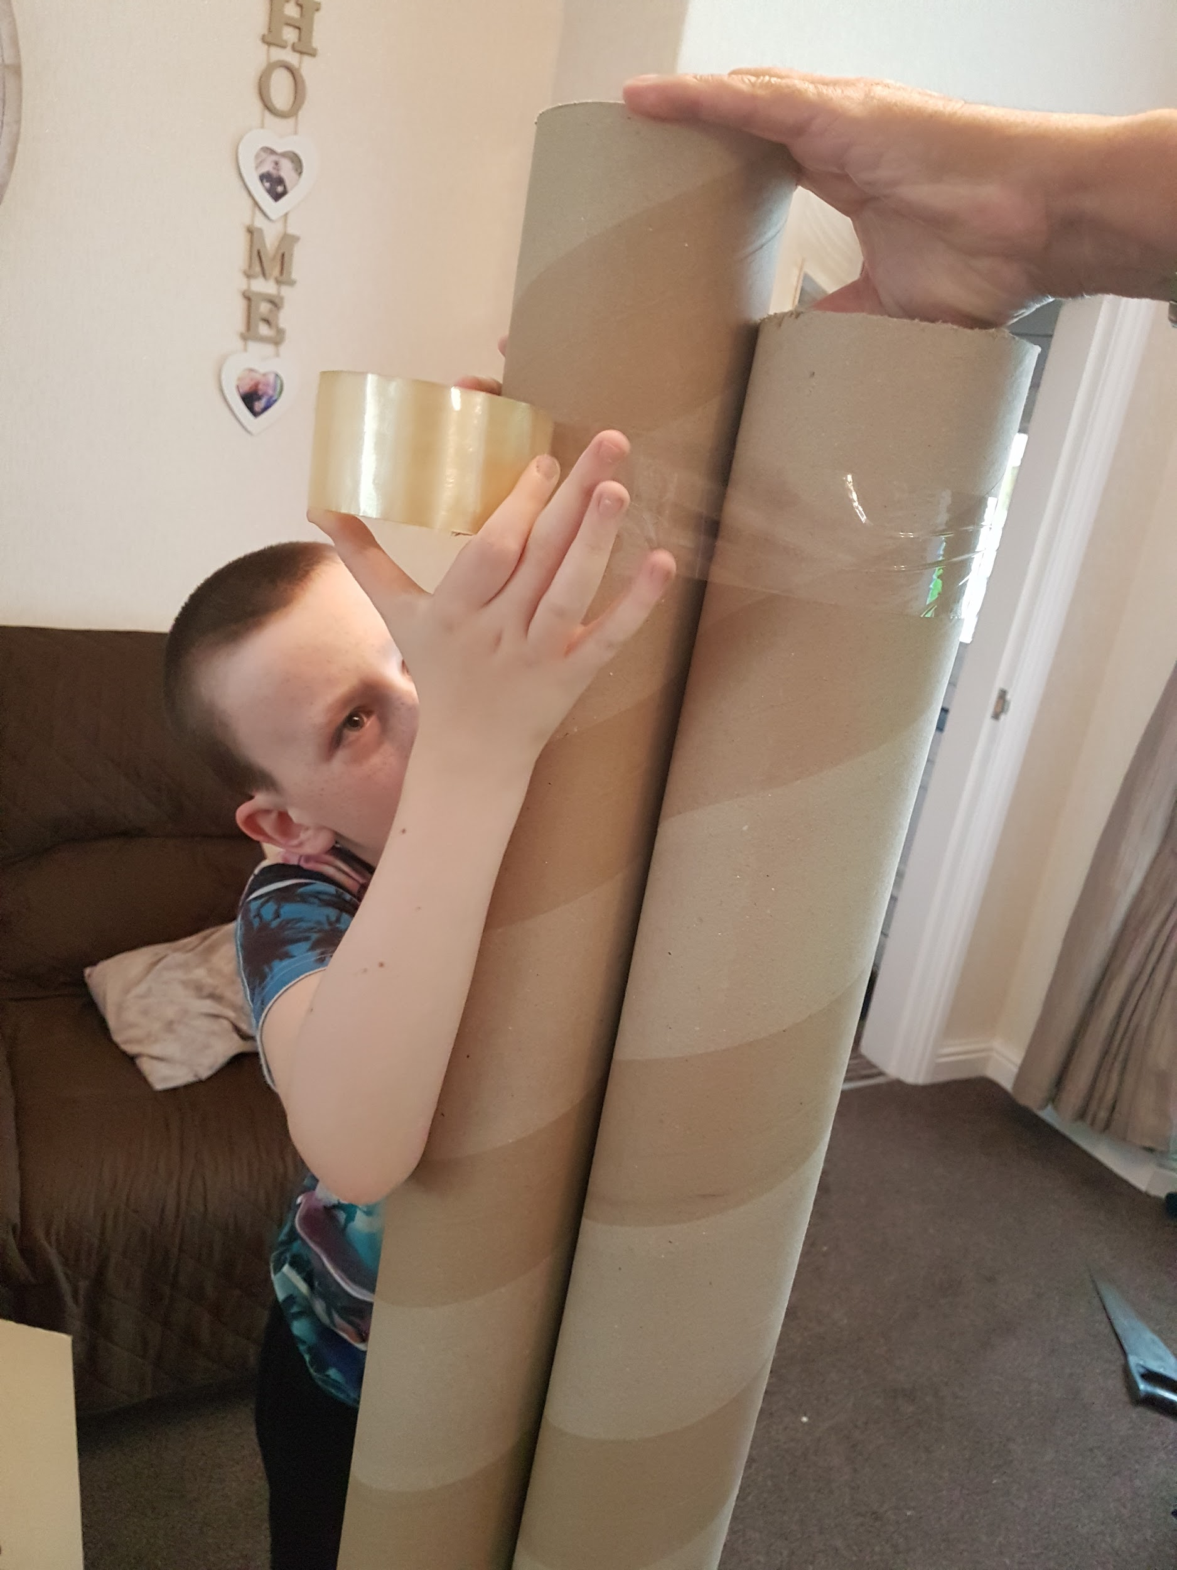
My Marble Run
The tubes were too tall tall so my Grandad used his saw to cut them down so I could then tape them together with strong sellotape. The 2 bits we cut off I stuck to the bottom as supports so it wouldn’t fall over.

Slide 10
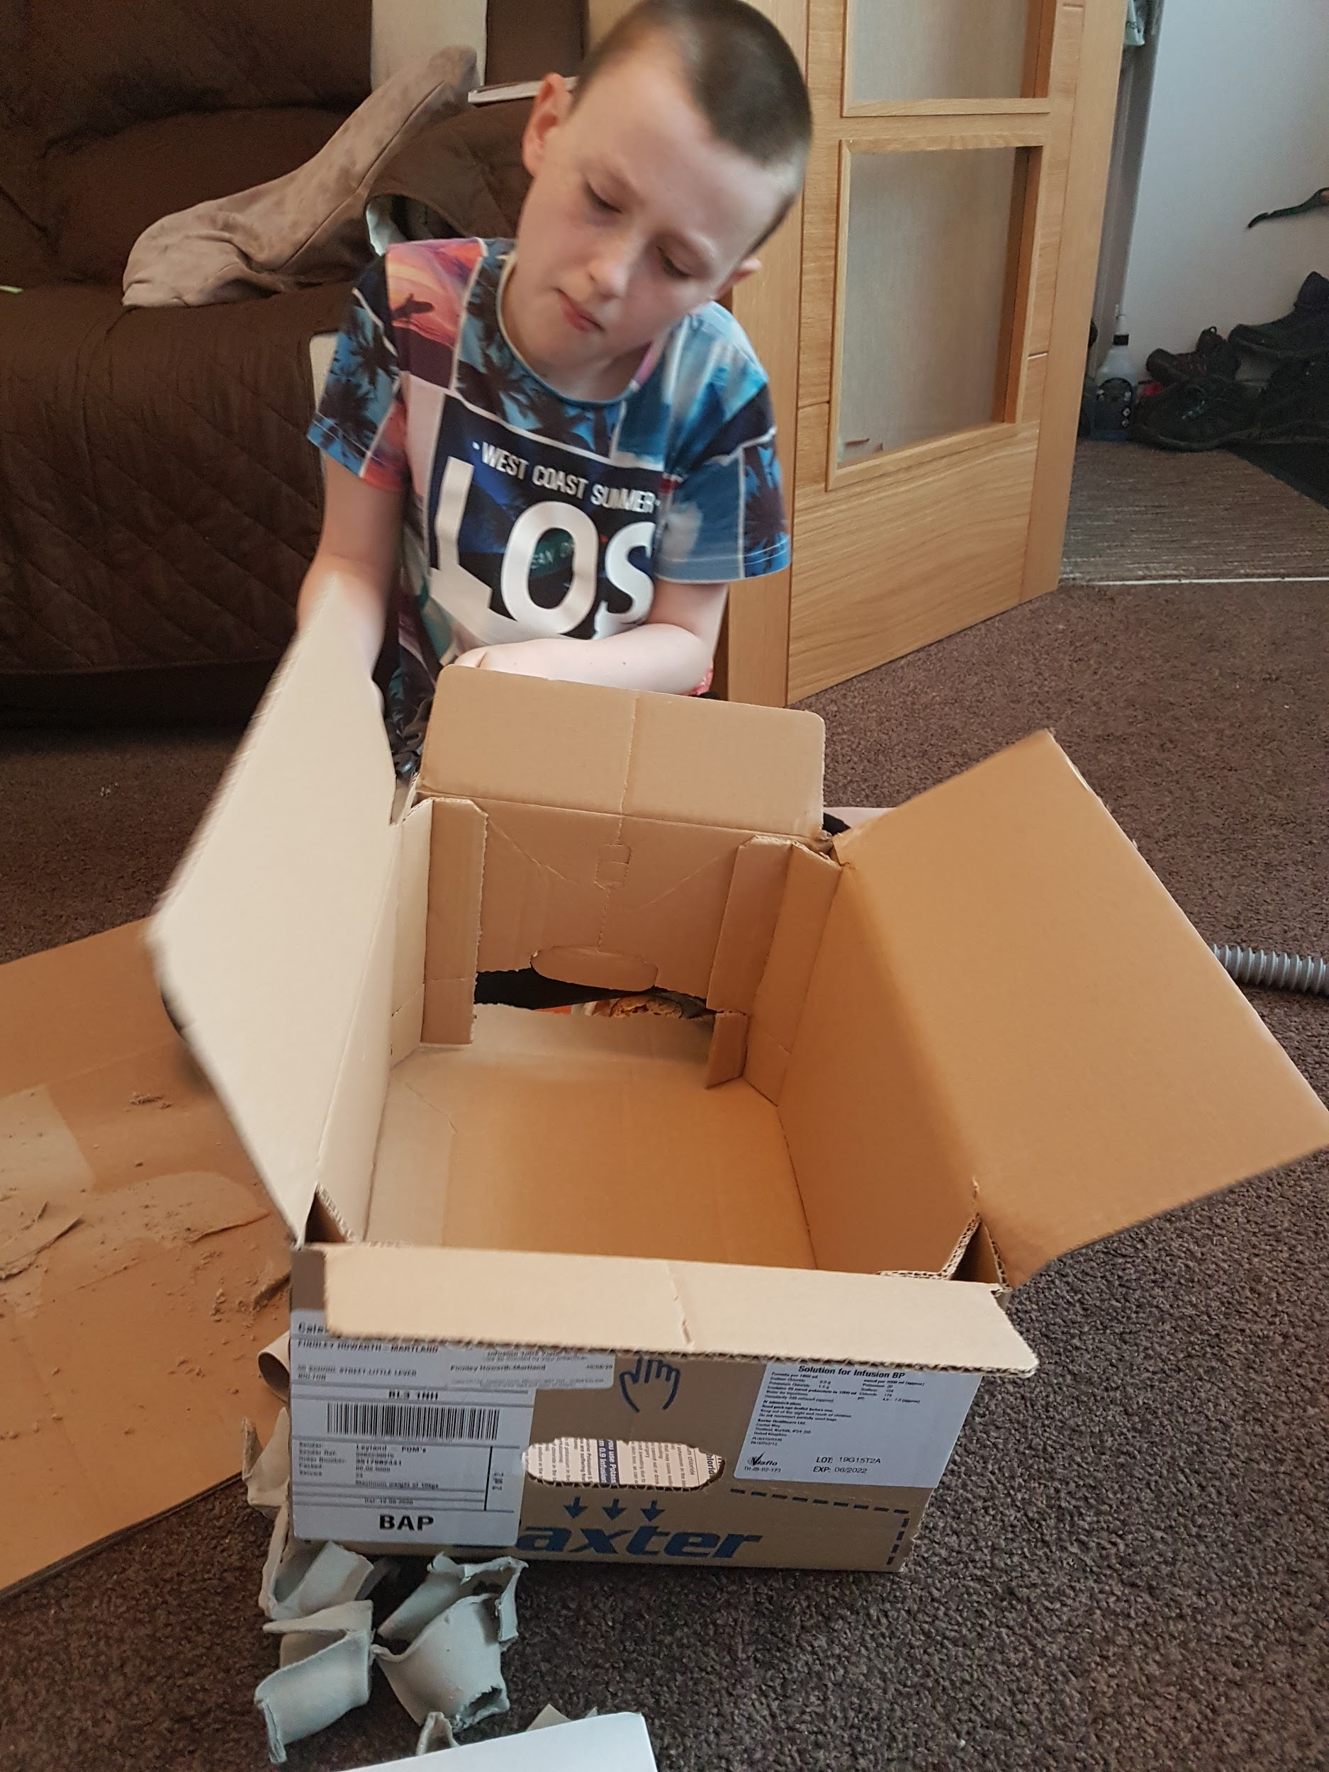
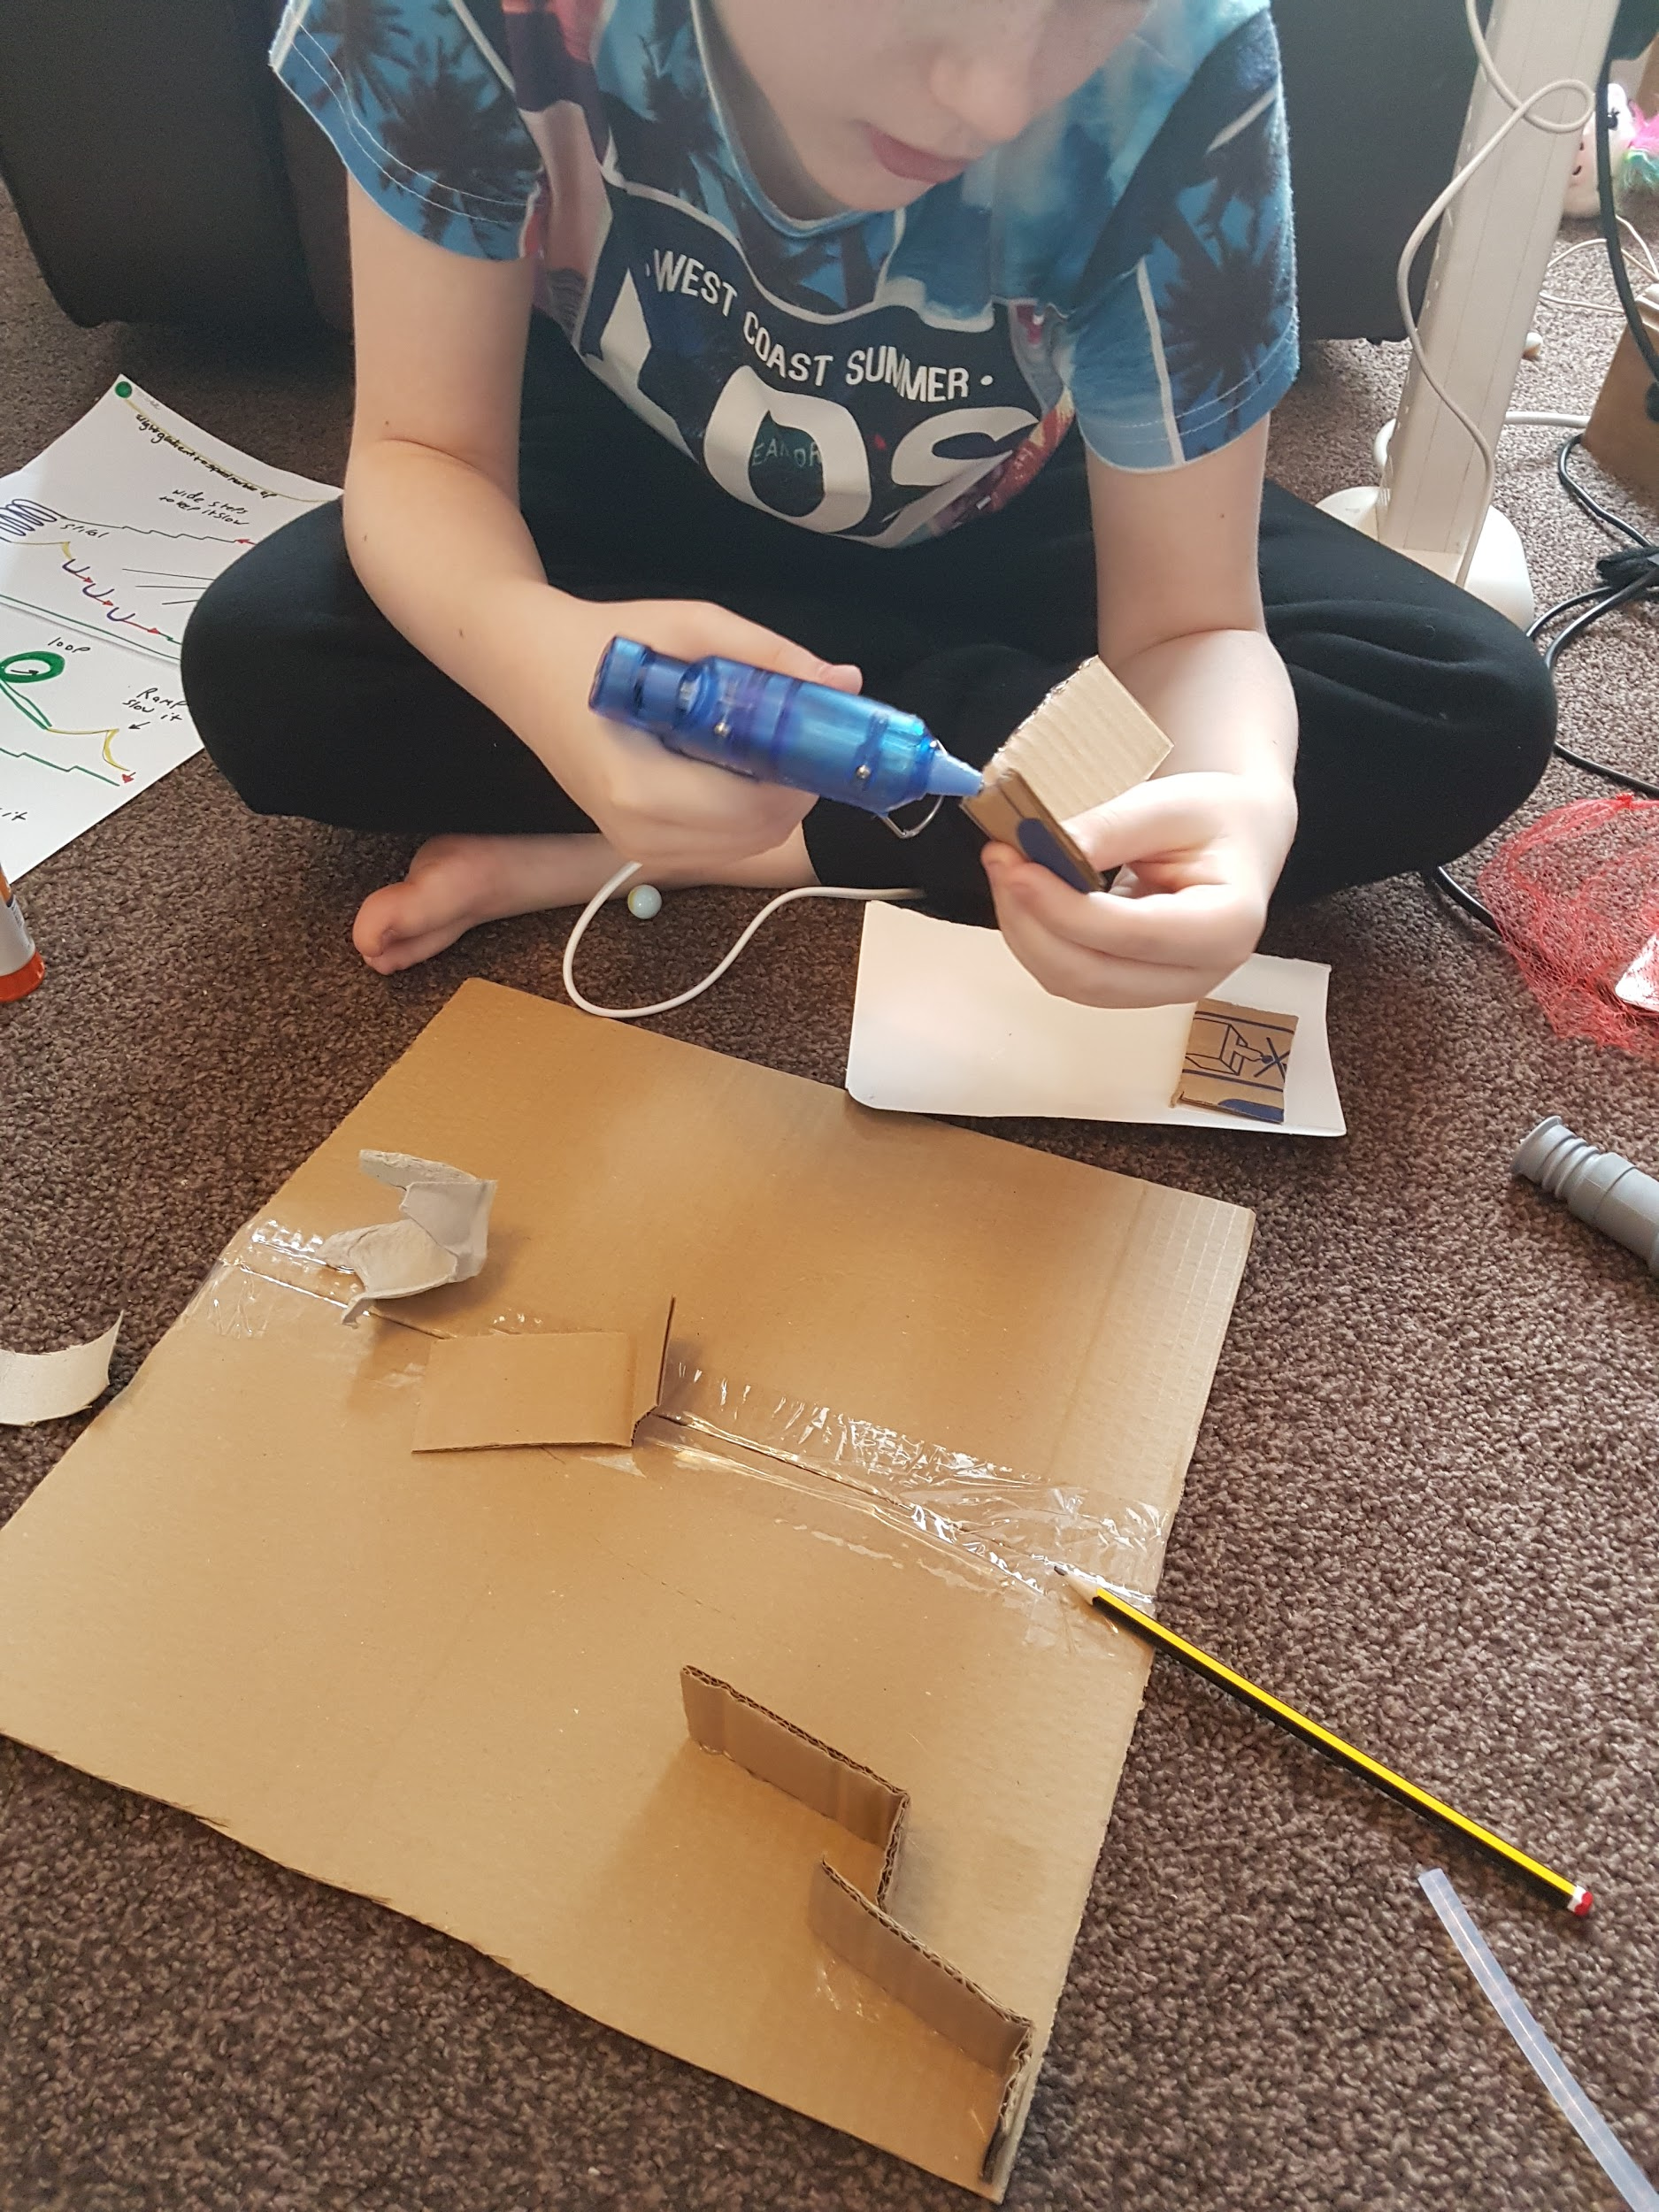
My Marble Run

Slide 11
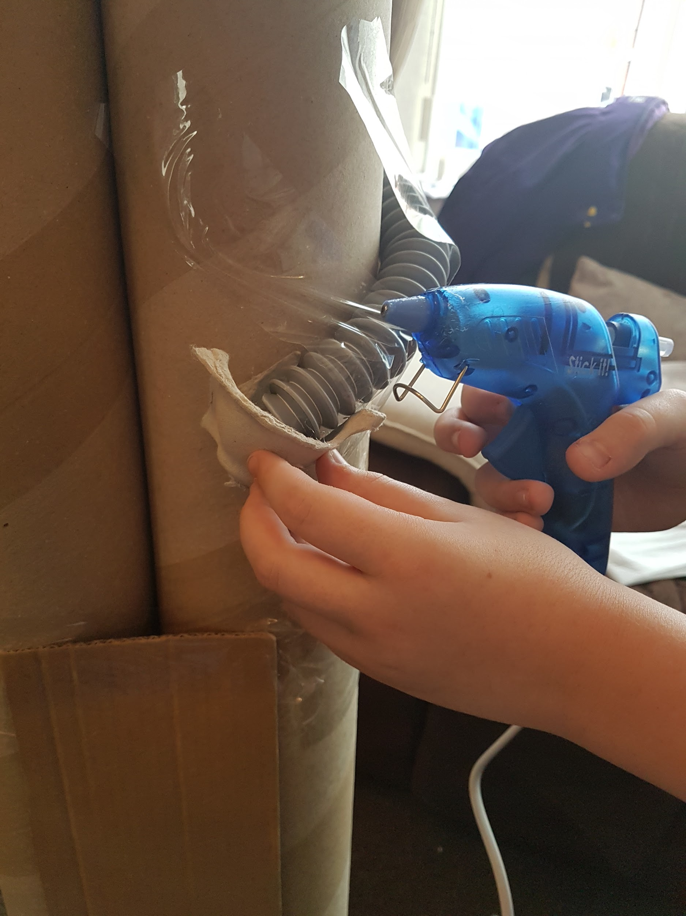
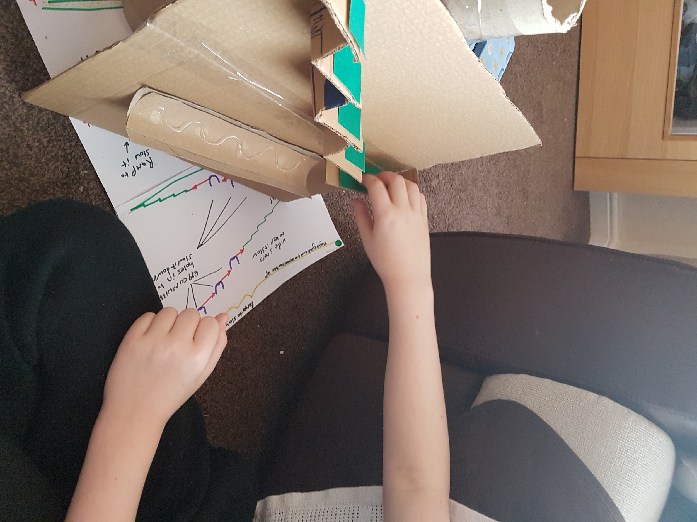
My Marble Run
I used the hot glue gun to stick things into place and as you can see on the half tube I did i wavy line of glue, when it dried it help to slow the marble as it didn’t have a smooth surface.

Slide 12
Evaluation
My marble run works ! The marble makes it all the way to the bottom . I have called it Marble Towers.
I planned to make my marble run in a piece of flat card pinned to the wall but then my Grandad brought me a carpet roll tube and some pipe from and old washing machine. I decided to make a tower using the carpet roll tube and make my run go around them so i could wind the pipe round it. The marble takes around 9 seconds to get through the first piece of pipe. I had to keep moving the pipe to get the correct position for the marble to run through , that is why it is quite tall at 165 cm. I used some egg carton cups with holes in and some toilet roll tubes cut in half lengthways to make channels for the marble to run down. Last week I made a sample zigzag run which i made again on a bigger scale at the end of the run and i also made some steps with sandpaper on as they were in my original drawings.
I had to use a lot of sellotape and hot glue to get things to stick in place.
My marble run does stand up on it's own, the cardboard tubes are thick and were supported at the bottom by some more tube that we cut off the tops of the tube.
I enjoyed watching the marble fall from the top to the bottom, it was hard to get it to last a long time so i had to add on to it more than I thought but it takes 22 seconds to get to the end.

Slide 13
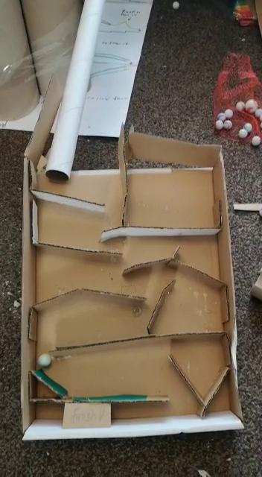
Marble Towers in Action

