Slide 1
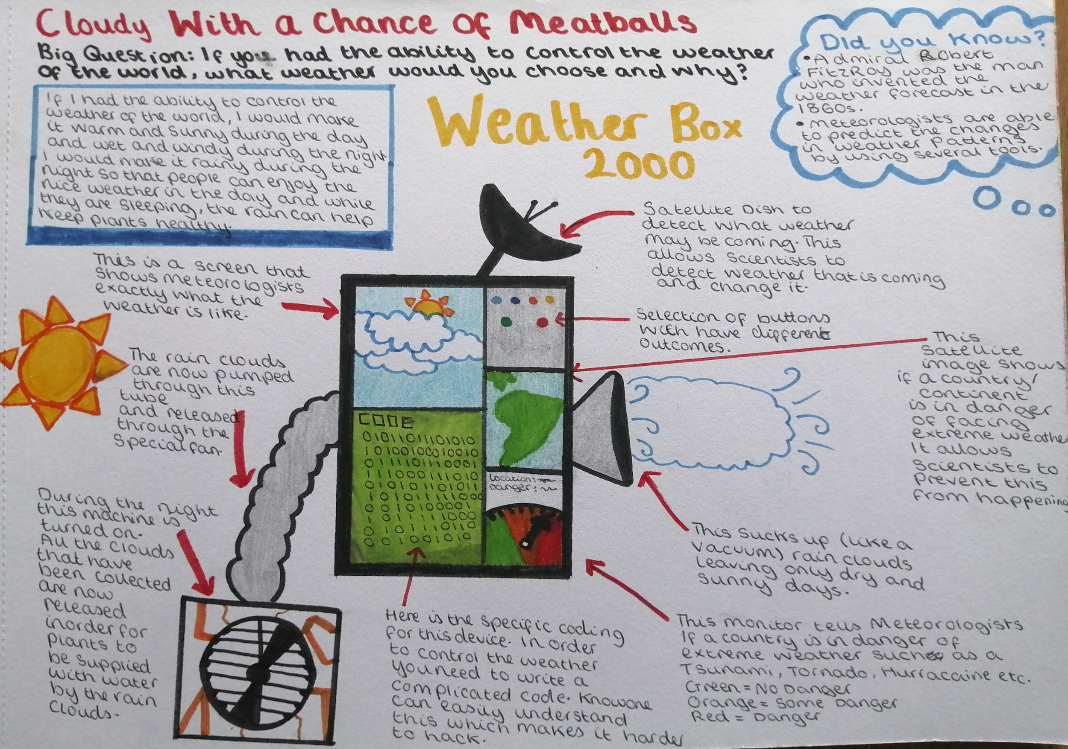
Lucy Willetts

Slide 2
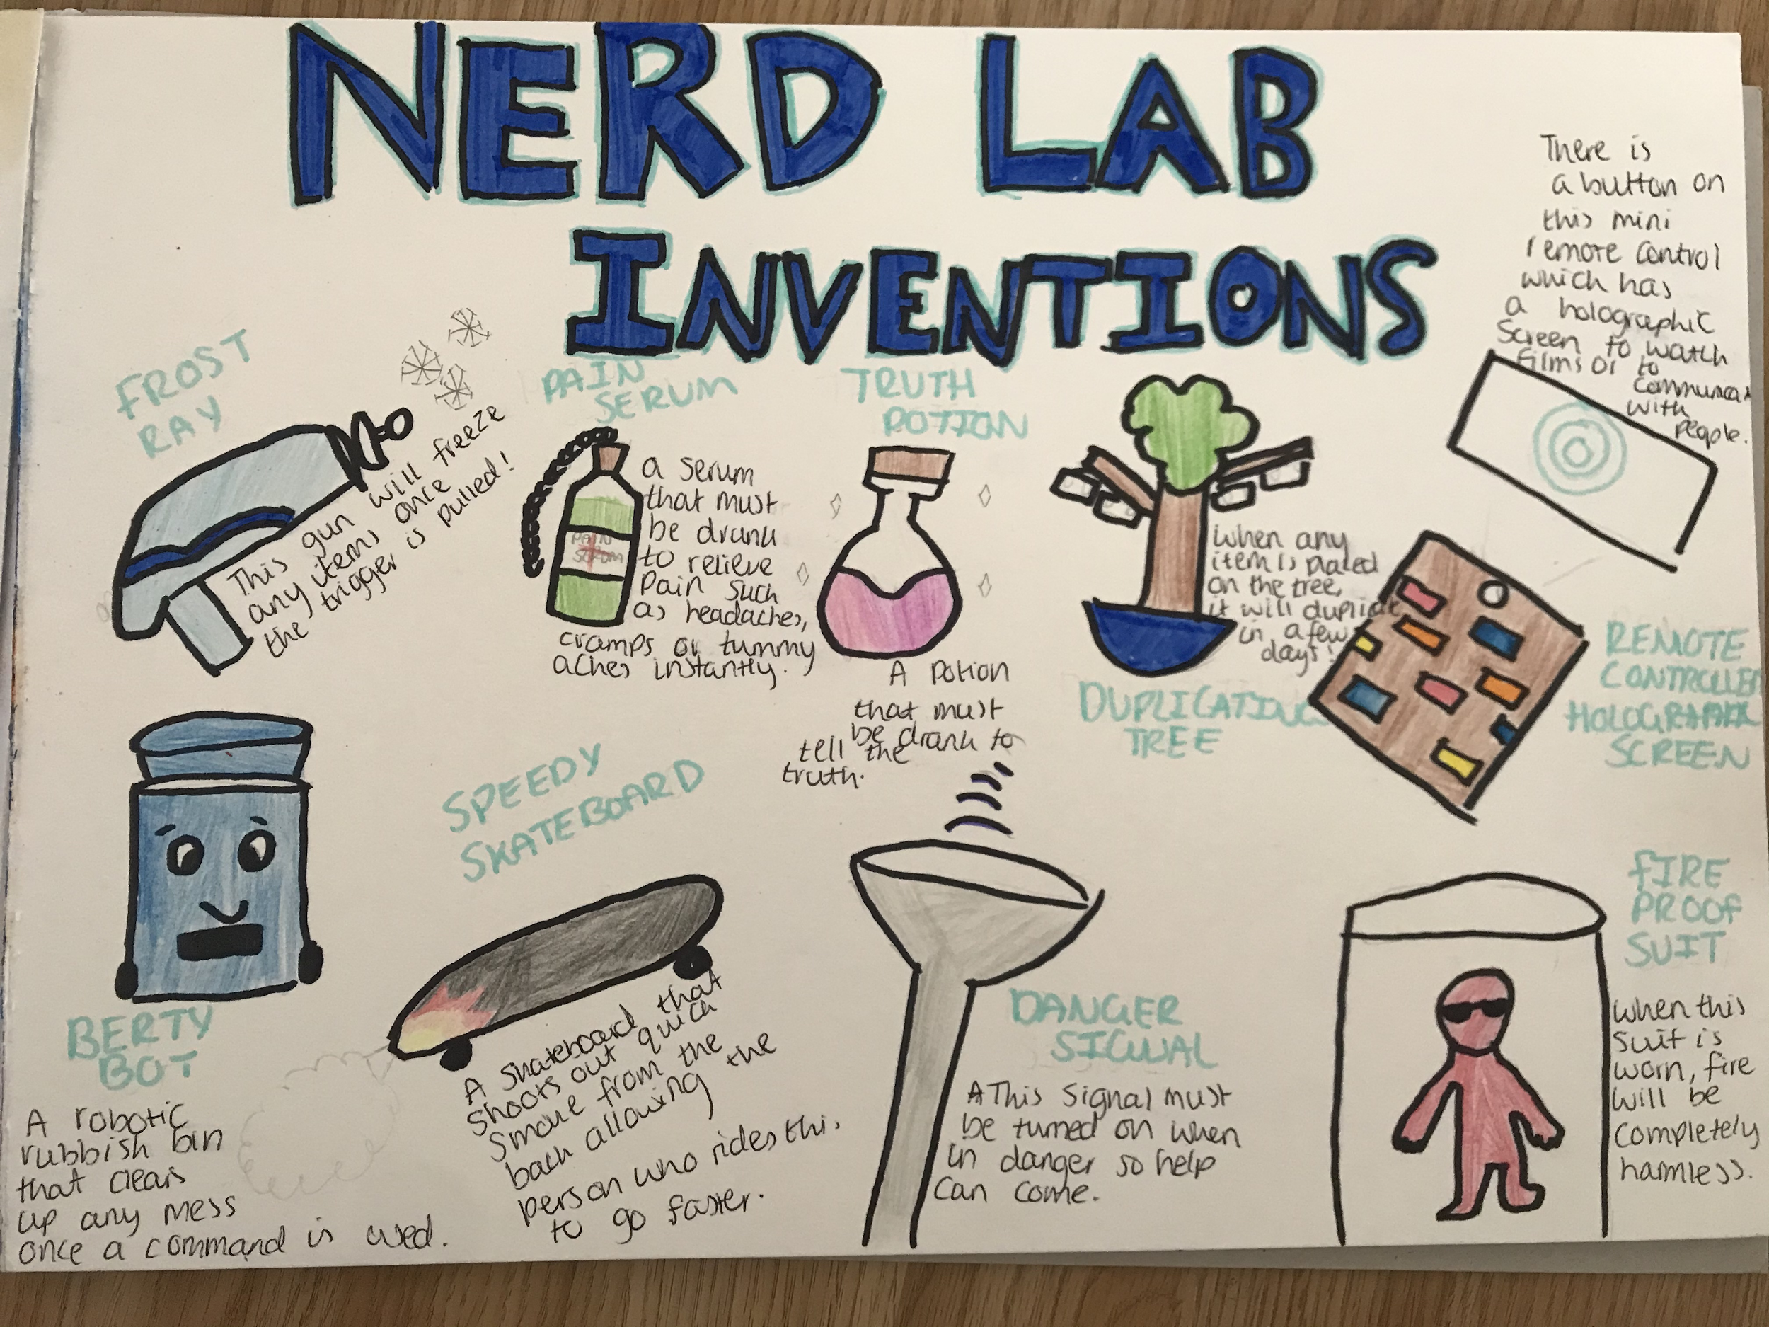
Charlotte Commons

Slide 3
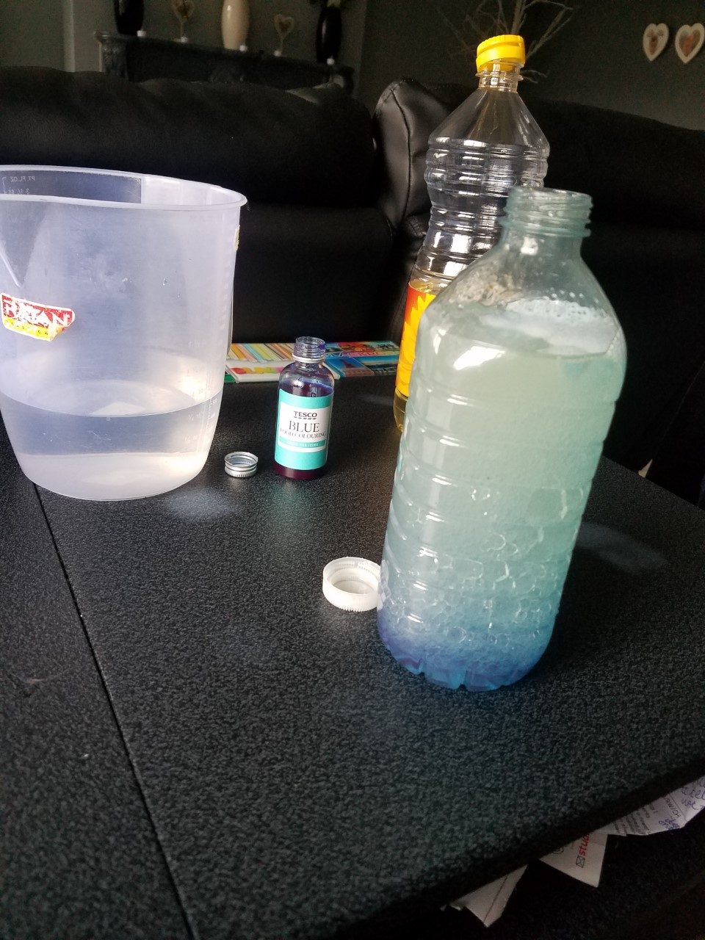
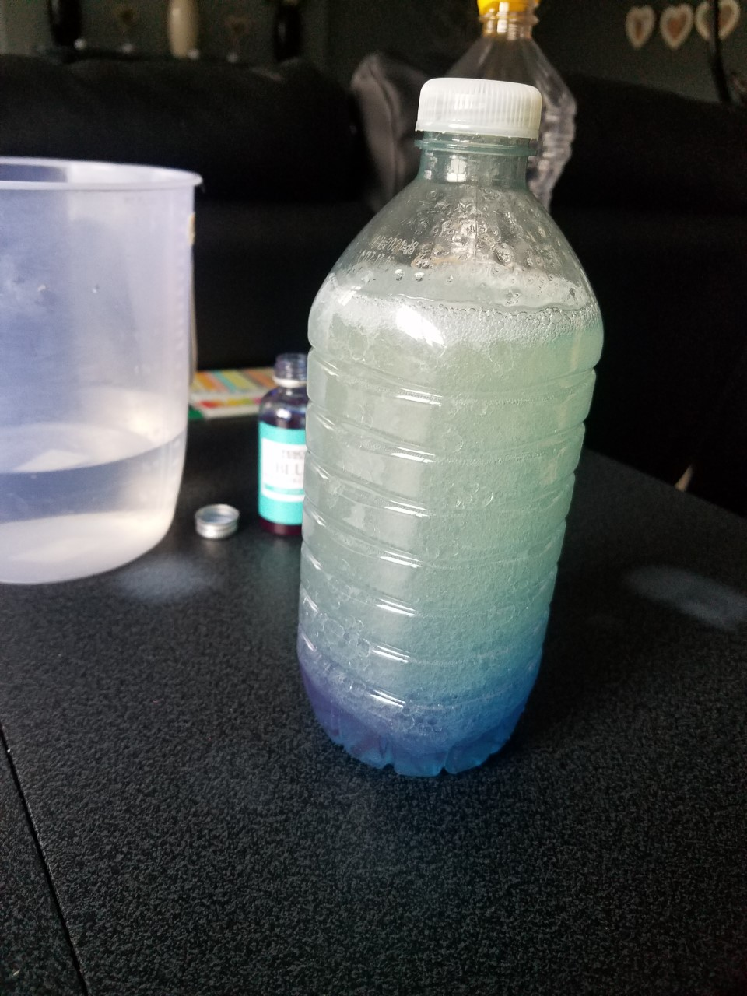
Kyle Barron
I attempted lava lamps again, but it still did not work how it is supposed to. Please look at the video, it was fun to watch for 20 seconds.

Slide 4
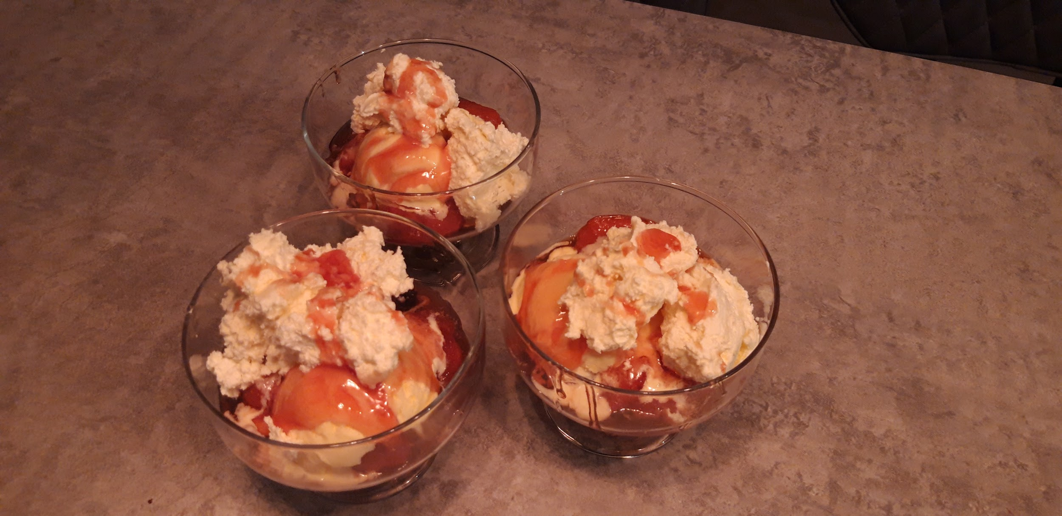
Ethan Turney

