Slide 1
A guide to the Revised Year 11 Assessments

Slide 2
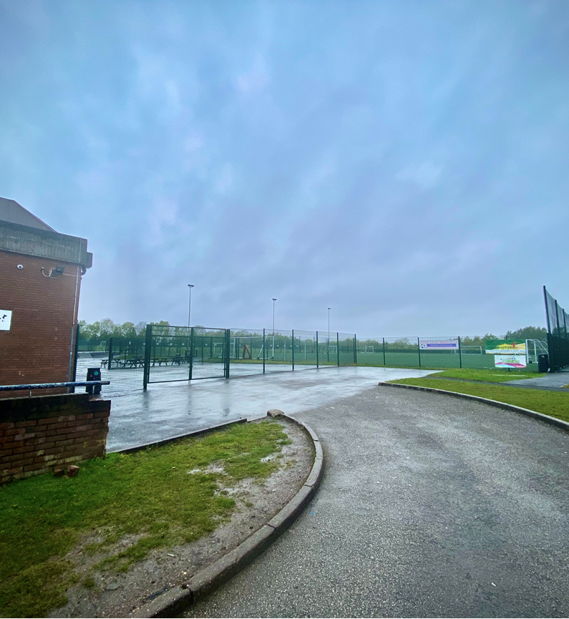
Arrival each morning…
Before your first assessment each morning please wait by the side gate entrance to the rear yard. PLEASE avoid coming into contact with other years and maintain social distancing when arriving to school.
You will be met by staff on duty there and led into the yard to line up on the yellow lines in your revised seating plan. These will be posted on the windows near the Sports Hall and staff will have a copy to refer to as well.
You will be sat in the same seat for every assessment you take if you are in the Sports Hall, Gym or I Block.

Slide 3
Breaks between assessments…
There are times when you will sit two assessments each morning.
Between each assessment there will be a 15 minute break.
Due to current COVID restrictions and to prevent the possibility of a positive case impacting on other students, you need to remain in your seat during that break, but you will be free to chat to the people around you. We will provide you with something to eat and drink free of charge.
Once you have completed the next assessment you will leave the exam room from the nearest external door and you a free to go home.

Slide 4
Morning and afternoon assessments…
There are some occasions where there are 2 assessments taking place in the morning and then a third later in the afternoon, with a 3 hour gap between them.
To be clear, after the second assessment in the morning students do not stay in school during this time, they a free to go home and then return for their afternoon assessment.
For a small number of students who travel a great distance to school, you will need to notify the school as soon as possible if this is an issue and we will arrange alternative provision on a case-by-case basis.

Slide 5
Sticking to your Year 11 bubble…
In these times of rising infection rates in Bolton, we hope you understand that we have to take every precaution to keep you and the other students and staff in school safe, but we also want to give you the opportunity to complete these remaining assessments to give you the best chance of achieving the grades you have worked so hard for.
Therefore, please do not enter the main part of the school building. This is why you will sit some assessments in the gym, not the LRC, to ensure year groups don’t come into contact with each other.

Slide 6
Equipment & uniform…
As always we will provide you with the equipment you need for your assessments, but you are welcome to bring your own if you prefer.
You must wear your full school uniform for EVERY assessment. This is so we can identify you as Little Lever student on arrival.

Slide 7
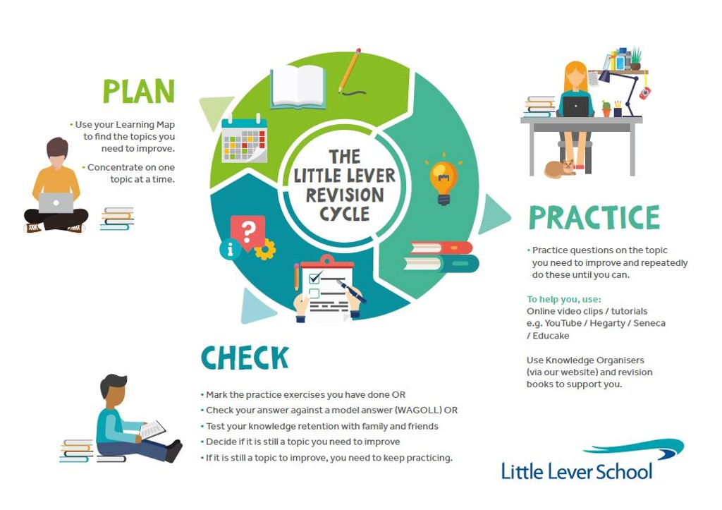
Lessons between assessments
Please keep an eye on your Google Classroom class announcements.
Your teachers will inform you whether to attend a live lesson on Google Meet OR they may set revision work for you to complete prior to the next assessment.
Remember to use our Little Lever Revision Cycle when studying at home.

