Slide 1
A guide to your Year 10 Summer Assessments

Slide 2
Why are you having assessments?
After so much disruption to learning this year due to COVID cases, lockdowns and self-isolating, you might be wondering why we need to assess you if you’ve missed a lot of learning. IS THIS FAIR??
What we need to know and understand is what are your gaps in learning and what do we (as your teachers) need to do to ensure what we teach you in Year 11 addresses and fills those knowledge gaps.
To do this you will sit a series of assessments which will test you on WHAT YOU HAVE BEEN TAUGHT both in school and remotely.

Slide 3
What do you mean by assessments?
Assessments are tests you will sit under examination conditions either in your classroom lessons in some subjects or as a whole year group in an exam room.
The assessment may be a section from a GCSE past exam paper; a specific extended writing question; a timed piece of classwork; it will vary from subject to subject.

Slide 4
When will they take place?
We have put together a Year 10 Assessment Calendar for you which maps out which subjects you’ll be sitting assessments in, when they take place and where in school you’ll be taking them.
Your Edge Tutor will give you a paper copy at the end of this presentation, and it will be posted on our website news feed and in your Parent Portals. Your Edge tutor will also remind you each morning what assessments are happening that day.
The assessments will run over a two-week period, starting on Monday 28th June and running through to Friday 9th July.

Slide 5
Assessments in the Sports Hall / LRC / I Block
For any Session 1 or Session 3 assessments which are in the above rooms, you will go to the yard to line up on the yellow lines according to which row you sit at in the Sports Hall. If you have assessments in the LRC, you will line up by the fence next to the yellow lines and I Block students line up on the yellow lines behind Year 10.
There will be a sign with the row name on it (A – K) so you know where to stand.
You will be sat in the same seat for every assessment you take if you are in the Sports Hall, Gym or I Block. Seating plans will be sent to your Edge tutors and be posted on the walls near the exam rooms.

Slide 6
Equipment and rules
You will be provided with the equipment you need for your assessments, but you are welcome to use your own if you prefer.
You may bring into the assessments a bottle of water only, with the label removed.
No mobile phones or electronic devices should be seen or heard. If you are seen with them or your phone goes off, your assessment will be disqualified.
Write in black pen only.
Any verbal or non-verbal form of communication could also result in your assessment being cancelled.

Slide 7
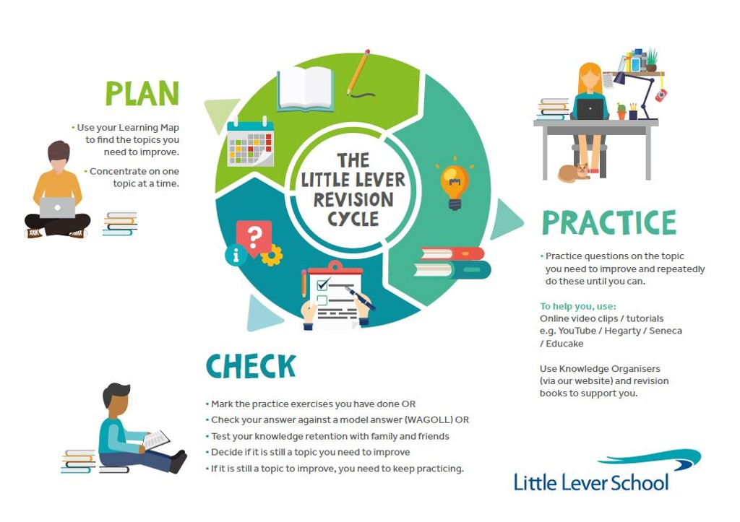
Preparing for these assessments
Your teachers will not be allowed to tell you what questions are on the assessments.
However, they will direct you to the topics you need focus for your study at home.
You must revise for these tests so use our Little Lever Revision Cycle when studying at home…

Slide 8
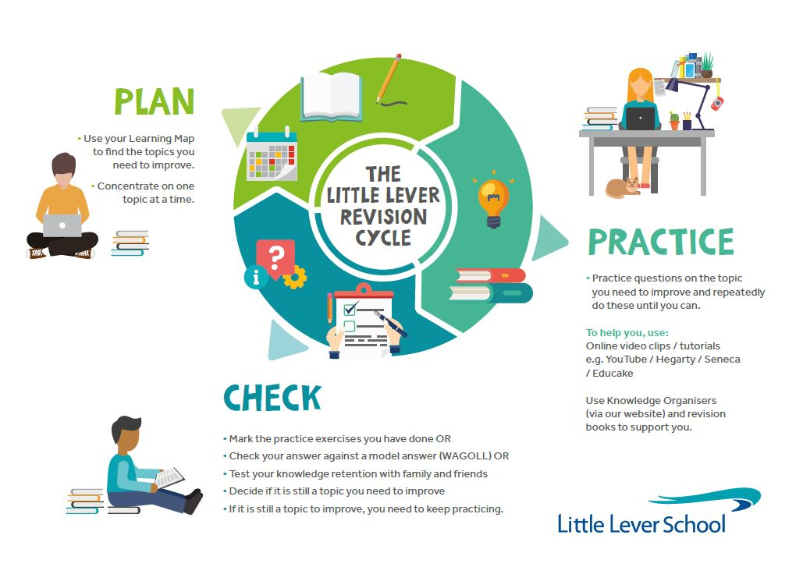
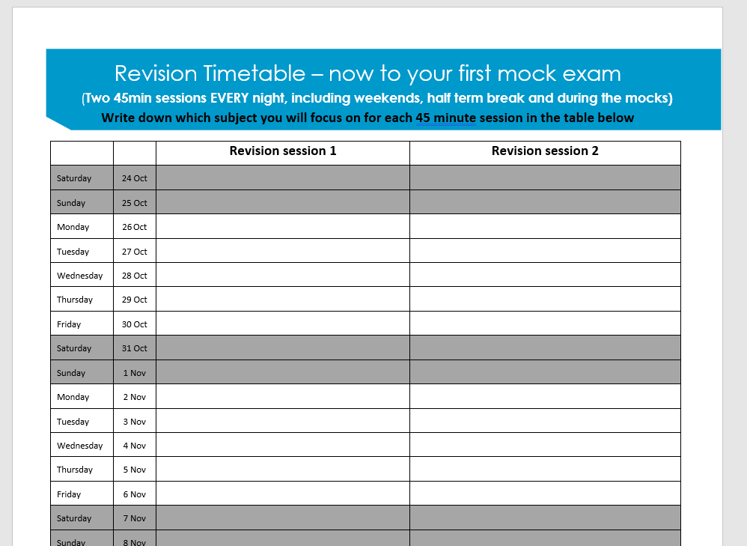
PLAN
Map out the subjects you will revise each day into two 45 minute slots.
Find your gaps: once you know which subject you are going to revise you need to find the key topics you need to concentrate on to improve your knowledge in this subject.
Use the online learning map on our website; this maps out all topics you will be studying this year and will help you identify the gaps you may have.

Slide 9
PRACTICE
Check Google Classroom to find specific tasks your teachers have set to help you practice the key topics ready for your mock exam.
Watch videos and complete the tasks from the online learning map links.
Complete past papers, self marking quizzes, practice essays, making flash cards from memory, diagrams, timelines.
Make revision active!

Slide 10
CHECK
Always check you are improving. Use the self marking quizzes that are included in the Online Learning map lessons or other platforms such as Hegarty.
If you get it right pick another topic!
If not...go back and practice some more.

Slide 11
Click on this video link below to watch a 3 minute guide on how to revise effectively at home
The 9 BEST Scientific Study Tips - YouTube

Slide 12
Don’t Panic, Go for it!
We know you have gaps in your knowledge due to lockdown, so we don’t expect top grades in these assessments just yet!
However…
Don’t leave everything to chance – start revising now: plan, practice and check every night!
Believe in yourself because we do!!

