Slide 1
What is the DofE?
Notes:
This can be tailored to your specific audience if required.

Slide 2
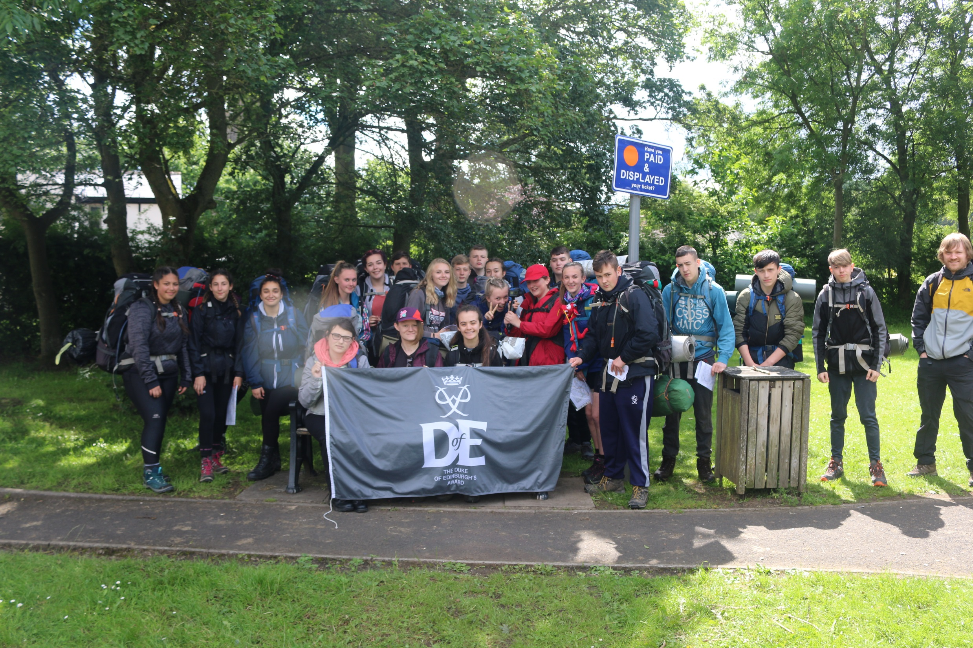

Slide 3
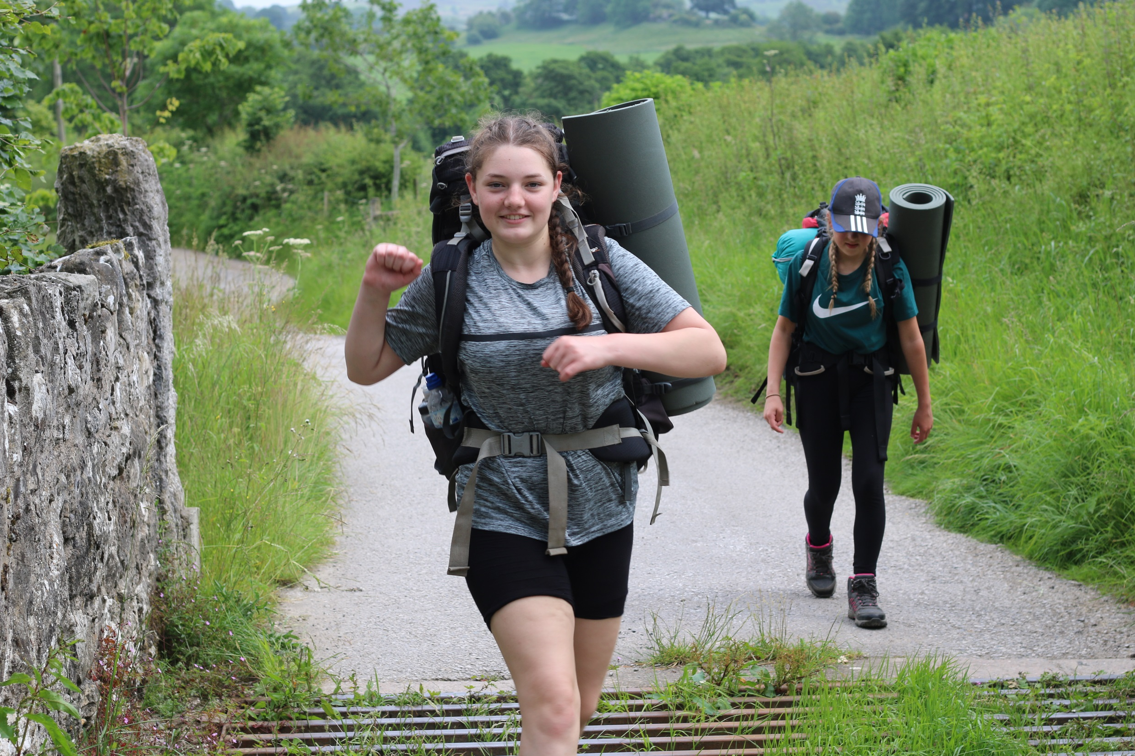

Slide 4
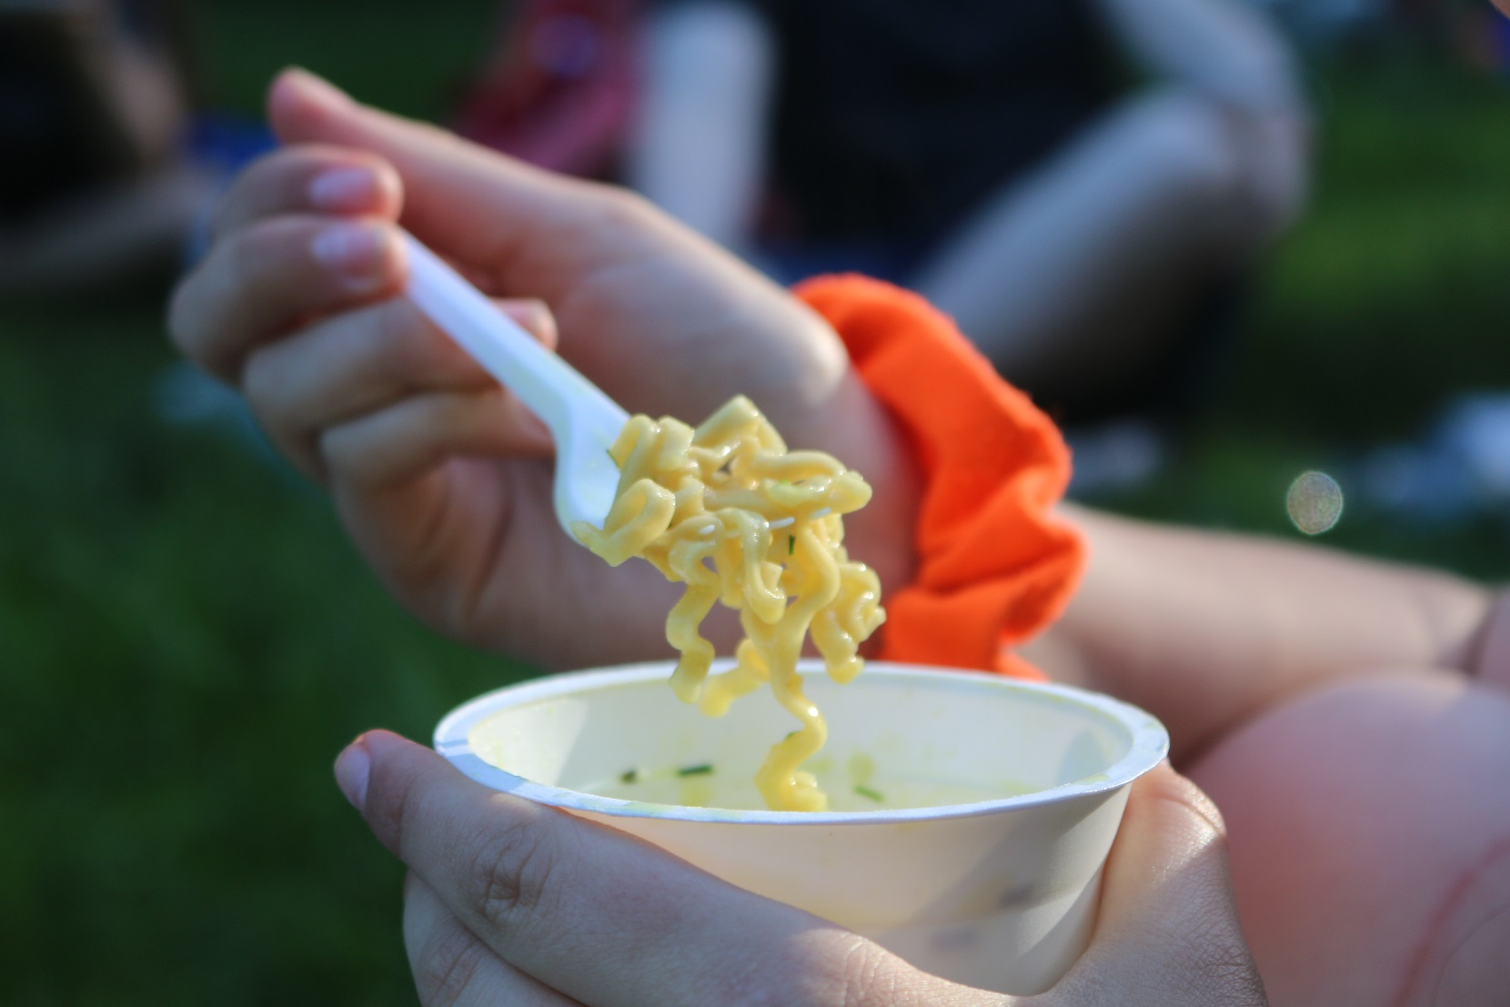
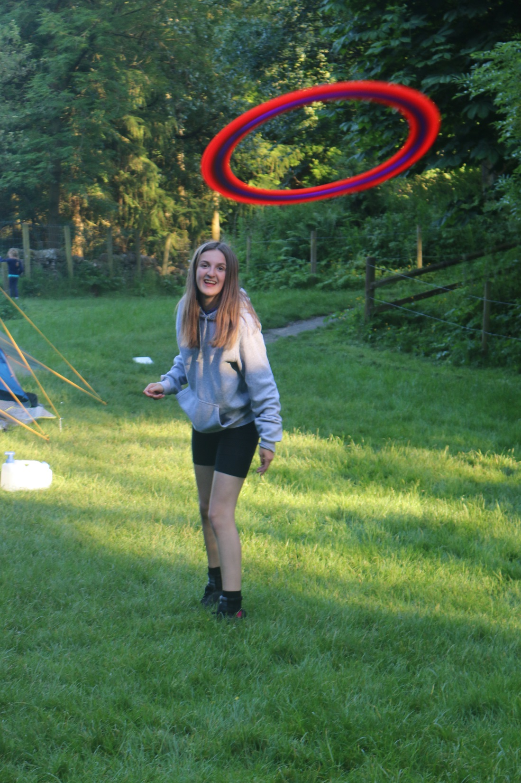

Slide 5
The DofE is…
Your DofE programme is a real adventure.
It doesn’t matter who you are or where you’re from.
You just need to be aged between 14 and 24.
You can do DofE programmes at three levels:
Bronze (aged 14+)
Silver (aged 15+)
Gold (aged 16+)
…which lead to a Duke of Edinburgh's Award.

Slide 6
The DofE is…
You achieve an Award by completing a personal programme
of activities in four sections:
Volunteering: undertaking service to individuals or the community.
Physical: improving in an area of sport, dance or fitness activities.
Skills: developing practical and social skills and personal interests.
Expedition: planning, training for and completion of an adventurous journey in the UK or abroad.
At Gold level, you must do an additional Residential section, which involves working and staying away from home doing a shared activity.

Slide 7
Time and age requirements
 | Minimum period of participation by:
Level: | Direct entrants | Previous level Award holders
Bronze | 6 months | n/a
Silver | 12 months | 6 months
Gold | 18 months | 12 months
Direct entrants are young people starting their DofE programme at either Silver or Gold level, who have not achieved the previous level of Award.

Slide 8
Bronze Award (14+ years old)
Volunteering | Physical | Skills | Expedition
3 months | 3 months | 3 months | Plan, train for and complete a 2 day, 1 night expedition
All participants must undertake a further 3 months in the Volunteering, Physical or Skills section.

Slide 9
Silver Award (15+ years old)
Volunteering | Physical | Skills | Expedition
6 months | One section for 6 months and the other section for 3 months |  | Plan, train for and complete a 3 day, 2 night expedition
Direct entrants must undertake a further 6 months in the Volunteering or the longer of the Physical or Skills sections.

Slide 10
Choosing activities
There is a massive choice of activities that count towards DofE programmes. You can select practically any activity you want – as long as it’s legal and morally acceptable.
Activities are placed in specific sections for a reason.
You need to choose activities you are going to enjoy.
Activities could be something that you are already doing or perhaps one you’ve always wanted to try.

Slide 11
Choosing activities
Think about what you want to do for each
section, and check with your DofE Leader
that your choices can be counted.
Use the helpful lists and category finder on
www.DofE.org/sections.

Slide 12
Timescales
From October to December students will begin to complete volunteering/physical/skill activities:
Bronze: All activities to last 3 months, with one activity chosen to continue for a further 3 months (6 total)
Silver: Volunteering activity to last 6 months, and physical/skill activity one to be completed for 3 months and the other 6 months. One of the 6-month activities must then be extended until 12 months.
Students to submit evidence of 3-month activity by January 2022

Slide 13
Expedition Training
Practice day walk – Sunday 13th March
Prior to day walk, enrichment sessions to be held between January and March to cover the following:
Map skills (maps, grid references, scale, directions, route planning)
Equipment (tents, bags, clothing, footwear)
Stoves and food
Teamwork
Rivington Plan

Slide 14
Expeditions
Bronze Practice – Waddow Hall, 2 days 1 night, 23 – 24th April
Bronze Qualifier – North Wales, 2 days 1 night, 18 – 19th June
Silver Practice – Waddecar Scout Camp, 2 days 1 night, 21 – 22nd May
Silver Qualifier – Edale, 3 days 2 nights, 9 – 11th July or 8 – 10th July

Slide 15
Questions
All camping equipment (tents, bags and stoves) will be provided by school as part of the cost – you can bring your own as long as Mr Foulkes checks it beforehand and you can carry it!
Students with disabilities can take part and there are ways to modify their expedition challenge – they can be in the normal groups.
Students need to choose their own activities for Physical, Skill and Volunteering – these will not be arranged for students but enrichment opportunities in the 2:45-3:30 slot are a great option.
What’s the benefit? Helps you challenge yourself, recognise your achievements with an internationally acclaimed award, employers REALLY like it as it shows teamwork and resilience but most importantly DO SOMETHING FUN AND CHALLENGING WITH A GROUP OF FRIENDS
What if you want to do it but don’t think you can afford it? – Ask, we might be able to help if you fit certain criteria
Is it hard? – Yes but fun, have a go but be ready for it to be tough.

