Slide 1
On Friday 17th June, at 3pm – 3.30pm we will be hosting the Praise Auction in the Conference Room.
This will be open to anyone in Years 7 to 10 with a NET total of 100 or more positive points from the start of the summer term up to Wednesday 15th June.
The auction is a ‘blind’ auction. You will bid for any of the prizes on offer by writing down your maximum points bid for that item based on how many points you have and posting it in the bid-box next to the item. The highest bid wins the prize!
On Thursday your form tutor will be given a list of students in your form who qualify for the auction.
The prizes are tiered. The higher the tier the more points you may need to bid to win the prize!

Slide 2
Tier 1 Prizes
M&M Brownie Party Bags

Slide 3
Tier 2 Prizes
£10 Amazon Gift Cards

Slide 4
Tier 3 Prizes
Art Mixed Media Sets

Slide 5
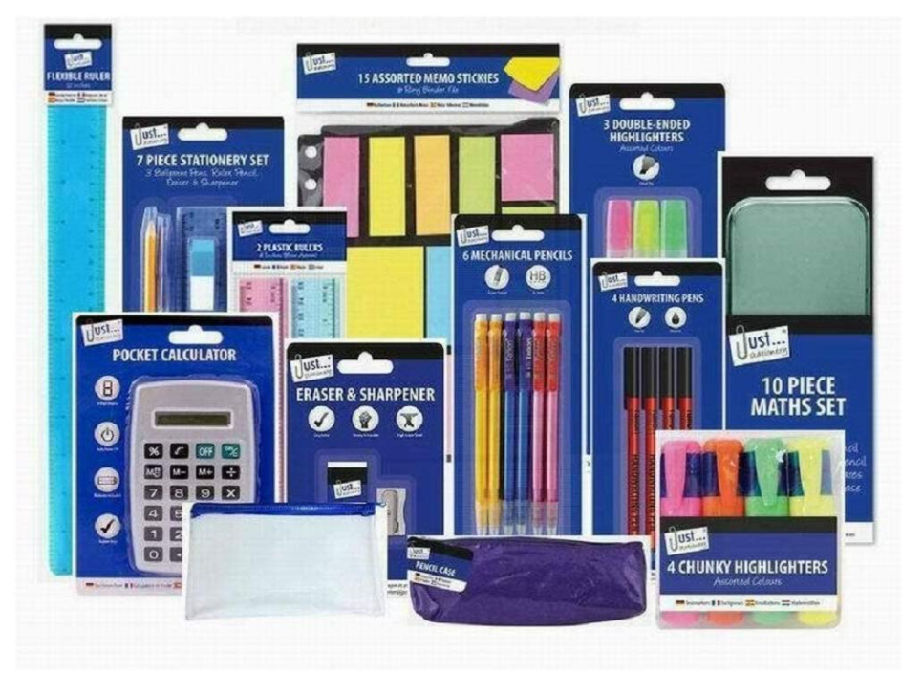
Tier 3 Prizes
Stationary sets

Slide 6
Tier 4 Prizes
Nike Footballs

Slide 7
Tier 4 Prizes
Mitre Netballs

Slide 8
Tier 4 Prizes
Lego Minecraft Set

Slide 9
Tier 4 Prizes
Lego Star Wars Set

Slide 10
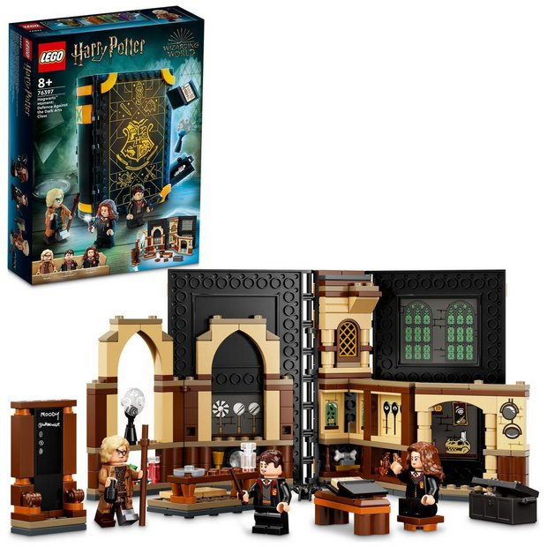
Tier 4 Prizes
Lego Harry Potter Set

Slide 11
Tier 5 Prizes
£50 Amazon Gift Cards

Slide 12
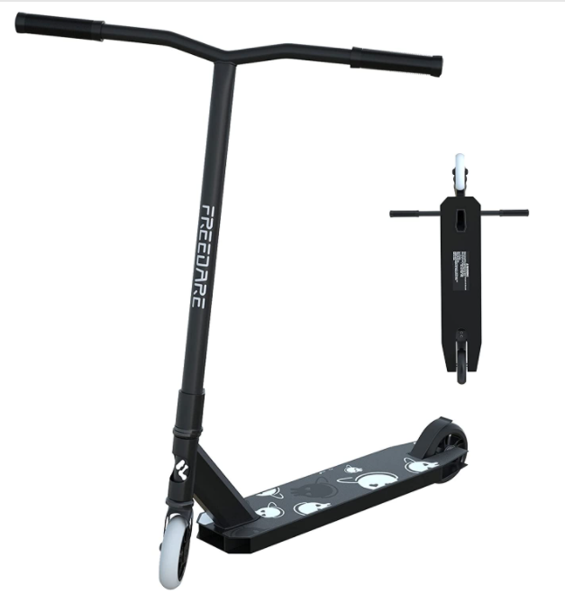
Tier 6 Prizes
Stunt Scooter with HELMET

Slide 13
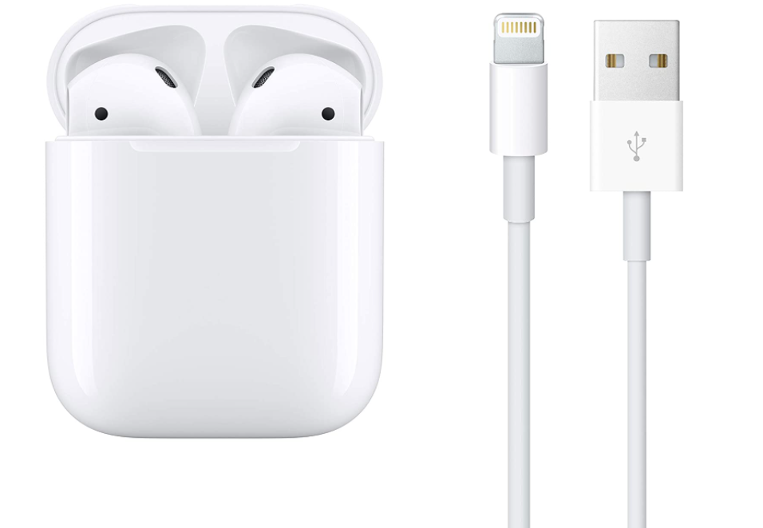
Tier 7 Prizes
Apple Airpods

Slide 14
Tier 7 Prizes
Apple iPad 65GB Silver 9th Gen

Slide 15
Tier 7 Prizes
Playstation 4

Slide 16
Tier 7 Prizes
Xbox and game pack Fortnite / Rocket League

