Slide 1
The Little Lever Curriculum
How to support your child

Slide 2
Our curriculum in every subject is well-planned so that it meets the needs of EVERY student. Our subject curriculums help students to have a strong understanding of the most important knowledge. This is so that EVERY student can achieve SUCCESS. Our curriculum will develop thoughtful young people who have acquired a strong sense of moral purpose. It will offer opportunities and experiences that will improve students’ life chances, taking in to account local, national and global circumstances.

Slide 3
Reading- the route to success
Why is reading such an important part of our daily routine at Little Lever?

Slide 4
“He that loves reading has everything within his reach”
Before School | Prep Time | During Lessons | Lunch Time | Reading Routes | After School
The library is open from 8am to read, borrow and swap books | Twice a week students will complete guided reading with their form teachers. | All lessons are knowledge rich and provide numerous reading opportunities | The library is open every lunchtime for students to read quietly and borrow books. | Once a fortnight students will complete a dedicated reading lesson as part of their English lessons. | Students are invited to visit the library until 3:30 or to go to Nightclub in G5 to complete additional studies.
Build reading into your child’s daily routine
Encourage your child to follow their interests
Have discussion about what they are reading and their favourite parts
Provide a quiet space to read (30 minutes a day)

Slide 5
Retrieval Practice: Research has shown that a key aspect of your child’s achievement is directly linked to regular, small learning tasks which help them to know more and remember more. Students will therefore be set a low stakes quiz or a retrieval task every fortnight from all subject areas.

Slide 6
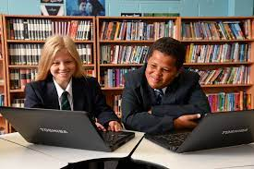
Prep/Form Time
Learning about the world around us. Why is this an important aspect of daily routines at school?

Slide 7
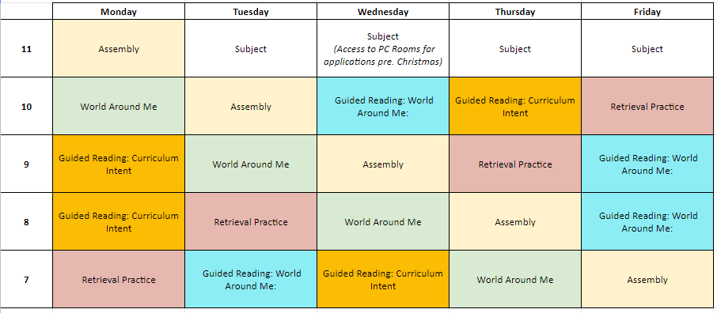

Slide 8
Supporting Your Child With Science
Year 8 and 9

Slide 9
Science at Little Lever school
During year 8 and students will study will build on a revisit basic key concepts in science. They will cover the following:
Year 8
Food and diet
Chemical reactions
PH and neutralisation
Electricity and magnetism
Properties of waves
Electromagnetic waves
Genetics
Evolution
The periodic table
Chemistry of the Earth
Working Scientifically

Slide 10
Science at Little Lever school
During year 9 and students will study the following topics in science. This will recover key concepts in much more detail in preparation for GCSEs in year 10:
Cells and division
Transport in cells
The structure of atoms
Groups and periods
Particle arrangement
Changes in state
Digestion and enzymes
Organs and non-communicable diseases
The PH scale and neutralisation
Energy
Reactions in cells
How elements make compounds

Slide 11
How can you support your child with science?
Retrieval practice is set using Seneca Learning every fortnight
This is then tested with a low stakes quiz the following week
The idea of retrieval practice is “spaced learning” which is testing knowledge that has been previously taught coupled with content that is being currently taught
This means that students will revisit key concepts several times at KS3
Students that make excellent progress complete all Seneca activities. This embeds the key knowledge that links to all areas in science

Slide 12
Students in years 8 and 9 will already know how to access their google classroom for all subjects and the links to Seneca should be there as well as on Class Charts.

Slide 13
What else can I do?
Ask your child what they have done at school each day
Let them show you some simple experiments
Encourage them to watch documentaries that are science based
Talk to them about what they want for the future. Many careers are science based – Medicine, Dentistry, Vets, Engineers, archaeology, geologists, audiologist, optometrist

Slide 14
Supporting Your Child With English
Year 8 and 9

Slide 15
Your child will develop their reading and writing competence, refining their knowledge of grammar and vocabulary, through the enjoyment of English Literature.
Year 8
Autumn Term | ‘Of Mice and Men’ by John Steinbeck Transactional Writing
Spring Term | `Blood Brothers’ by Willy Russell Narrative Writing
Summer Term | ‘The Book Thief’ by Markus Zusak Descriptive Writing

Slide 16
Your child will develop their reading and writing competence, refining their knowledge of grammar and vocabulary, through the enjoyment of English Literature.
Year 9
Autumn Term | ‘Boys Don’t Cry’ by Malorie Blackman Transactional Writing
Spring Term | Protest Poetry by various poets Narrative Writing
Summer Term | ‘Othello’ by William Shakespeare Narrative Writing

Slide 17
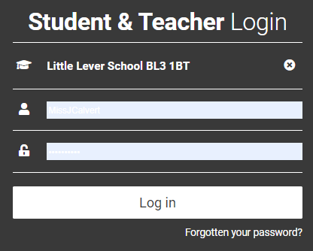
Home Retrieval Practice will be set and completed online, every fortnight.
Students have their own unique code for ‘Doddle’
https://www.doddlelearn.co.uk/
Students type in their …
School name: Little Lever School
Username: Same username as for school computers
Password: Little
(until they change it to something of their choice)
Instructions for accessing these tasks can be found on Class Charts.

Slide 18
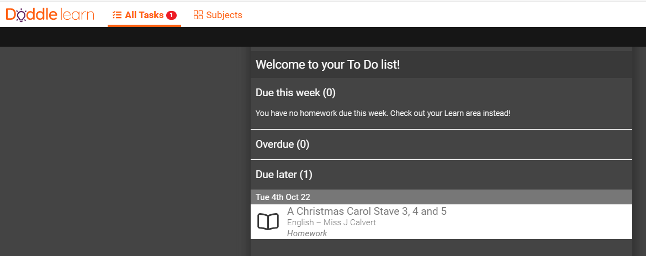
Students will then see their ‘to do list’ of tasks with deadlines.

Slide 19
Developing fluency, competence and enjoyment of English Literature and the English language itself, requires more knowledge than simply grammar and vocabulary. You can help prepare your child for their journey through the English curriculum at Key Stage Three in many ways…
Read to and with your child regularly
Visit a library, museum or theatre
Discuss the lyrics to your favourite songs
Watch the news together and discuss current affairs
Watch a dystopian film or adaptation of a Shakespeare play
Develop spoken language through conversation

Slide 20
Supporting Your Child With Maths
Year 8 and 9

Slide 21
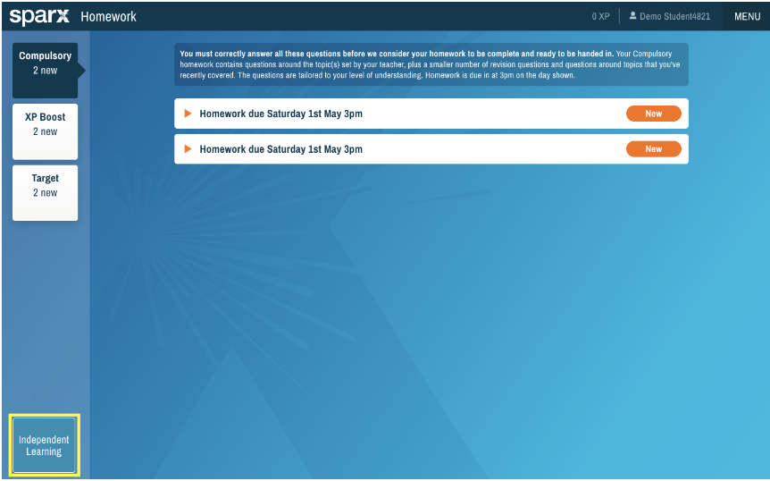
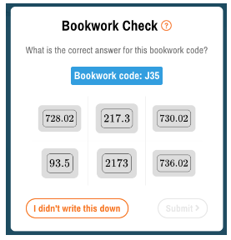
Sparx Maths
Any problems please email mli@little-lever.bolton.sch.uk
Set Monday Week 1, due in two weeks.
Notes:
https://f.hubspotusercontent30.net/hubfs/5530880/KB Resources Summer 2021/Parent video_v2.mp4

Slide 22
Option Subjects- where will this lead?
Year 8 and 9

Slide 23
Our curriculum in every subject is well-planned so that it meets the needs of EVERY student. Our subject curriculums help students to have a strong understanding of the most important knowledge. This is so that EVERY student can achieve SUCCESS. Our curriculum will develop thoughtful young people who have acquired a strong sense of moral purpose. It will offer opportunities and experiences that will improve students’ life chances, taking in to account local, national and global circumstances.

